Slide 1
Unit 2: Our Names
Lesson 3 – Part 1,2,3

Slide 2
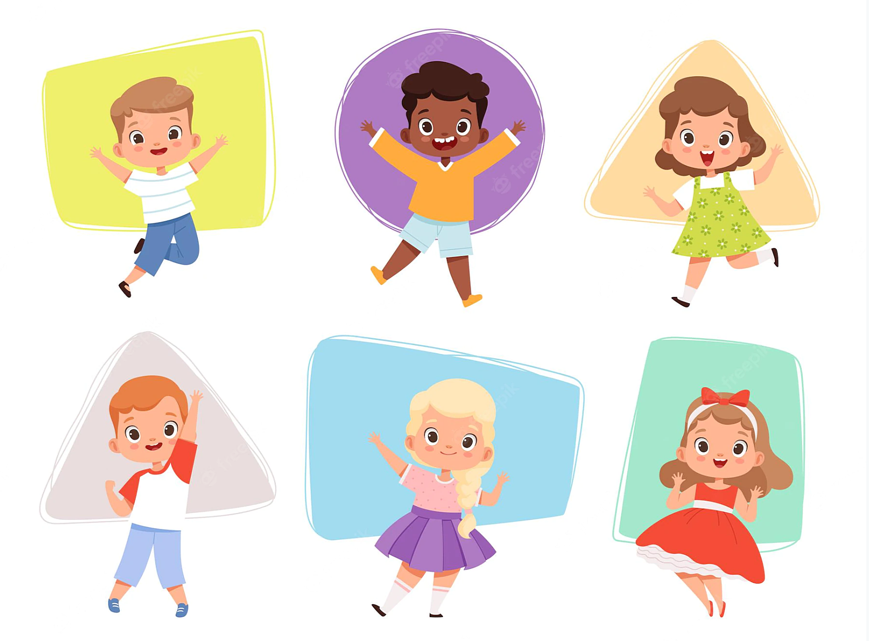
Contents
1. Warm Up
2. Phonic
3. Phonic Songs
4. Review

Slide 3
Warm
Up

Slide 5
Phonic

Slide 7
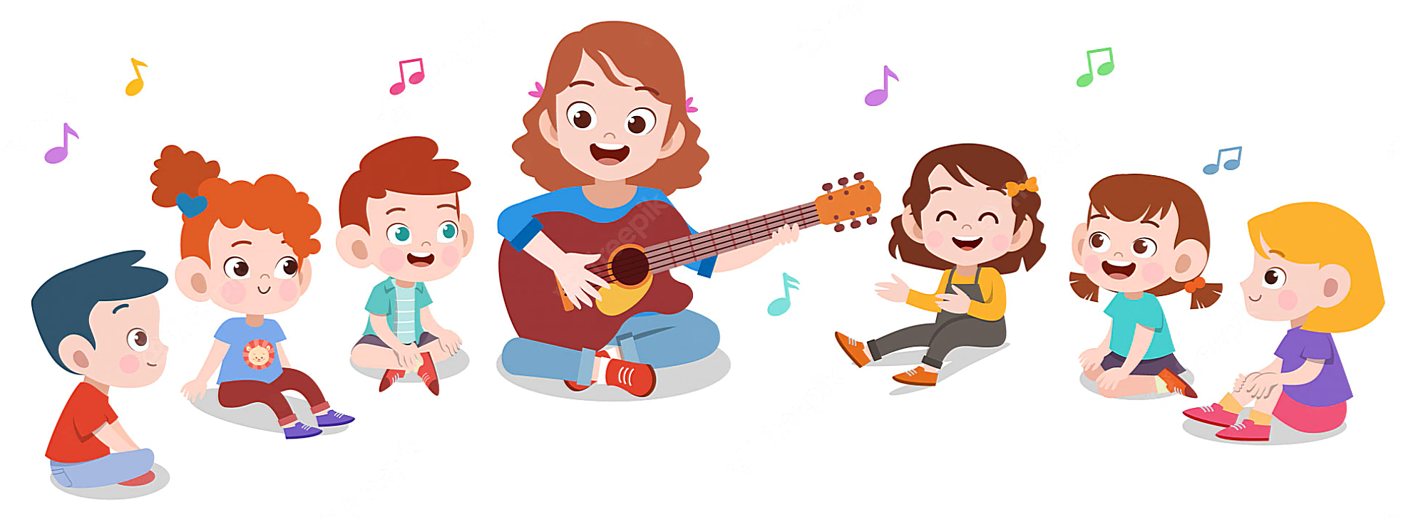
Phonic Songs

Slide 8
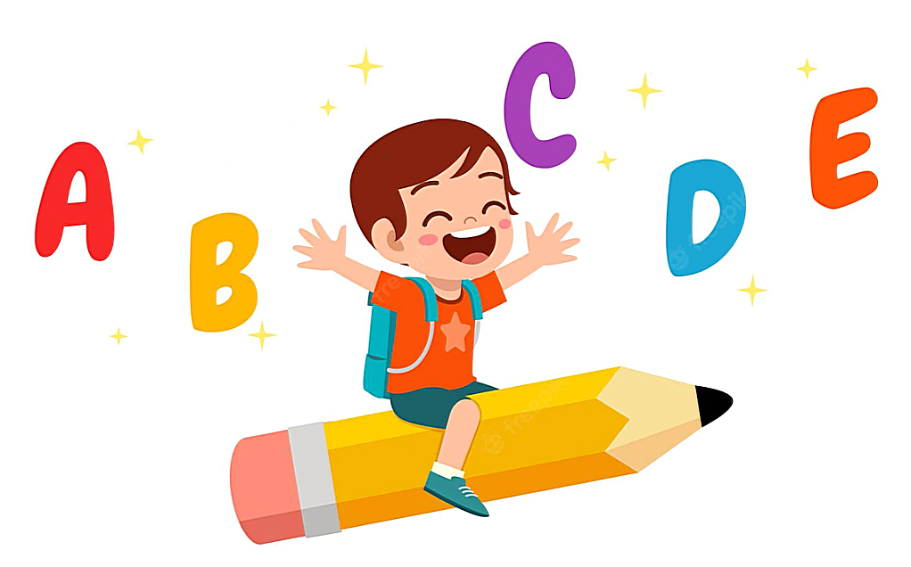
Letter M song

Slide 9
Letter N song

Slide 11
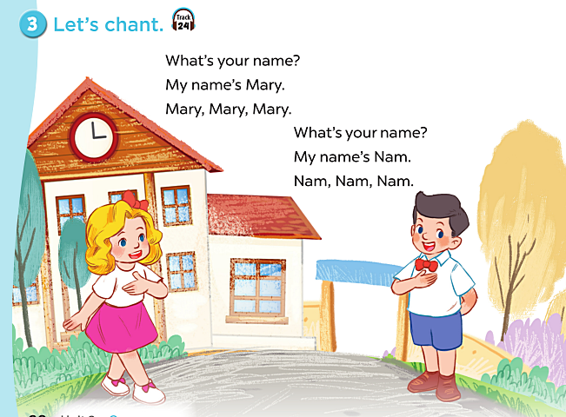

Slide 12
Review
Game

Slide 13
PHONIC QUIZ

Slide 14
Initial Sound Matches
Click on the picture that matches the sound on each slide. Good luck!
Play

Slide 15
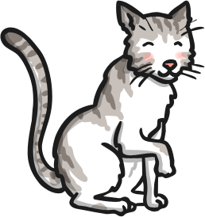
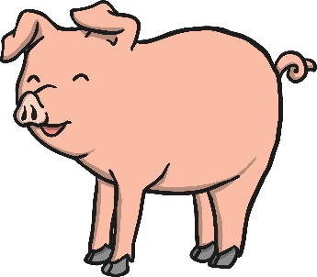
m

Slide 16
n

Slide 17
n

Slide 18
m

Slide 19
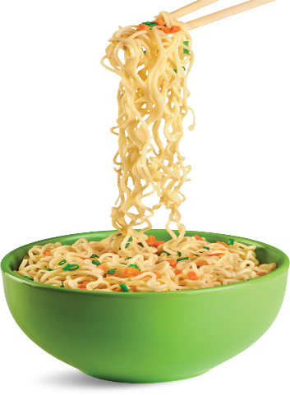
n

Slide 20
m

Slide 21
m

Slide 22
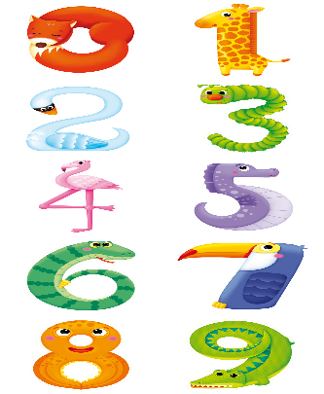
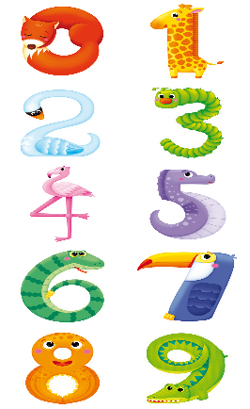
n

Slide 23
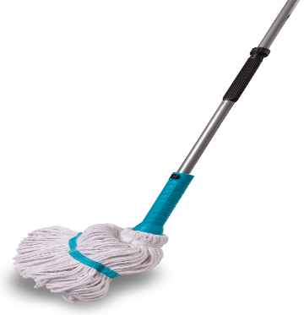
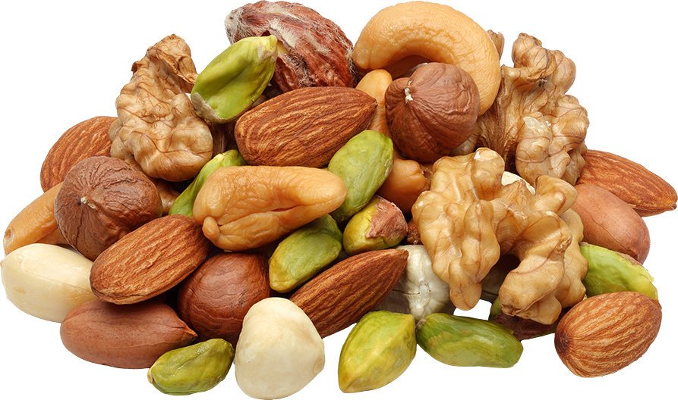
m

Slide 24
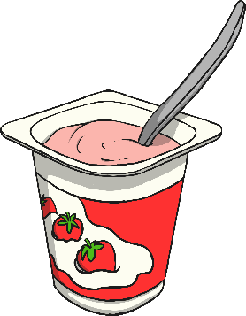
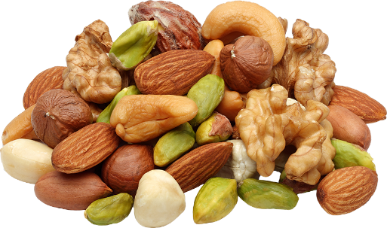
n

Slide 26
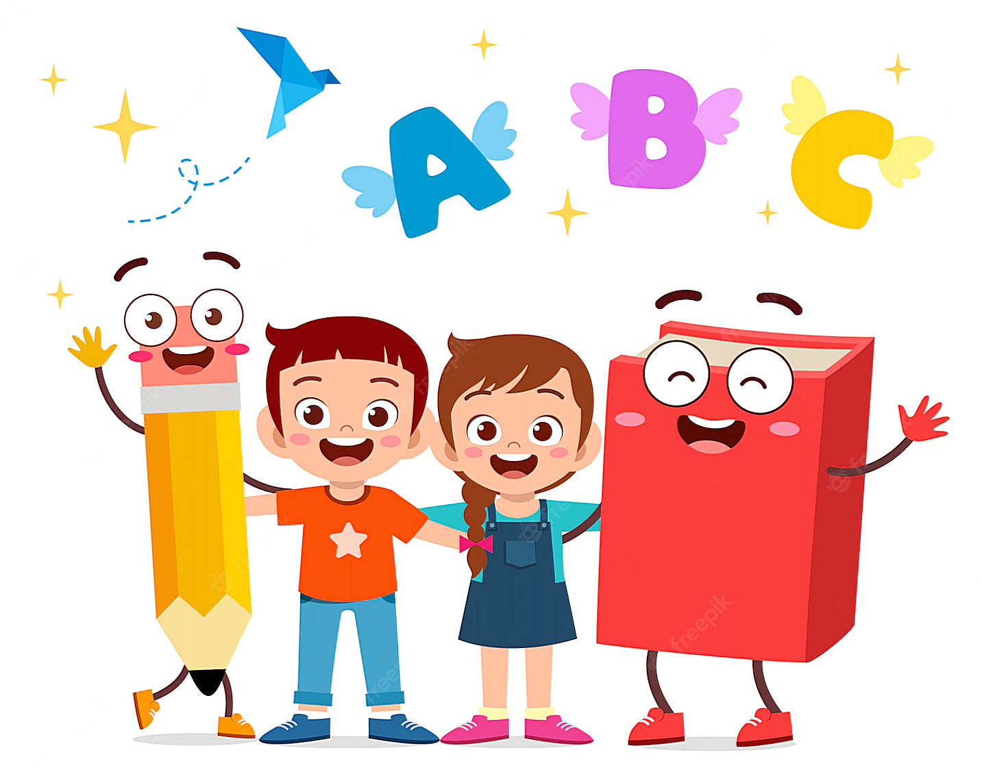
Good Bye

