Slide 1
Unit 2: Our Names
Lesson 3 – Part 4,5,6

Slide 2
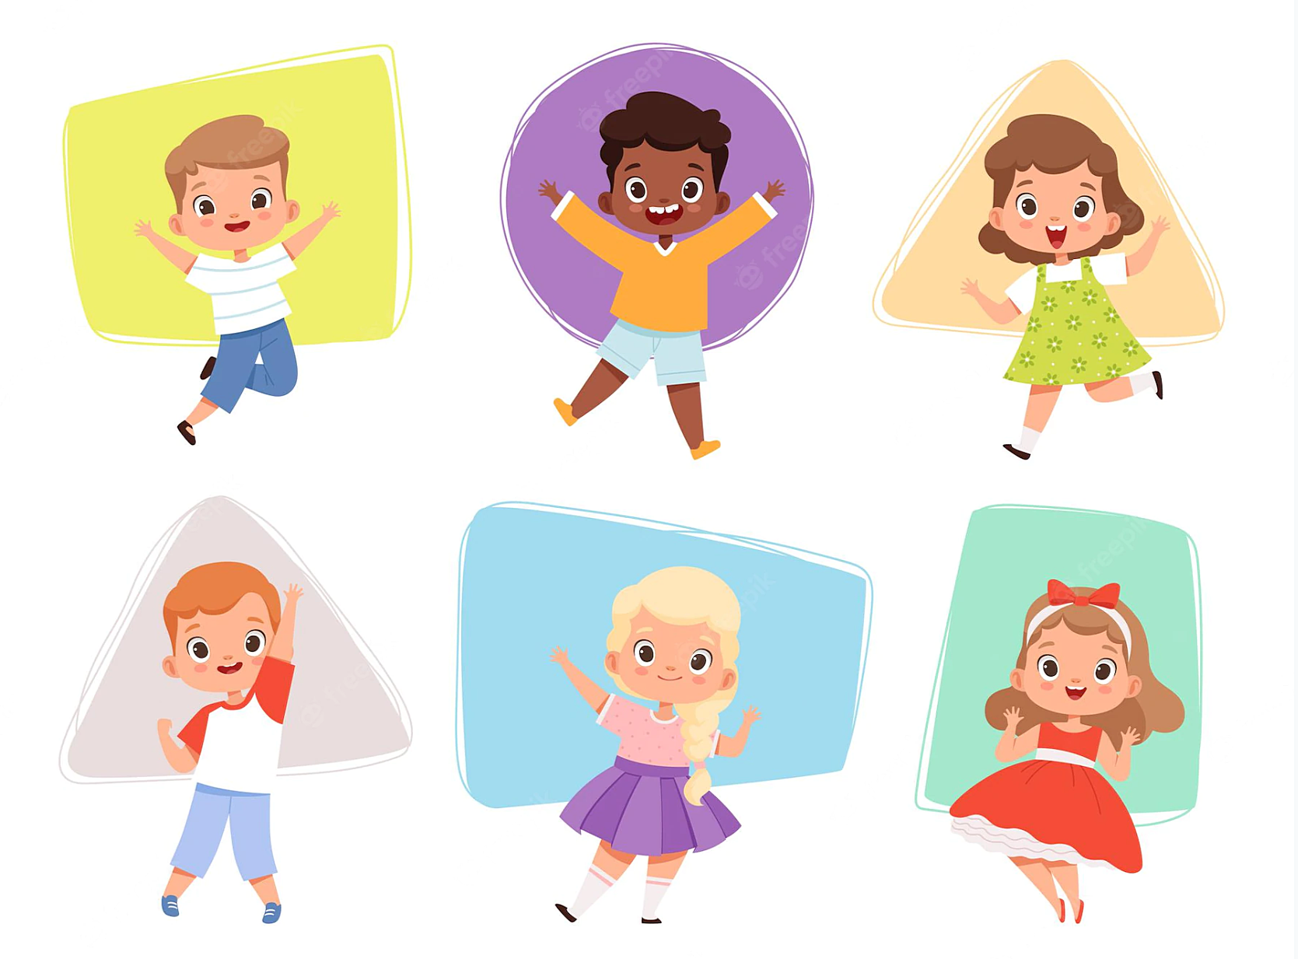
Contents
1. Warm up
2. Reading
3. Writing
4. Project

Slide 3
Warm
Up

Slide 4
Start

Slide 5
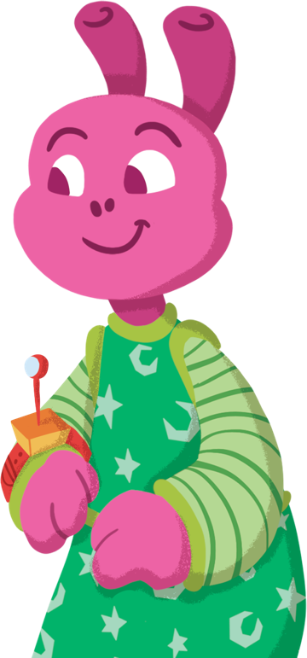
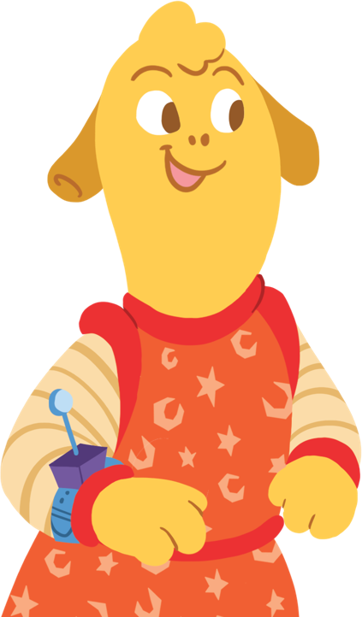
Instructions
Each slide shows a different object that can be found in space.
Click on the word that matches the picture.

Slide 6
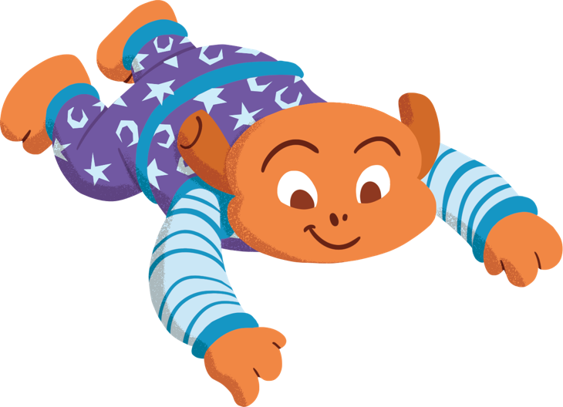
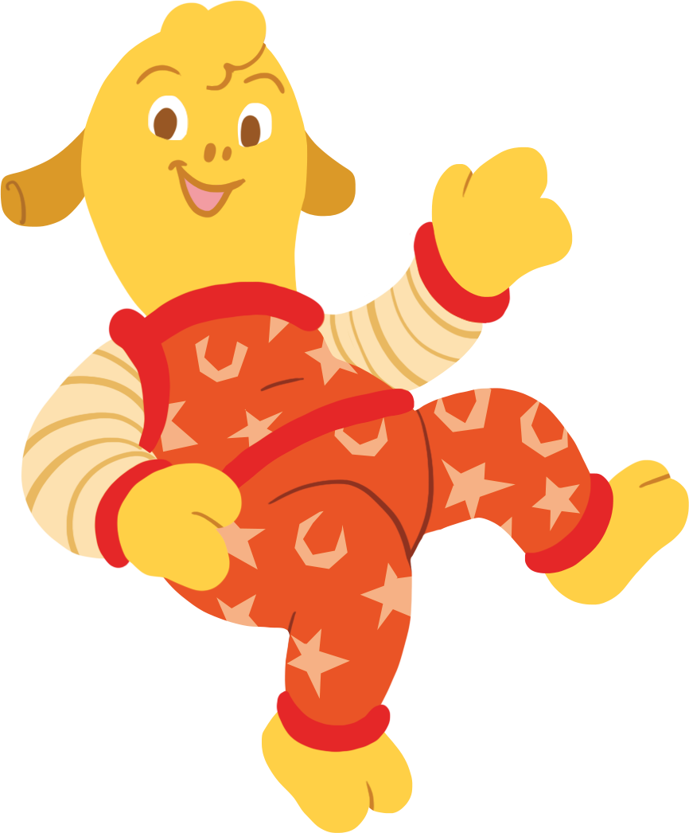
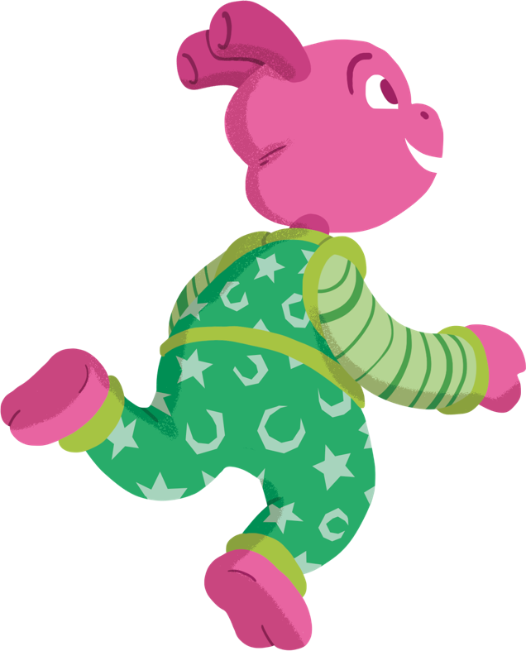
How old are you?
Try again!
I’m eight years old.
Well done!
I’m nine years old.
Try again!
I’m ten years old.
Next question

Slide 7
What’s your name?
Try again!
My name Nam
Well done!
My name is Minh.
Try again!
My name is Nam.
Next question

Slide 8
Try again!
Bill
My name is
......…..
Well done!
Minh
Try again!
Mary
Next question

Slide 9
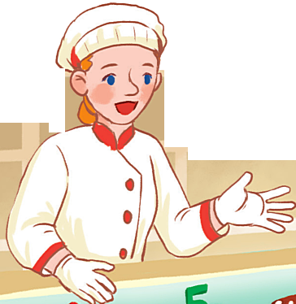
…………………
I’m five years old.
Try again!
How old are you?
How are you?
Well done!
Try again!
How old you are?
Next question

Slide 10
Try again!
What’s your name?
Listen and choose:
My name’s Minh
Well done!
Try again!
How old are you?
Next question

Slide 11
How old are you?
Try again!
I’m seven years old.
I’m eight years old.
Well done!
Try again!
I’m six years old.
Next question

Slide 12
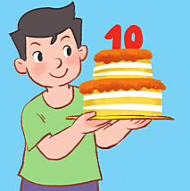
How …..are you?
Try again!
old
are
Well done!
Try again!
old are
Next question

Slide 13
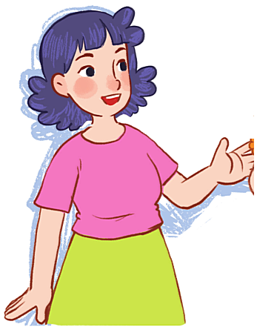
name-your-what-is
Try again!
What is name your?
What name is your?
Well done!
Try again!
What is your name?
Next question

Slide 14
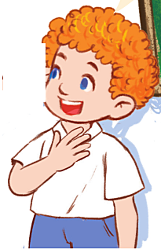
My ……is Bill.
Try again!
is
name
Well done!
Try again!
name is
Next question

Slide 15
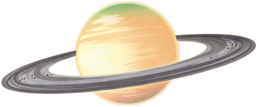
old- you- how - are
Try again!
How old are you?
Well done!
How are you?
Try again!
How you old are?
Finish

Slide 17
Reading

Slide 18
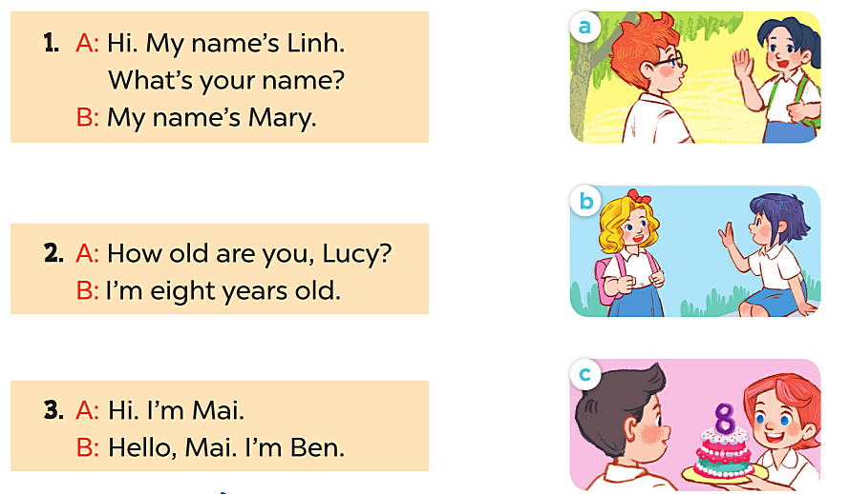
4. READ AND MATCH

Slide 19
Writing

Slide 20
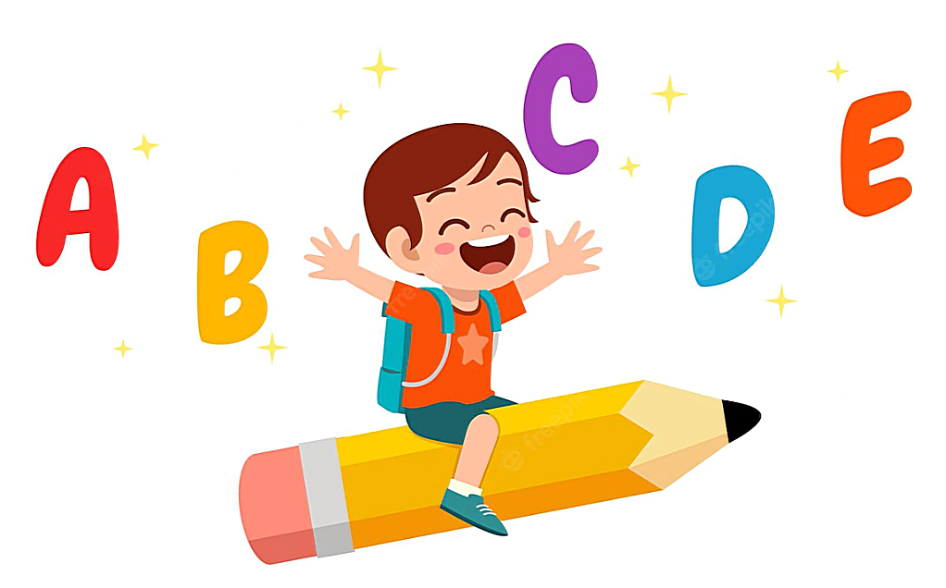
5. Read and write
My name is …………….
I’m …………years old.

Slide 21
Project

Slide 22
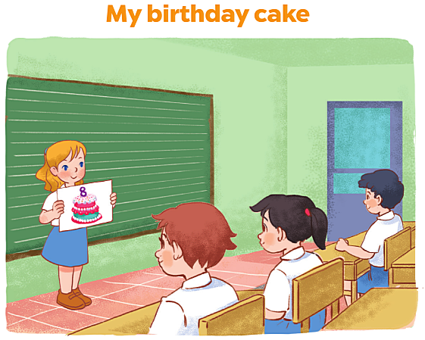

Slide 23
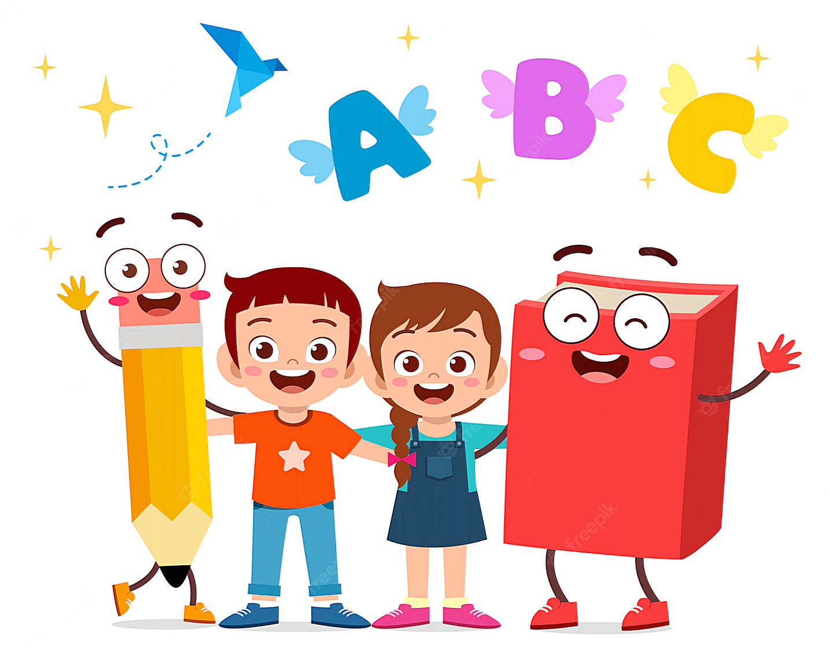
Good Bye

