Slide 1
DAI LOC DEPARTMENT OF EDUCATION AND TRAINING
TRUONG HOANH PRIMARY SCHOOL
WELCOME TO OUR CLASS !
Subject: English 4
Class: 4A
Teacher: Pham Thi Le Huyen

Slide 2
Saturday, October 15th, 2016
Warm up: Sing a song

Slide 4
Satrday, October 15th, 2016
✰ UNIT 5 : CAN YOU SWIM?
*Lesson 1:
Part: 1, 2

Slide 10
Game:
Charades

Slide 12
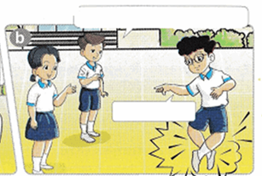
Saturday, October 15th, 2016
UNIT 5: CAN YOU SWIM?
Lesson 1: Part 1&2
2. Sentence patterns:
Hỏi và trả lời về khả năng của bạn em
What can you do?
I can dance

Slide 15
Saturday, October 15th, 2016
UNIT 5: CAN YOU SWIM?
Lesson 1: Part 1&2
II. Point and say
What can you do?
I can skip

Slide 16
Saturday, October 15th, 2016
UNIT 5: CAN YOU SWIM?
Lesson 1: Part 1&2
II. Point and say
What can you do?
I can skate

Slide 17
Saturday, October 15th, 2016
UNIT 5: CAN YOU SWIM?
Lesson 1: Part 1&2
II. Point and say
What can you do?
I can cook

Slide 18
Saturday, October 15th, 2016
UNIT 5: CAN YOU SWIM?
Lesson 1: Part 1&2
II. Point and say
What can you do?
I can swim

Slide 19
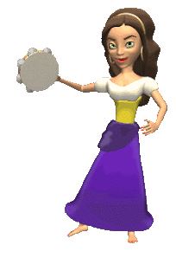
What can you do?
Work in pairs. Tell your partners What can you do?
dance
play football
I can………
sing a song
play the piano

Slide 20
Game:
Pass the secret!

Slide 21
Saturday, October 15th, 2016
UNIT 5: CAN YOU SWIM?
Lesson 1: Part 1&2
I.Look, listen and repeat:
1. Vocabulary
What can you do?
swim: bơi
skip: nhảy dây
I can skip
dance: nhảy, múa
skate: trượt băng, pa – tanh
cook: nấu ăn
can: có thể (chỉ khả năng)
can’t = can not: không thể
2. Sentence patterns: Hỏi và trả lời về khả năng của bạn em
What can you do?
I can skip

Slide 22
Thank you very much

