Slide 1
Unit 1 - English 5
What’s your address?
Lesson 1

Slide 2
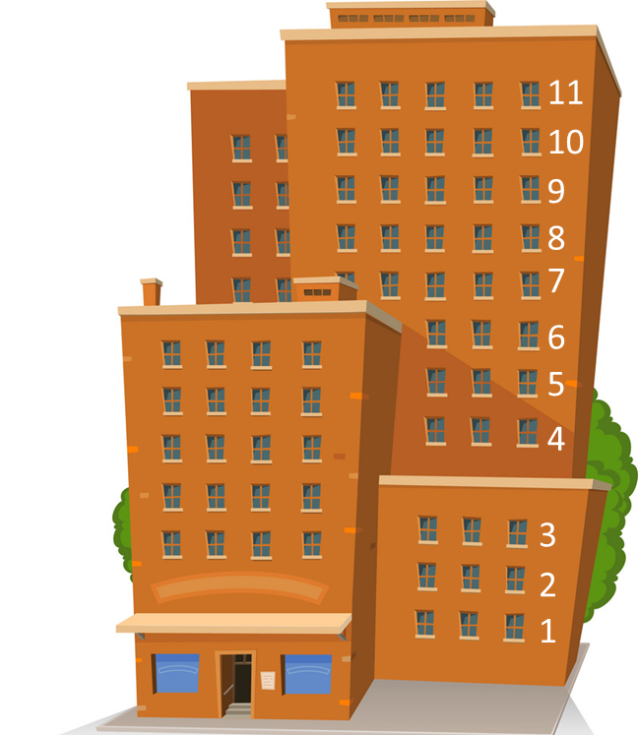
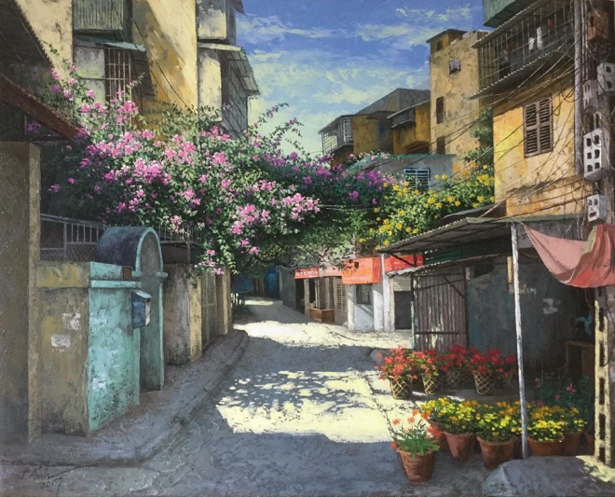
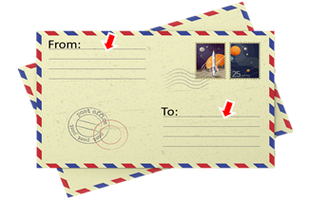
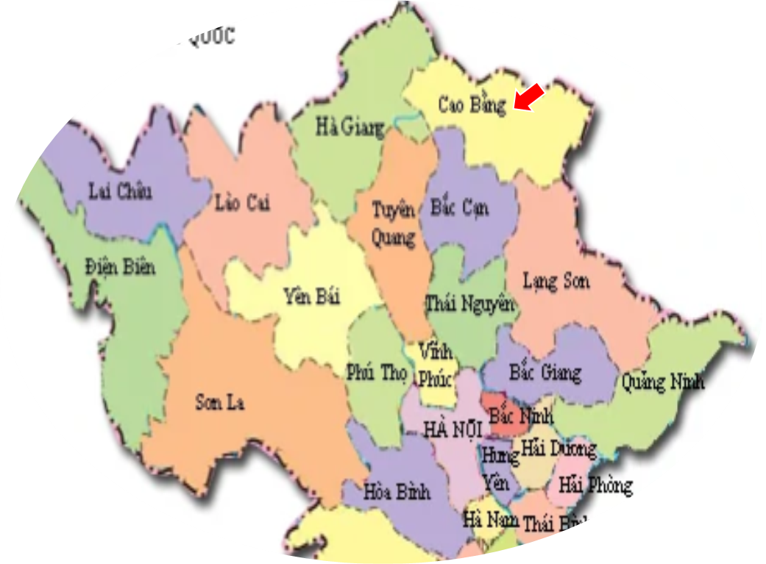
Vocabulary
1
2
3
4
5
village
town
tower
floor
flat
6
7
8
9
10
lane
address
street
province
road

Slide 3
GRAMMAR

Slide 4
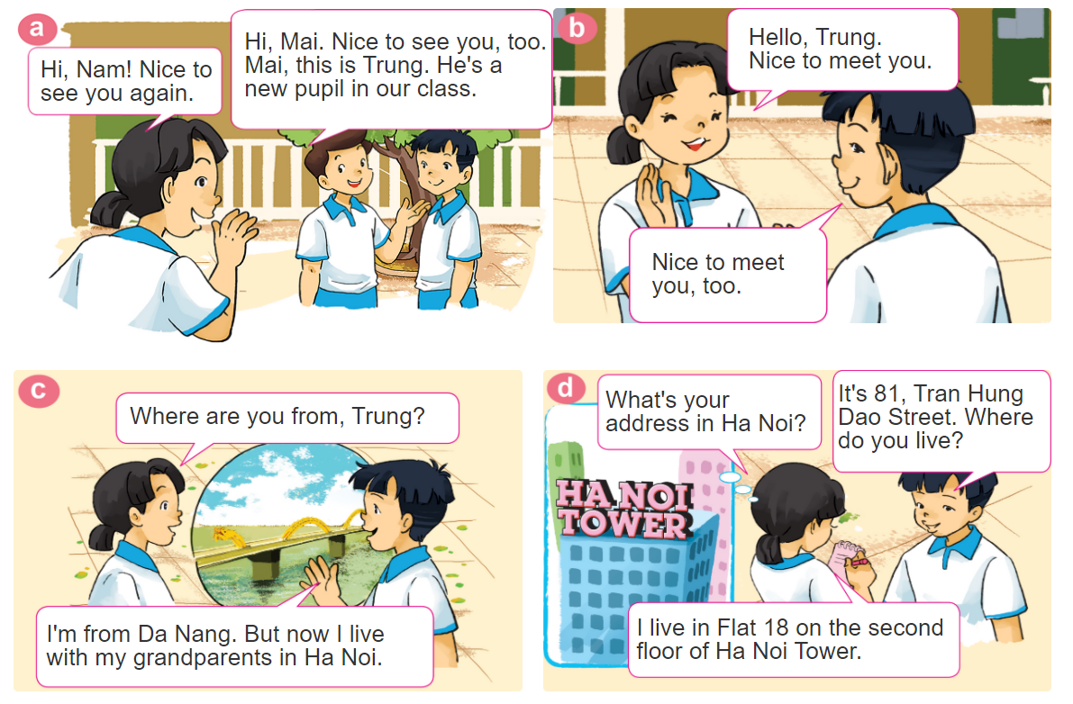
1. Look, listen and repeat.

Slide 5
1. Look, listen and repeat.

Slide 6
GRAMMAR
Hỏi - đáp ai đó đến từ đâu:
Where are you from?
(Bạn đến từ đâu)
I’m from _____________.
+ address
(Tớ đến từ_________)
Hỏi - đáp về địa chỉ nhà:
What's your address?
It's _________.
+ address
(Địa chỉ của bạn là gì?)
(Đó là ___________.)

Slide 7
GRAMMAR
Hỏi - đáp ai đó sống ở đâu:
Where do you live?
(Bạn sống ở đâu?)
I live in/on/at _____________.
+ address
(Tớ sống ở_________)

Slide 8
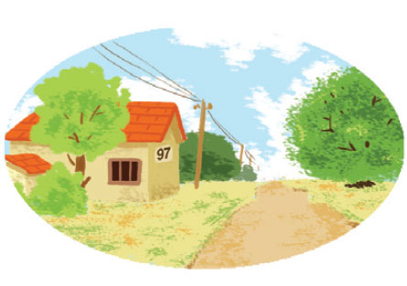
2. Point and say.
97, Village Road
It's __________________.
What's your address?
97, Village Road.

Slide 9
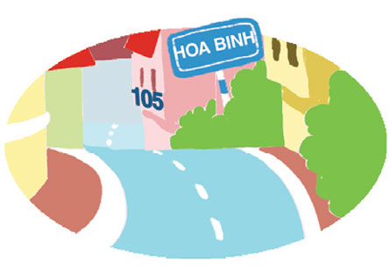
2. Point and say.
75, Hai Ba Trung Street
It's __________________.
What's your address?
75, Hai Ba Trung Street

Slide 10
2. Point and say.
flat 8, second floor, City Tower
It's ______________
_____________.
What's your address?
flat 8, second floor,
City Tower

Slide 11
3. Let’s talk.
Where are you from?
I’m from _______.
What’s your address?
It’s _______.
Where do you live?
I live in/at/on _______.

Slide 12
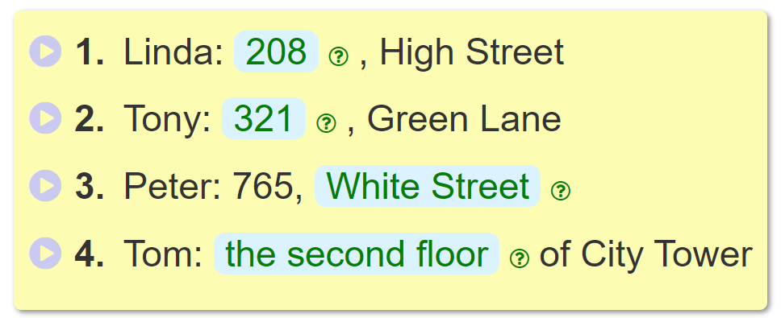
4. Listen and complete.
_________
208
_________
321
______________________.
White Street
___________________________
the second floor

Slide 13
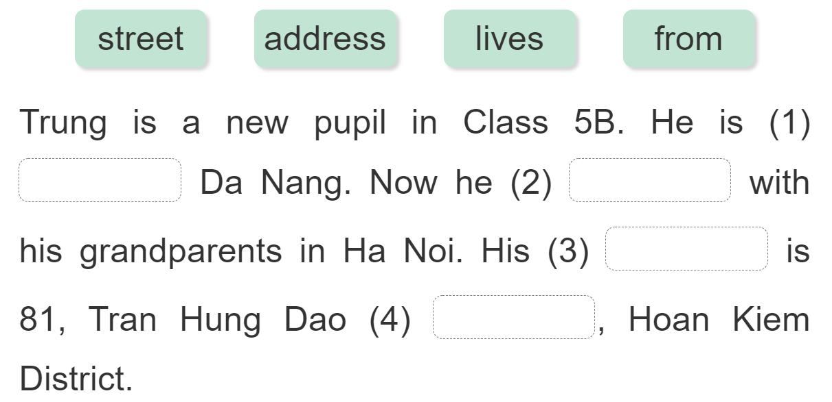
5. Read and complete.
from
lives
address
street

Slide 14
6. Let’s sing.
https://www.youtube.com/watch?v=KZU9aBsZwxE&t=1s

