Slide 1
Unit 1
What’s your address?
Lesson 2

Slide 2
VOCABULARY

Slide 3
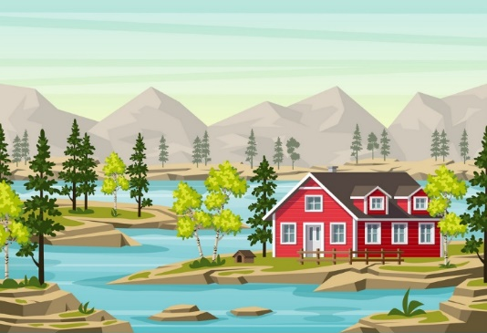
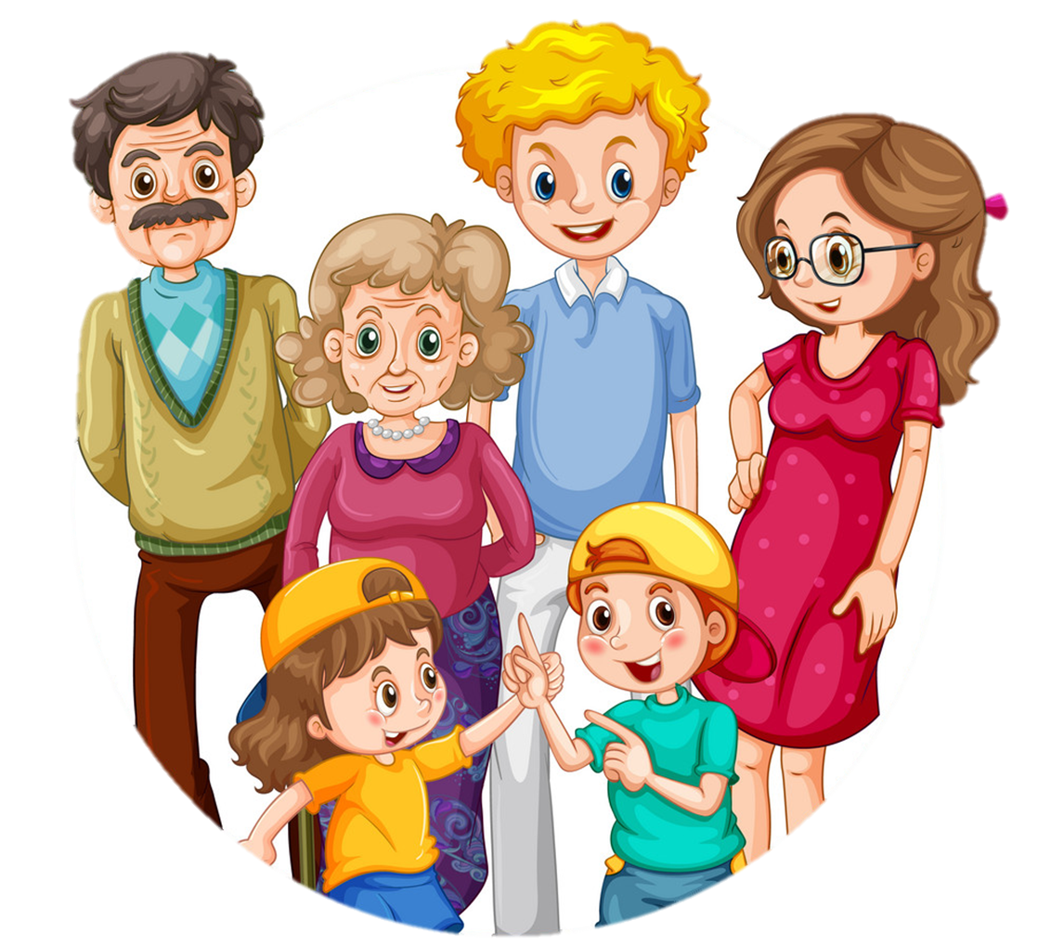
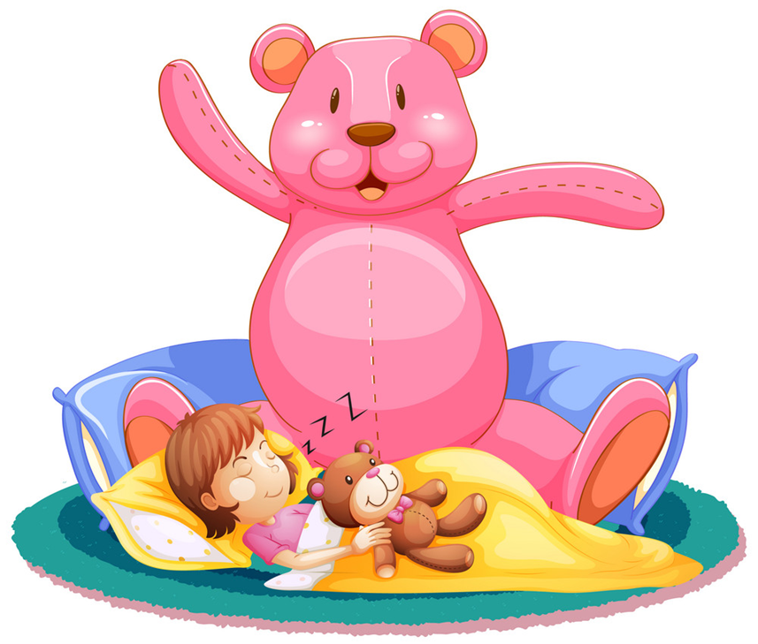
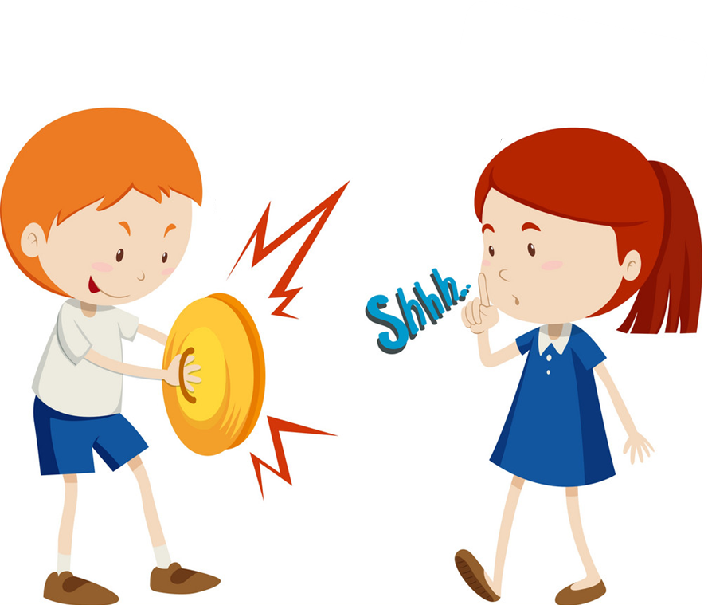
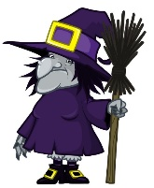
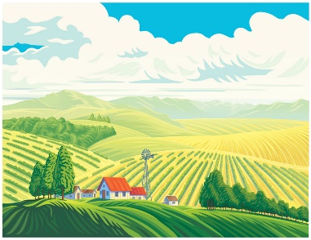
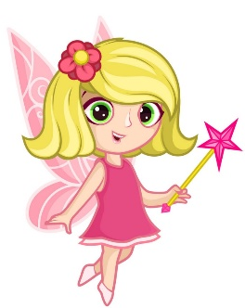
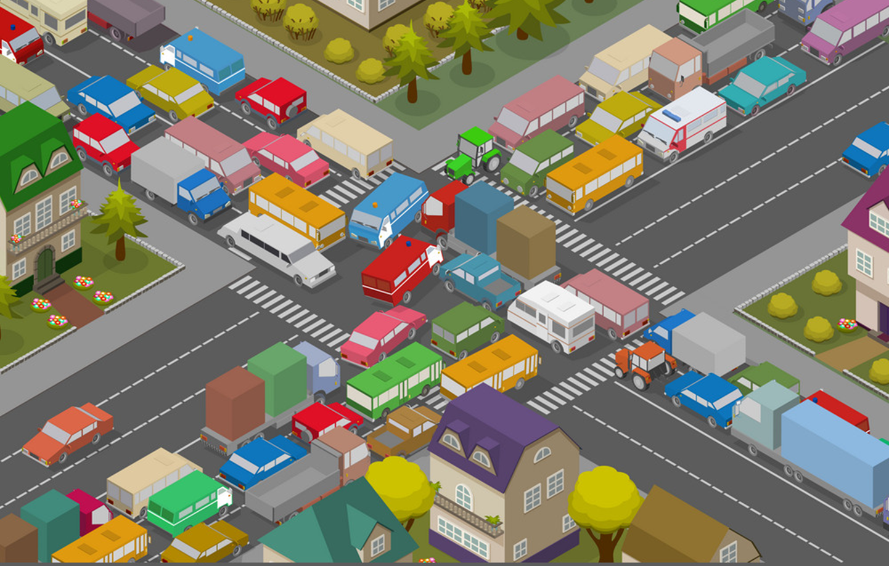
Vocabulary
island
mountain
hometown
far
noisy
big
large
quiet
small
beautiful
crowded

Slide 4
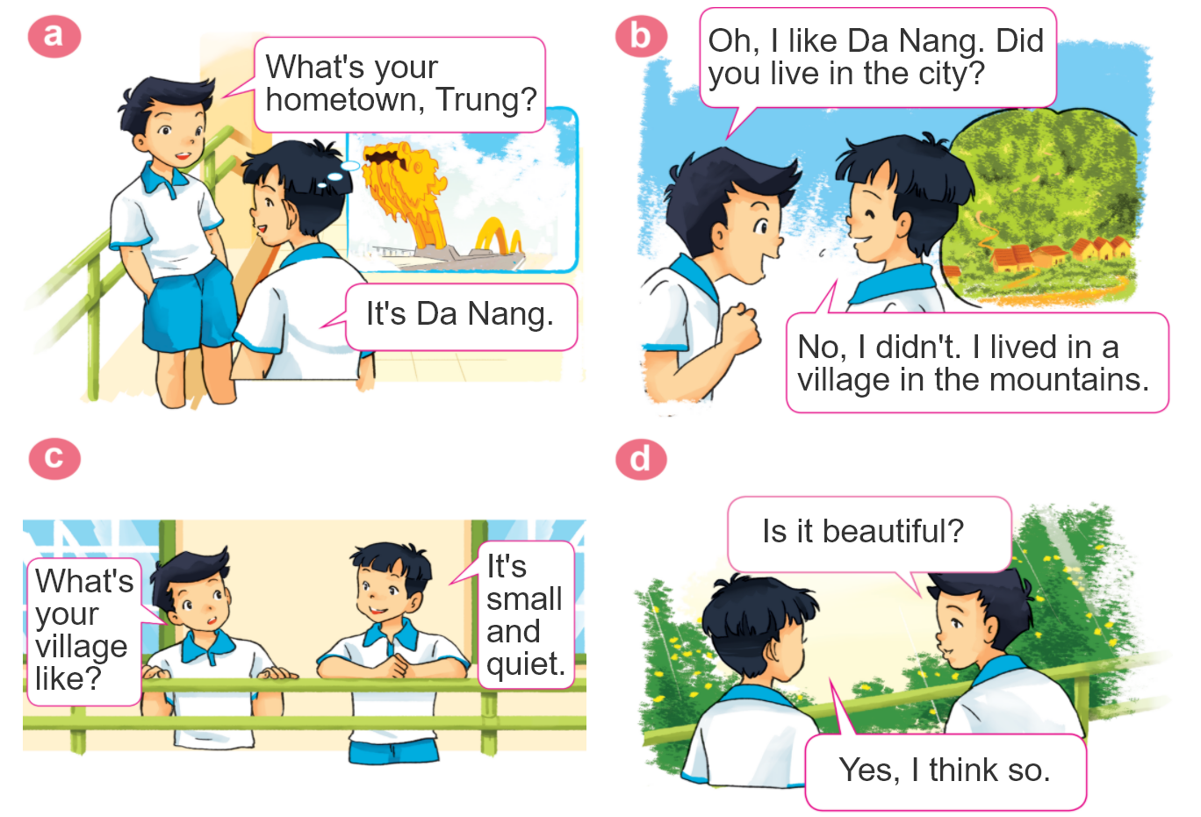
1. Look, listen and repeat.

Slide 5
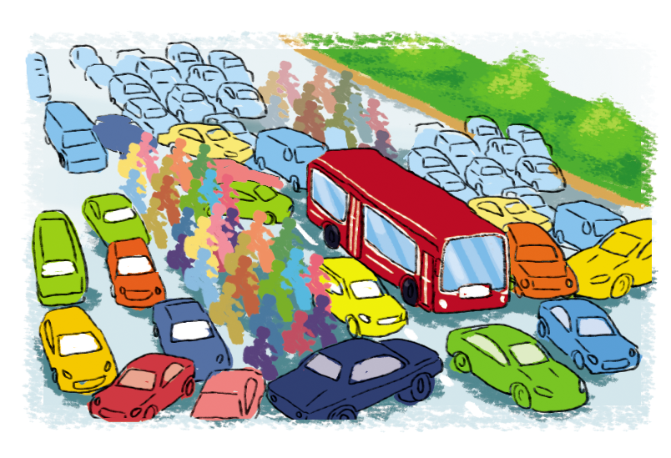
2. Point and say.
city,
big and busy
What's the ________ like?
city
It's __________________.
big and busy

Slide 6
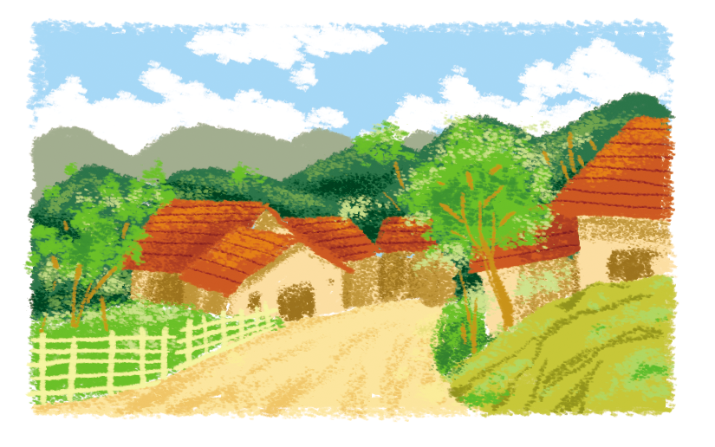
2. Point and say.
village,
far and quiet
What's the ________ like?
village
It's __________________.
far and quiet

Slide 7
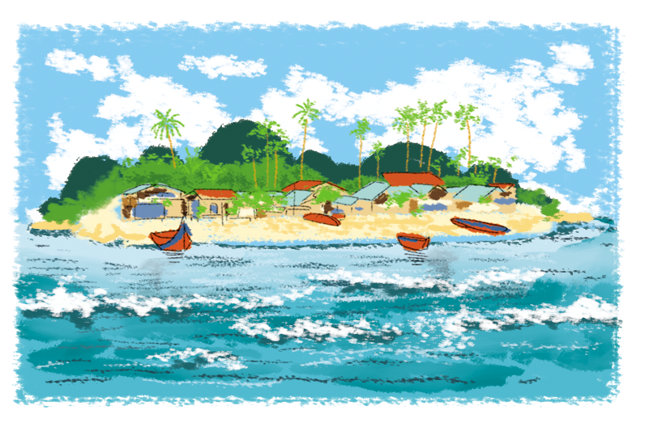
2. Point and say.
island,
small and pretty
What's the ________ like?
island
It's __________________.
small and pretty

Slide 8
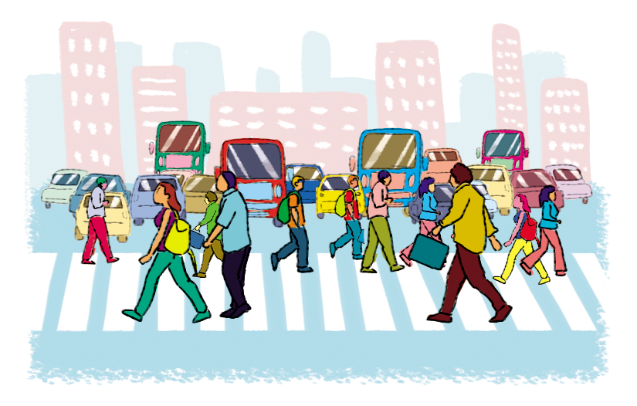
2. Point and say.
town,
large and crowded
What's the ________ like?
town
It's __________________.
large and crowded

Slide 9
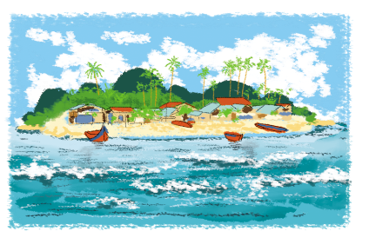
2. Point and say.
What's the ________ like?
It's ___________.
city,
big and busy
town,
large and crowded
village,
far and quiet
island,
small and pretty

Slide 10
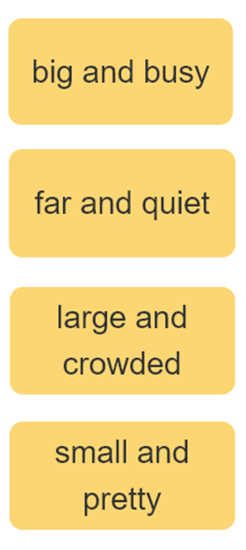
3. Let’s talk
I live ____________.
Where do you live?
What's it like?
It’s ______.
Who do you live with?
I live with ________.
parents
grandparents

Slide 11
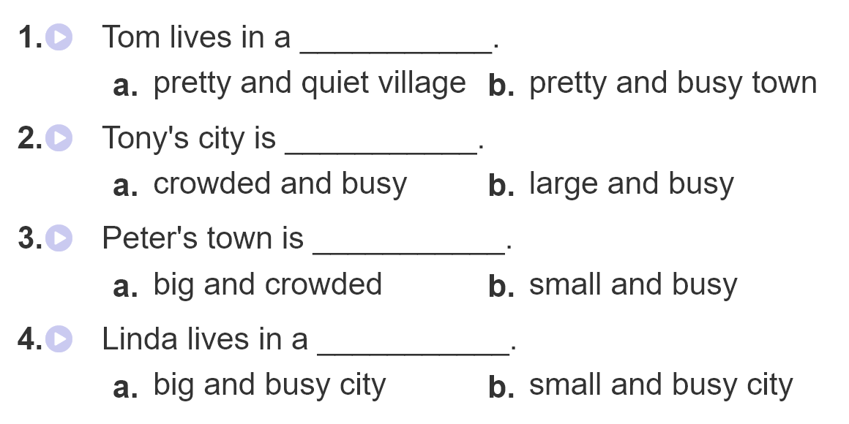
4. Listen and circle.

Slide 12
5. Write about you.
1. What's your address?
_________________________________.
2. What's your hometown like?
__________________________________.
3. Who do you live with?
__________________________________.
4. Do you like living there? Why?/Why not?
_____________________________________________.
__________________.
It's 28,Quang Trung street, Hanoi city.
It's big and busy.
I live with my parents.
Yes, I do. Because it has the modern life, high education,
and good health care

Slide 13
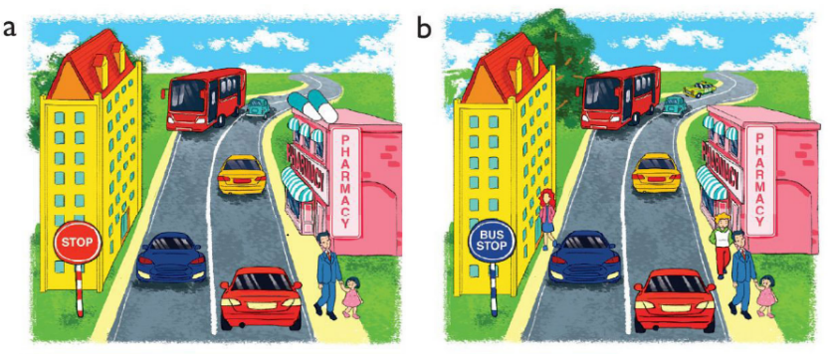
6. Let’s play.
Spot the difference
(Click the different spot)

