Slide 1





Unit 1
What’s your address?
Lesson 2

Slide 2


PRONUNCIATION

Slide 3

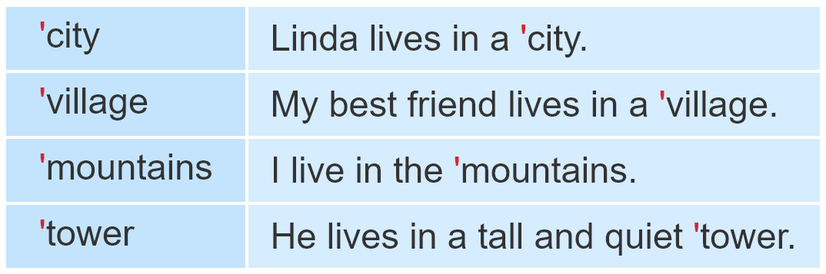


1. Listen and repeat.

Slide 4
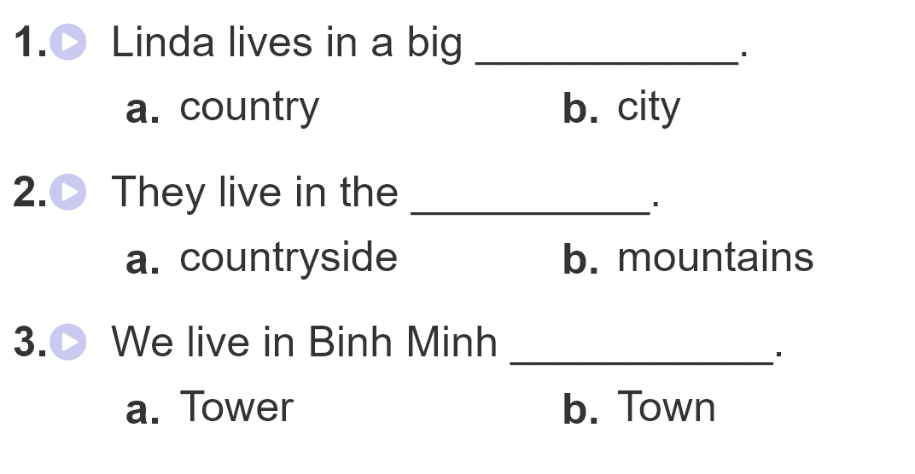
2.Listen and circle.

Slide 5
PRACTISE

Slide 6
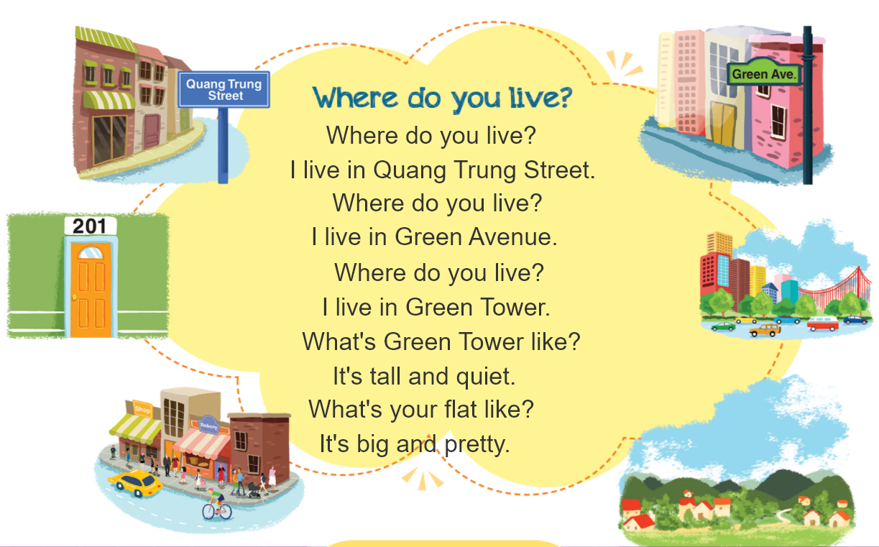


3. Let’s chant.

Slide 7
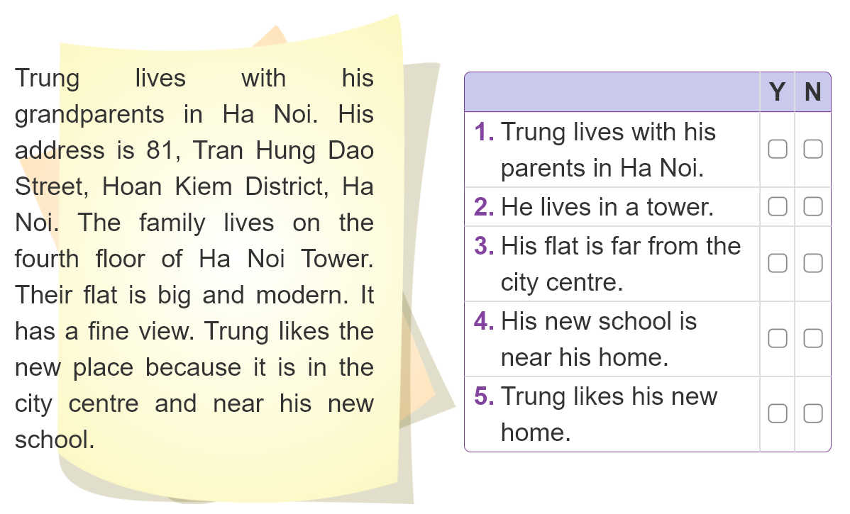

4. Read and tick.

Slide 8
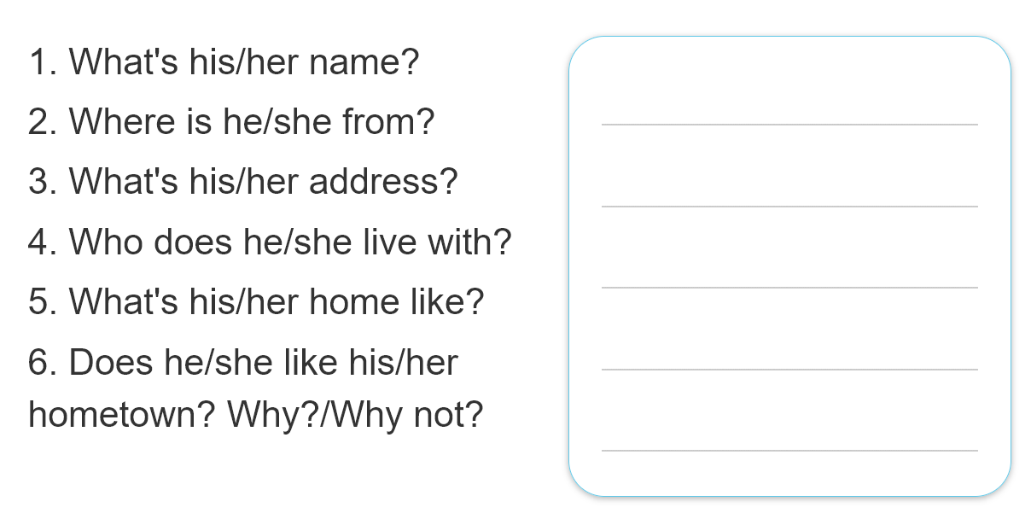
5. Write about your friend.
______________________________________________________________________________________________________________________________________________________________________________________________________________________________________________________________________________
His name is Quan.
He is from Hanoi City.
It’s 28, Quang Trung Street, Hanoi City.
He lives with his parents.
His home is big and modern.
No, he doesn't. Because it is busy and crowded.

Slide 9
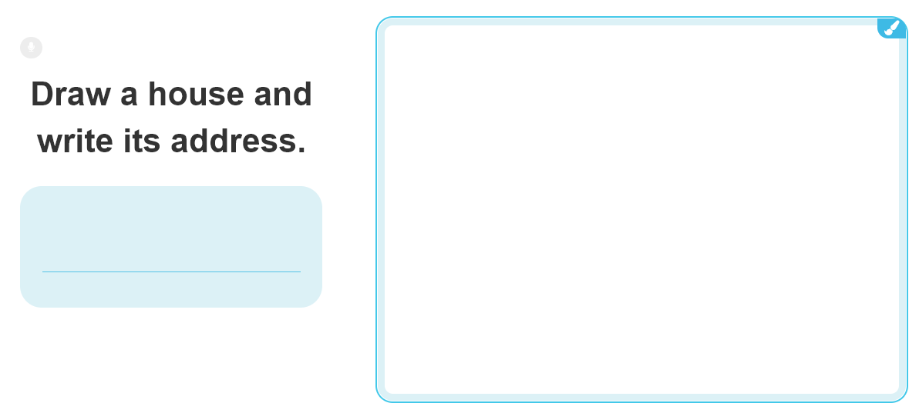
6. Project.

Slide 10
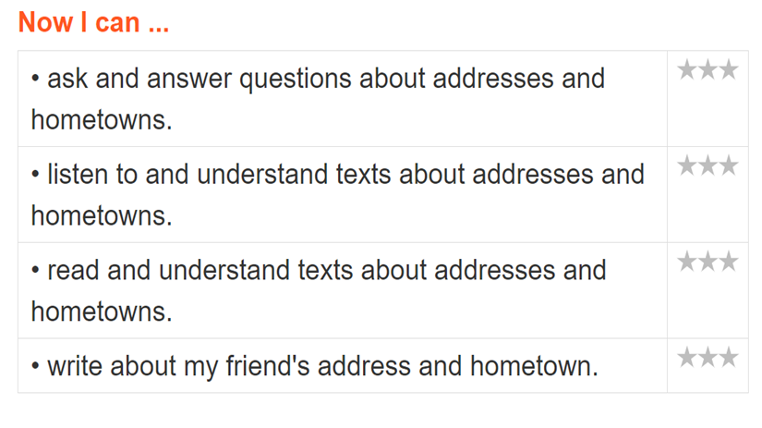
7.Colour the stars.

