Slide 1
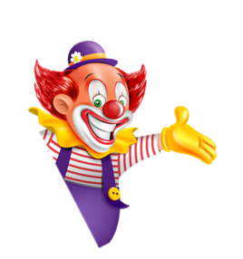
I always get up early.
How about you?
Unit
02
Lesson 3

Slide 2
Prounciation

Slide 3
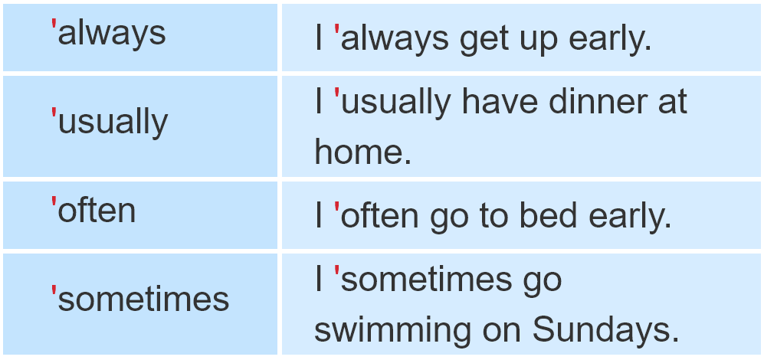
1. Listen and repeat

Slide 4
2. Listen and circle a or b. Then say the sentences aloud.
1. I___________ go to bed early.
a. always b. sometimes
2. He ___________ plays football after school.
a. sometimes b. often
3. She ___________ goes shopping on Sundays.
a. usually b. always
4. We___________ go camping at the weekend.
a. often b. sometimes

Slide 5
Practise

Slide 6
3. Let’s chant.

Slide 7
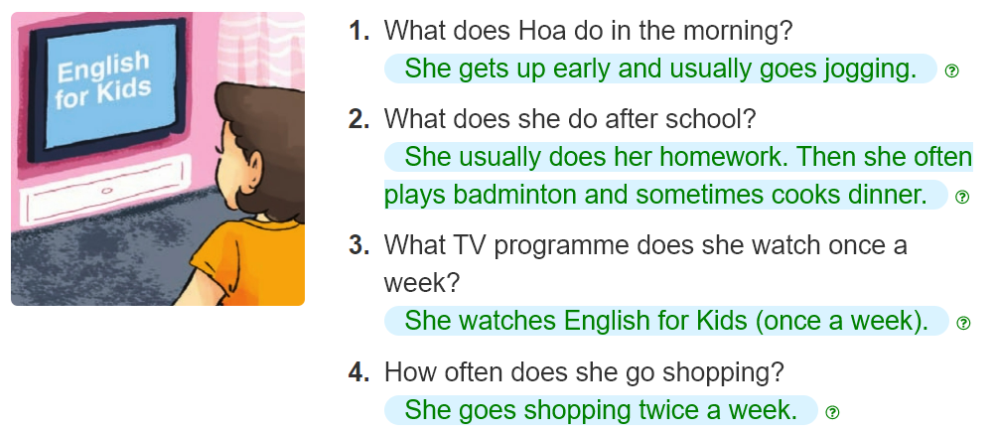
4. Read and answer.
______________________________________.
________________________________________.
______________________________________.
______________________________________.

Slide 8
5. Write about your day.
My name is ____________.
In the morning, I always____________.
In the afternoon, I usually ____________.
In the evening, I ____________.
I ____________a week.

Slide 9
6. Project.
Interview two of your classmates about their daily routines.

Slide 10
7.Colour the stars.
Now I can...

