Slide 1
Unit 4
Did you go to
the party?
Lesson 1

Slide 2
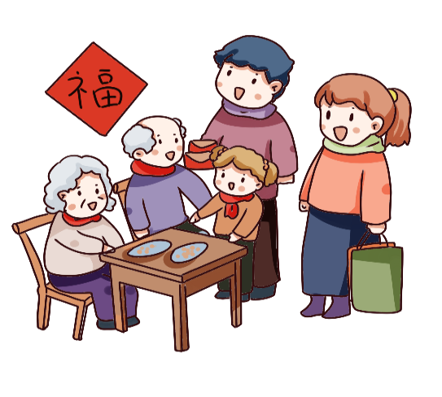
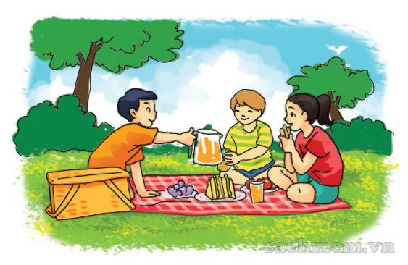
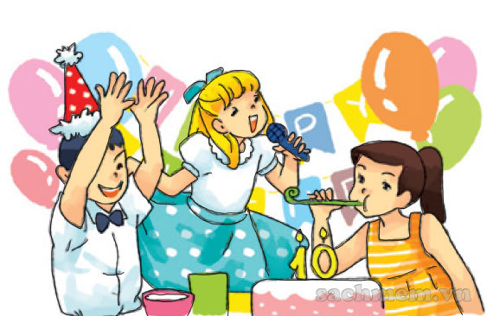
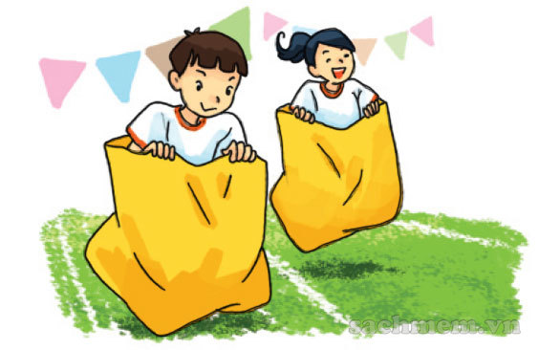
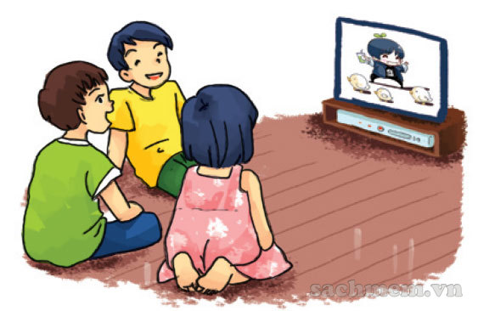
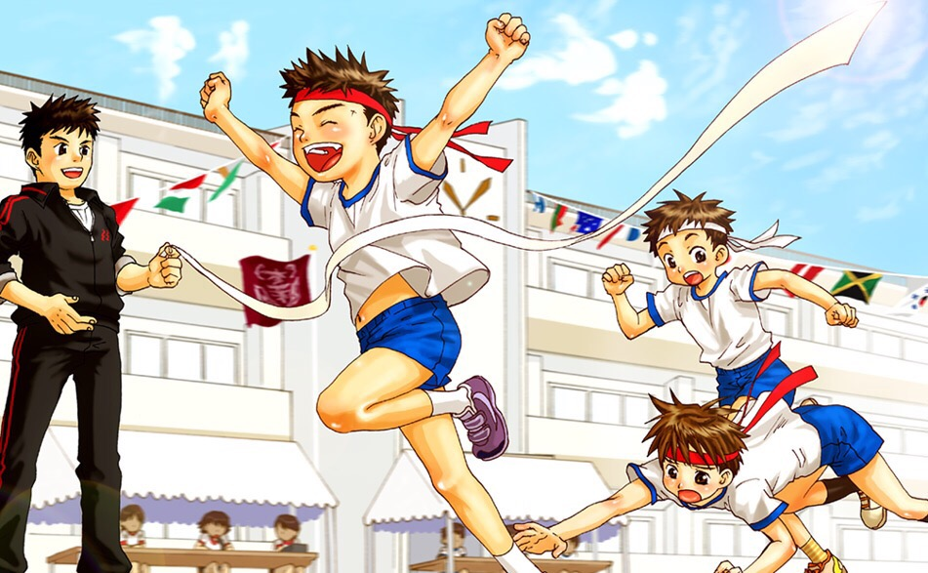
A. Vocabulary
go on a picnic
enjoy a party
visit my grandparents
đi dã ngoại
thích bữa tiệc
đi thăm ông bà
join the funfair
watch cartoon
sport festival
tham gia hội trại
xem hoạt hình
lễ hội thể thao

Slide 3
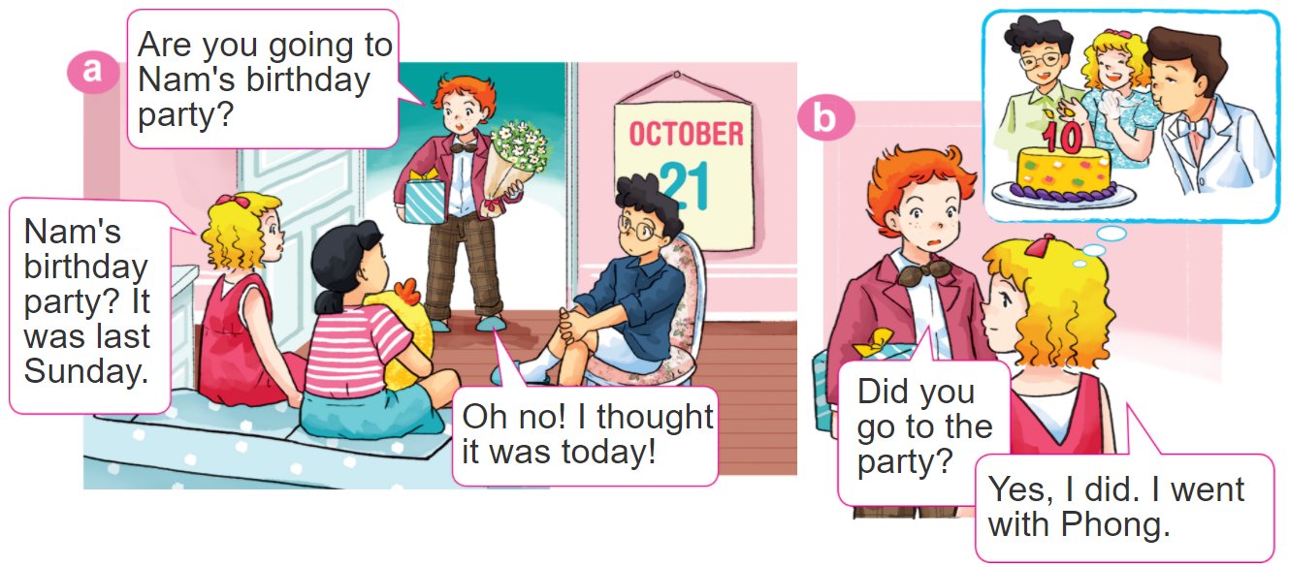
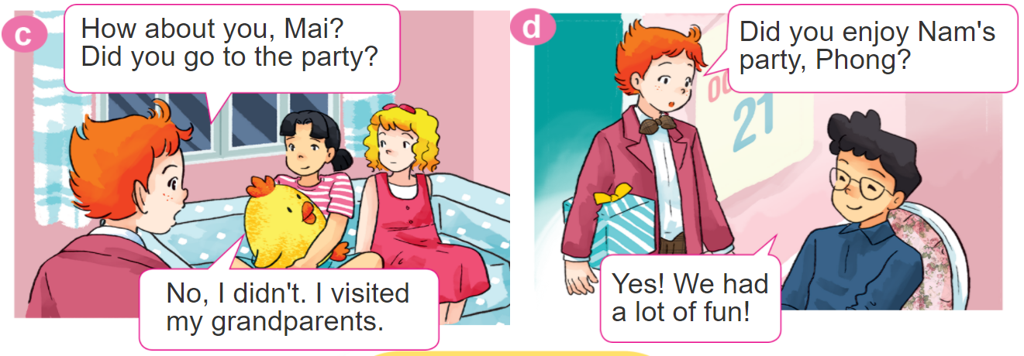
1. Look, listen and repeat.

Slide 4
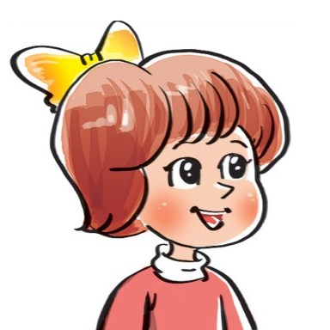
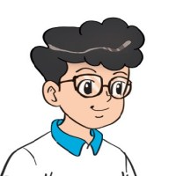
2. Point and say.
Yes. I did.
Did you _________?
No, I didn't.
go on a picnic
watch TV
enjoy a party
join the funfair

Slide 5
3. Let’s talk
Did you go on a picnic?
Yes. I did.
Did you enjoy the weekend?
No, I didn't.
Did you watch TV?

Slide 6
B. Grammar
Hỏi và đáp bạn đã làm gì đó phải không:
Did you ___________?
+ activity
Yes. I did.
No, I didn't.

Slide 7
4. Listen and tick Yes (Y) or No (N).

Slide 8
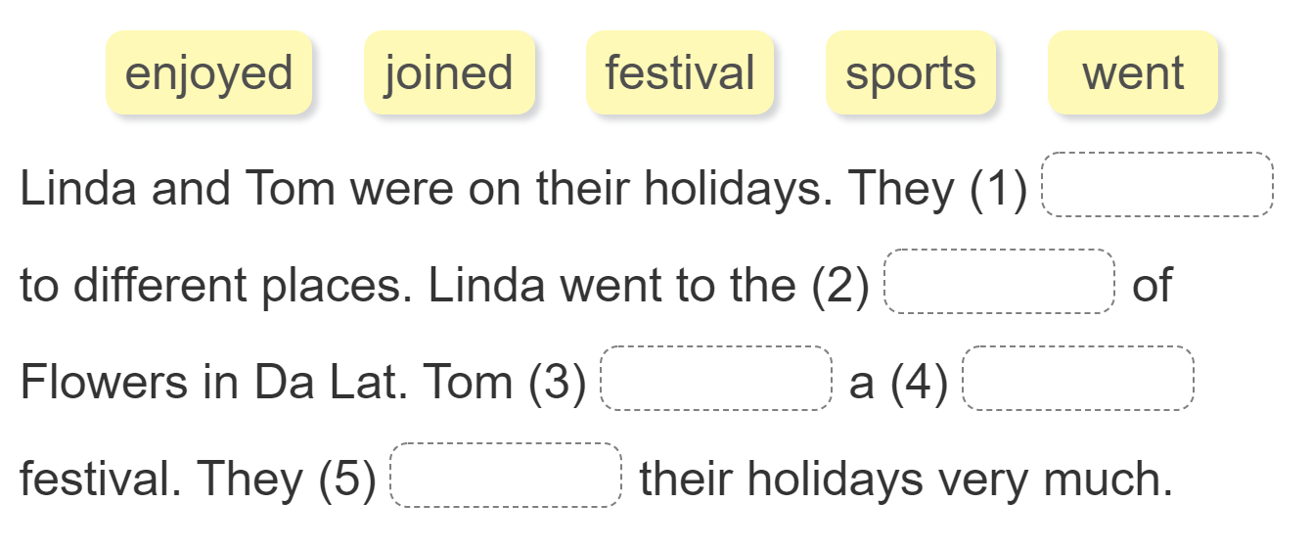
5. Read and complete.
went
festival
joined
sports
enjoyed

Slide 9
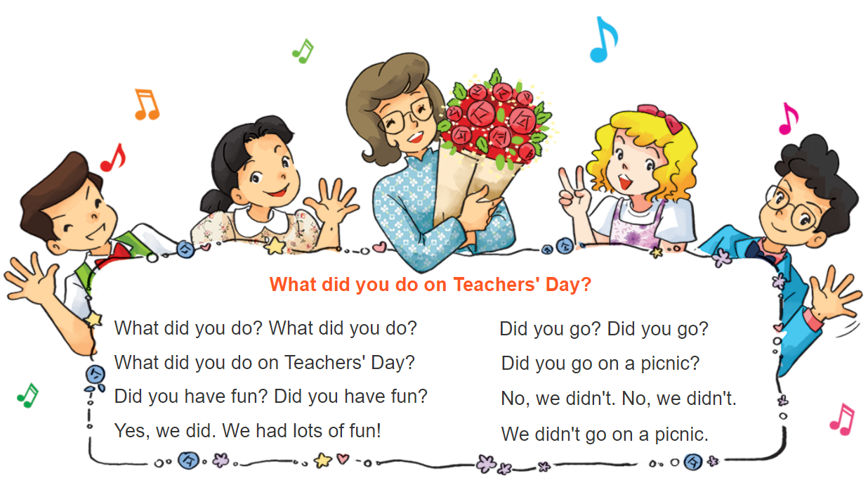
6. Let’s sing

