Slide 1
Unit 4
Did you go to
the party?
Lesson 3

Slide 2
PRONUNCIATION

Slide 3
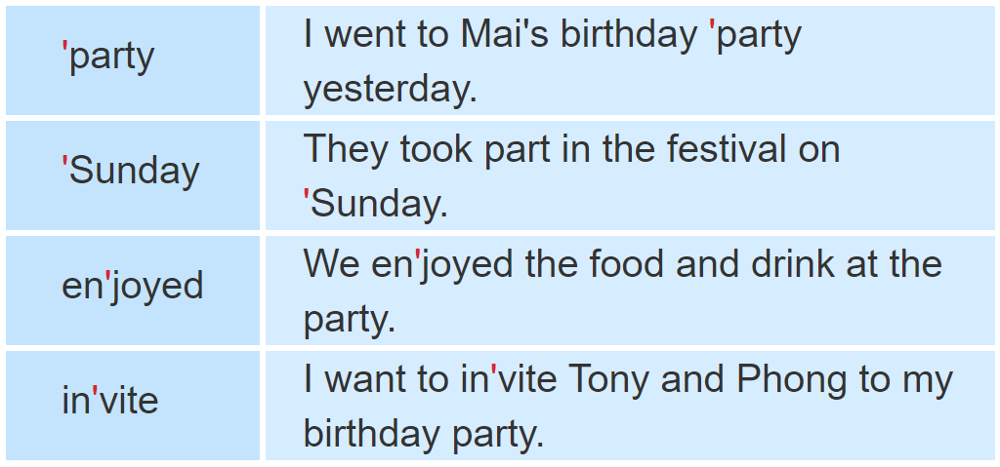
1. Listen and repeat.

Slide 4
2. Mark the word stress. Then say the words aloud.
'water
'party
en'joy
'birthday
in'vite
'Monday
'comics
'picnic
car'toon
'Sunday
re'peat
com'plete

Slide 5
PRACTISE

Slide 6
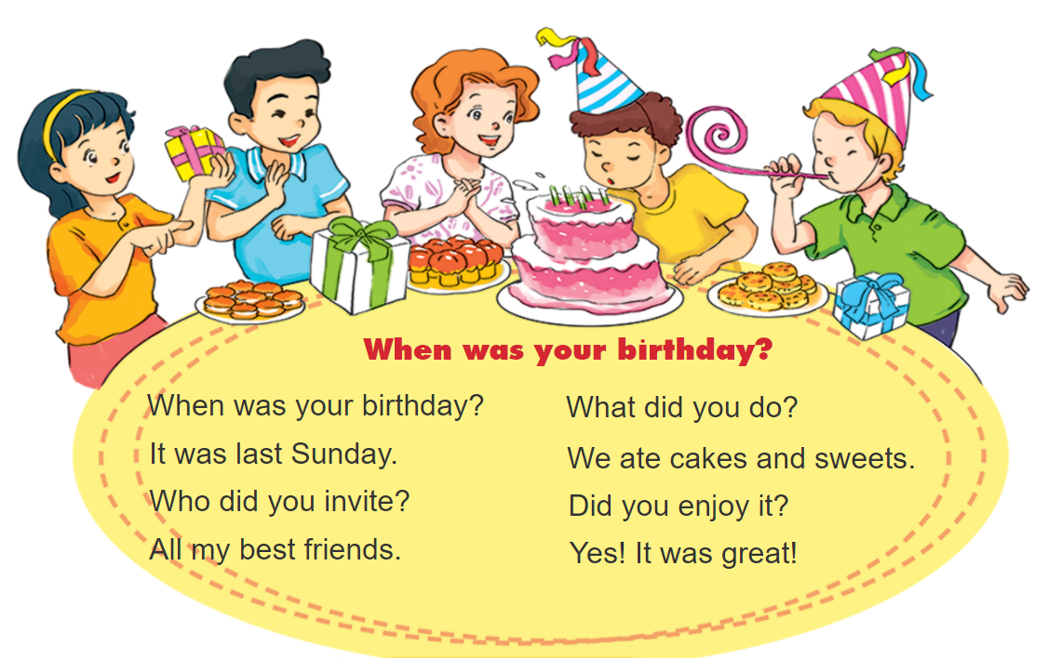
3. Let’s chant.

Slide 7
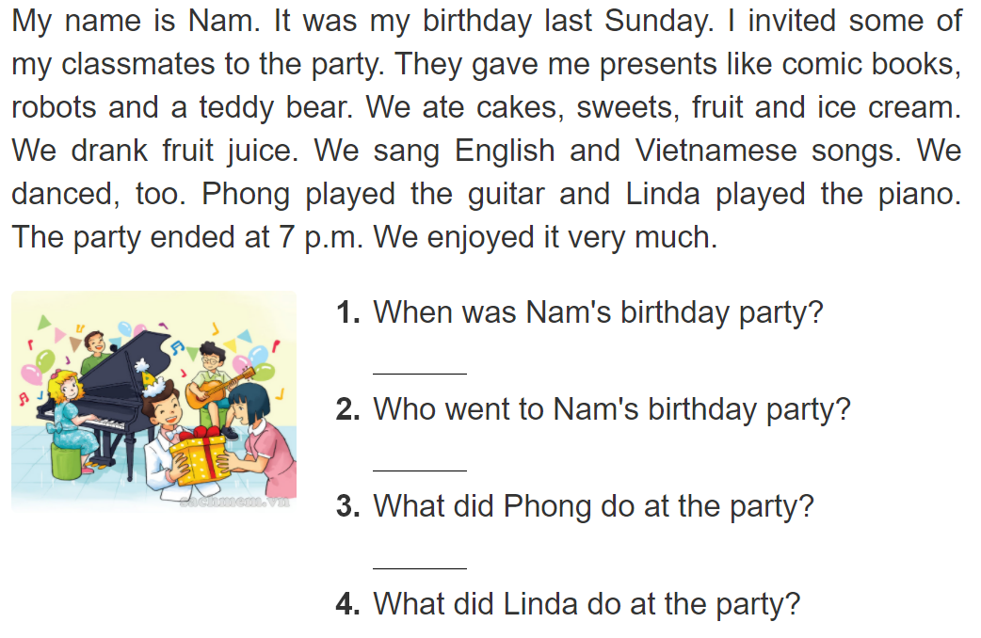
4. Read and answer.
It was last Sunday.
Some of his classmates went to the birthday party.
He played the guitar.
She played the piano.

Slide 8
5. Write about your birthday party.
When was your last birthday party?
____________________________________________.
2. Who went to your party?
____________________________________________.
3. What did you and your friends do at the party?
____________________________________________.

Slide 9
6.Project.
Discuss in groups what present to give a classmate for his/her birthday.

Slide 10
7.Colour the stars.
Now I can...
• ask and answer questions about past activities.
• listen to and understand texts about past activities.
• read and understand texts about past activities.
• write about my birthday party.

