Slide 1
Unit 5
Where will you be this weekend?
Lesson 2

Slide 2
VOCABULARY

Slide 3
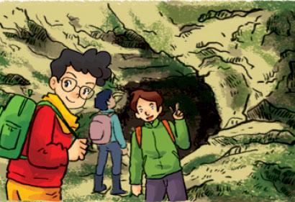
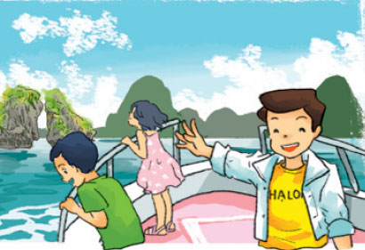
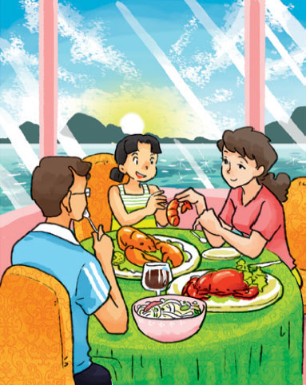
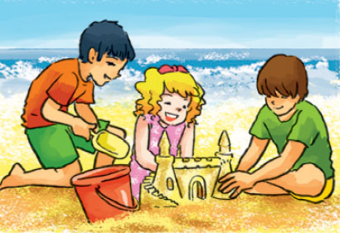
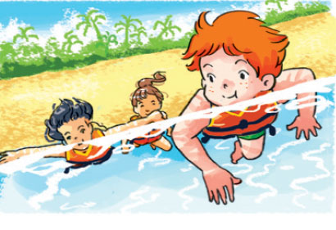
A. Vocabulary
explore the caves
khám phá hang động
take a boat trip
đi tham quan
bằng thuyền
eat seafood
ăn đồ biển
build sandcastles
xây lâu đài cát
swim in the sea
bơi ở biển

Slide 4
Look read and match
eat
seafood
swim
in the sea
explore
the caves
take
a boat trip
build
sandcastles

Slide 5
GRAMMAR

Slide 6
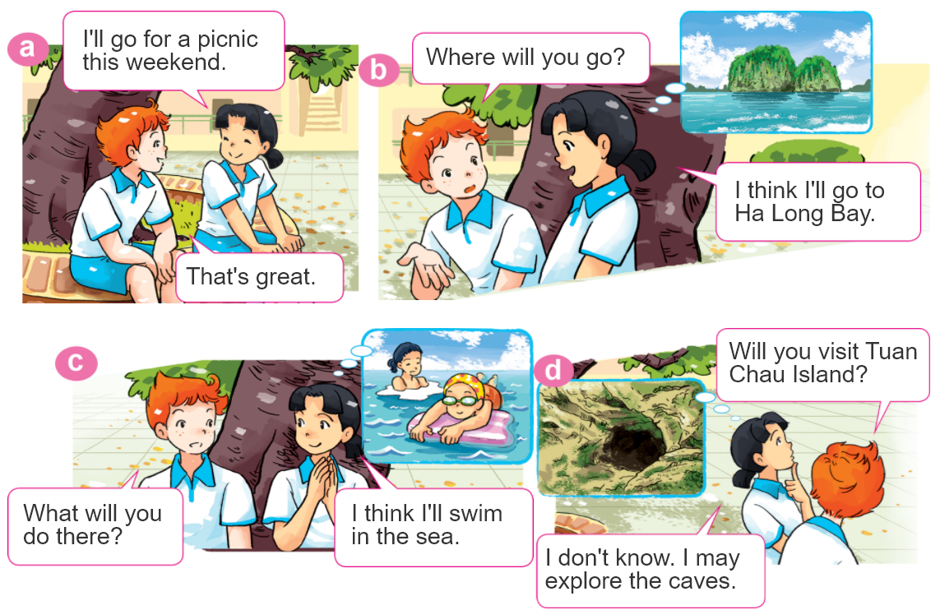
1. Look, listen and repeat.

Slide 7
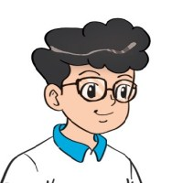
2. Point and say.
What will you do at Ha Long Bay?
I think I'll ____________.
explore
the caves
swim
in the sea
take a boat trip
around the islands
build sandcastles
on the beach

Slide 8
2. Point and say.
What will you do at Ha Long Bay?
I don’t know. I may ________.
explore
the caves
swim
in the sea
take a boat trip
around the islands
build sandcastles
on the beach

Slide 9
3. Let’s talk.
Where will you be next week?
I think I'll ____________.
I don't know. I may _____________.
What will you do?

Slide 10
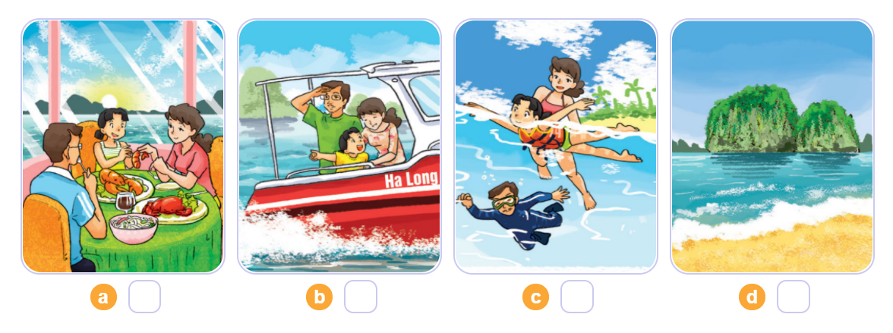
4. Listen and number.
2
3
4
1
1
2
3
4

Slide 11
5. Write about your daily routines.
Where will you be tomorrow?
____________________________________.
2. What will you do?
____________________________________.

Slide 12
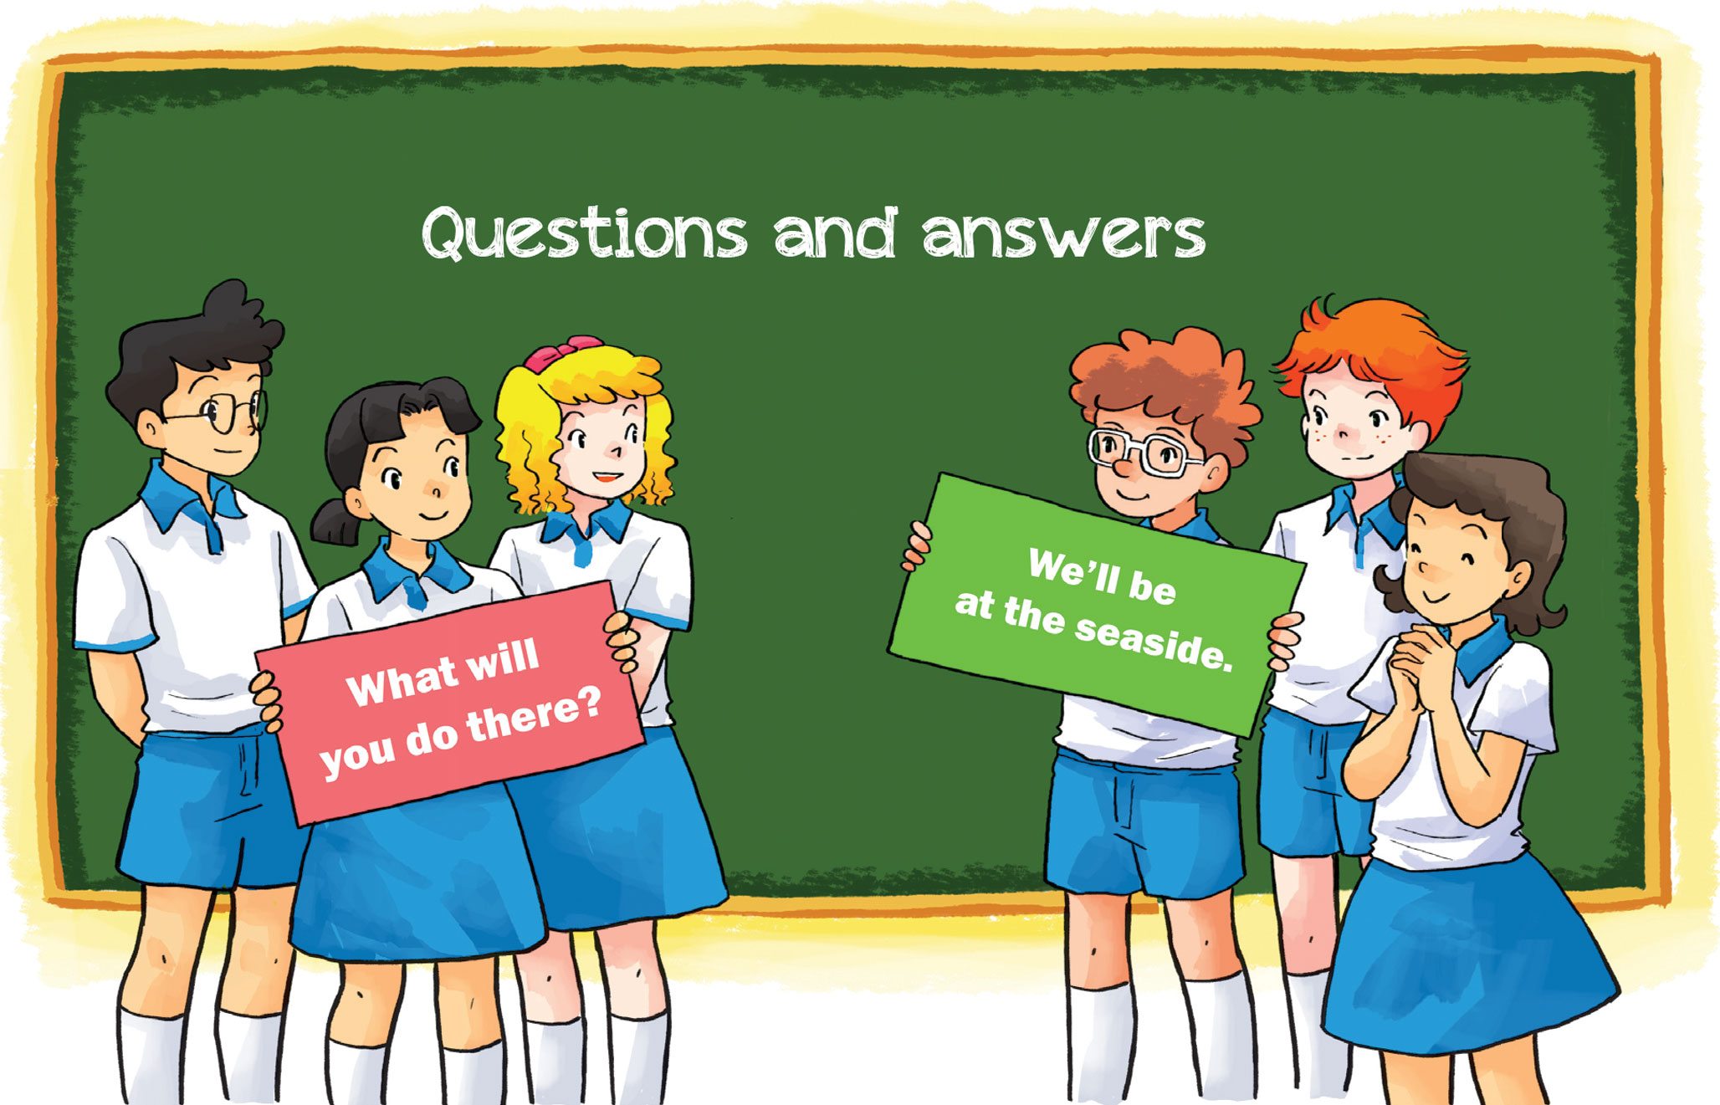
6. Let’s play.

