Slide 1
Unit 5
Where will you be this weekend?
Lesson 3

Slide 2
PRONUNCIATON

Slide 3
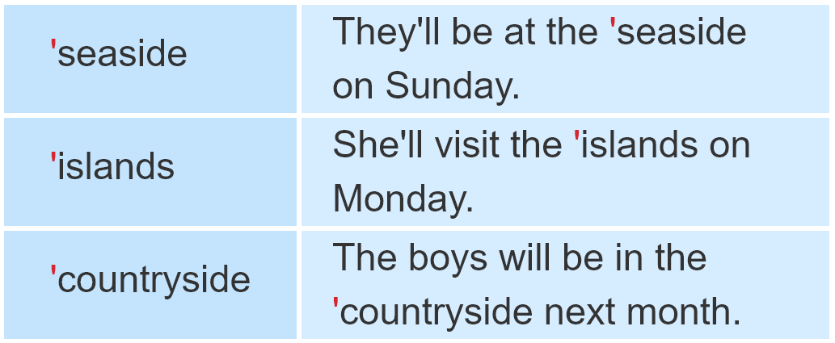
1. Listen and repeat.

Slide 4
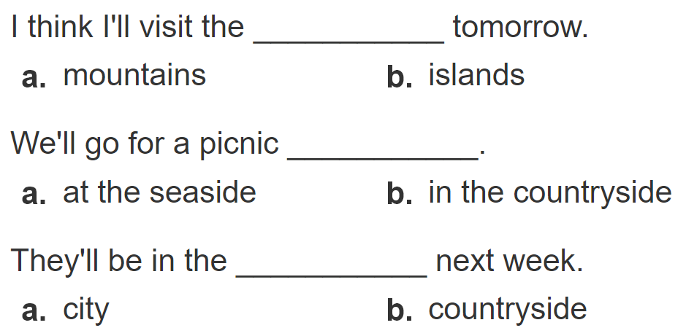
2. Listen and circle a or b. Then say the sentences aloud.
1
2
3
Clcik số để nghe từng câu

Slide 5
PRACTISE

Slide 6
3. Let’s chant.

Slide 7
4. Read and answer.
 | Morning | Afternoon | Evening
Mai's parents | will swim in the sea
Mai and her brother
will sunbathe
will have dinner on
Tuan Chau Island
will build
sandcastles
will play
badminton
will have dinner on
Tuan Chau Island

Slide 8
5. Write about you.
Hi. My name's ____________________ .
Next Sunday, I think I will be ________________.
In the morning, I will _______________________.
In the afternoon, __________________________.
In the evening, ___________________________.
Peter.
at Ha Long Bay
swim in the sea.
I will play football with Nam.
I will eat seafood with my family.

Slide 9
6. Project.
Interview three classmates about where they will go and what they will do next weekend.

Slide 10
7.Colour the stars.
Now I can ...
• ask and answer questions about future activities.
• listen to and understand texts about future activities.
• read and understand texts about future activities.
• write about my future activities.

