Slide 1
Unit 1
Feeling
Lesson 1

Slide 2
WARM UP

Slide 4
VOCABULARY

Slide 5
happy

Slide 6
sad

Slide 7
fine/ OK

Slide 8
great

Slide 9
01
03
02
04
happy
fine/OK
sad
great

Slide 10
Whoa!
It could be the part of the presentation
where you can introduce yourself, write your email...

Slide 11
SING

Slide 12
01
GRAMMAR

Slide 13
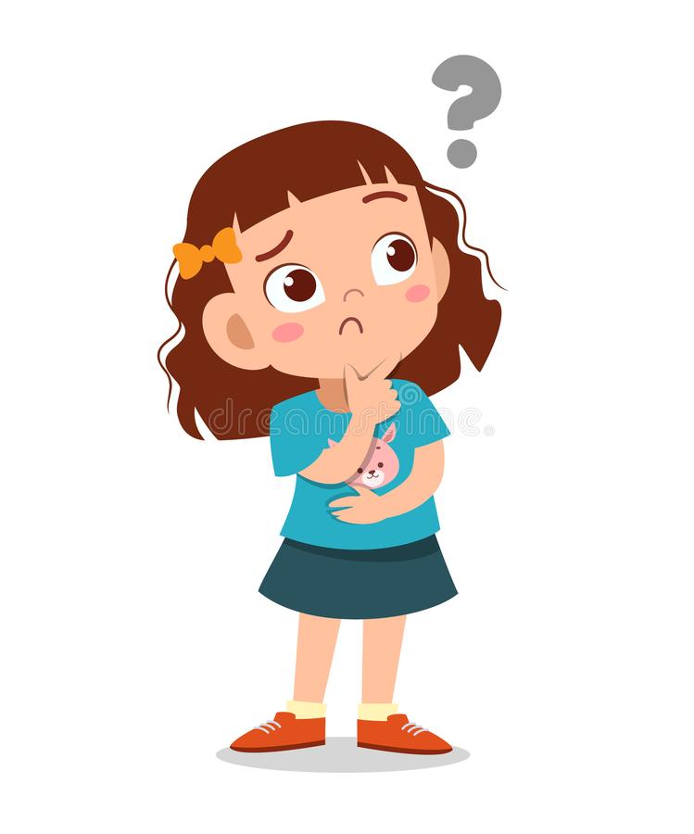
How are you?
Sentences
I’m sad.

Slide 14
01
SPEAKING PRACTISE

Slide 15
How are you?
Sing
Q
Q
I am sad.

Slide 16
How are you?
Sing
Q
Q
I am OK.

Slide 17
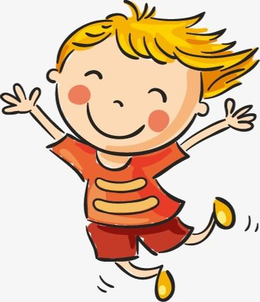
How are you?
Sing
Q
Q
I’m happy.

Slide 18
How are you?
Sing
Q
Q
I’m great.

Slide 19
01
GAME

Slide 20
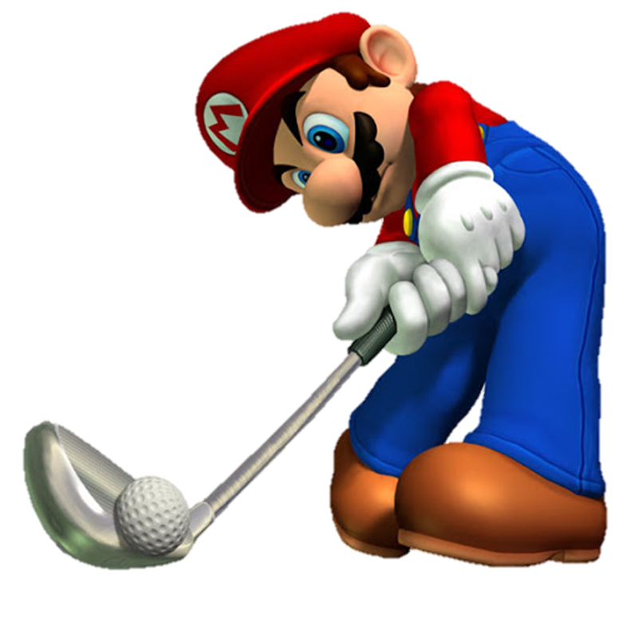
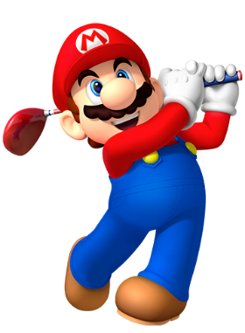
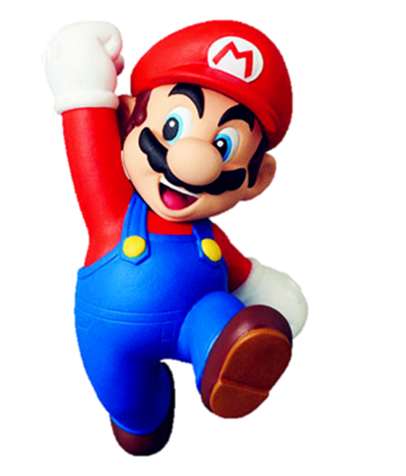

Slide 21
How are you ?
I am
sad
happy
OK

Slide 22
How are you ?
I am
happy
great
sad

Slide 23
How are you ?
I am
great
sad
OK

Slide 24
How are you ?
I am
great
fine
happy

Slide 25
How are you?
I am……
great
happy
fine

Slide 26
How are you?
I am……
Ok
sad
happy

Slide 27
How are you?
I am……
happy
sad
fine

Slide 28
How do you spell _____ name?
Q-U-A-N
she
he
his

Slide 29
How are you?
I am……
OK
great
sad

Slide 31
01
GOODBYE

