Slide 1
Unit 1
THANH YEN TRAN 0967 255 149 FB Thanhyentran
Feeling
Lesson 2

Slide 2
WARM UP

Slide 4
REVIEW

Slide 5
01
03
02
04
happy
fine/OK
sad
great

Slide 6
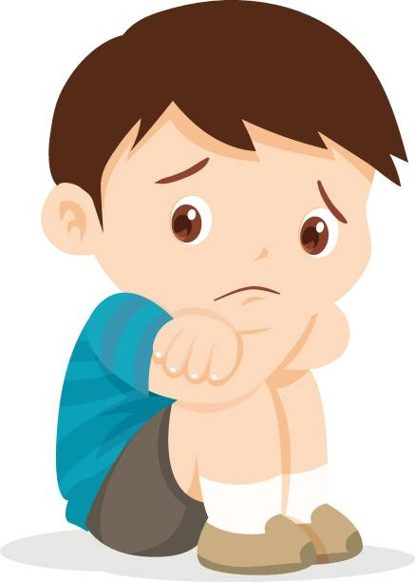
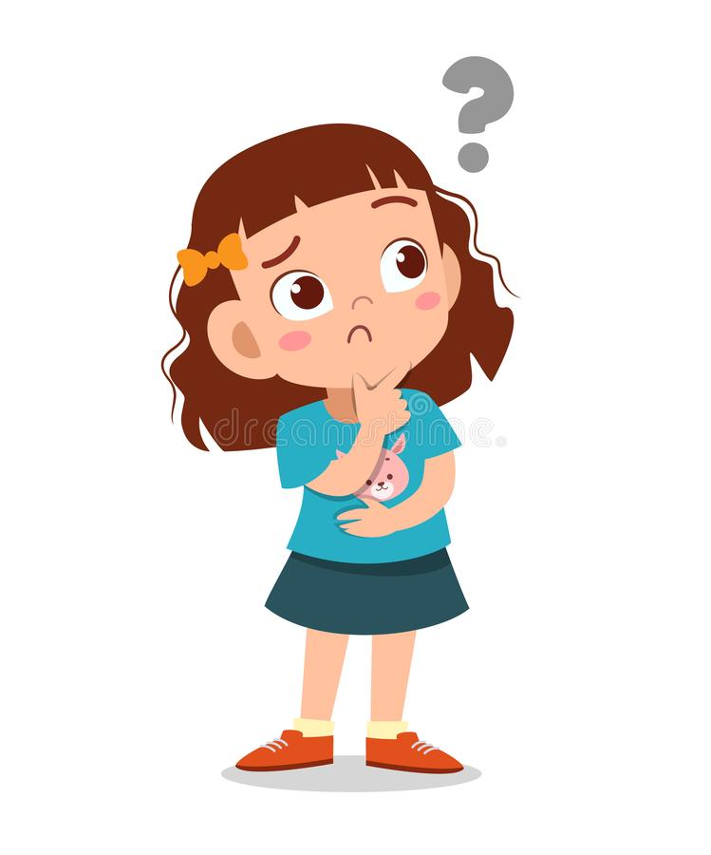
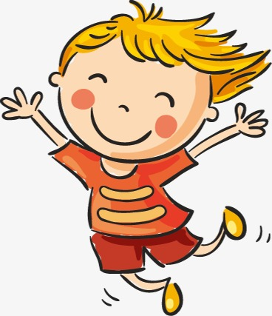
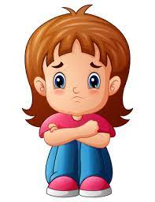
How are you?
Sing
Q
Q
I am …...
1
2
3
4

Slide 7
PHONIC

Slide 8
Whoa!
It could be the part of the presentation
where you can introduce yourself, write your email...

Slide 9
n
n

Slide 10
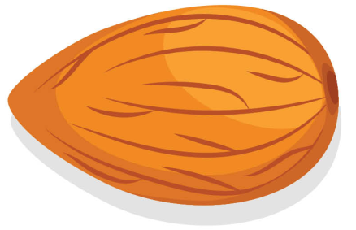
SING
This is a
n, n,
This is a
n, n,n

Slide 11
01
Listen and clap

Slide 12
Whoa!
It could be the part of the presentation
where you can introduce yourself, write your email...

Slide 13
o
o

Slide 14
SING
This is an
o, o,
This is n
o, o, o

Slide 15
01
Listen and hop

Slide 16
01
GAME

Slide 17
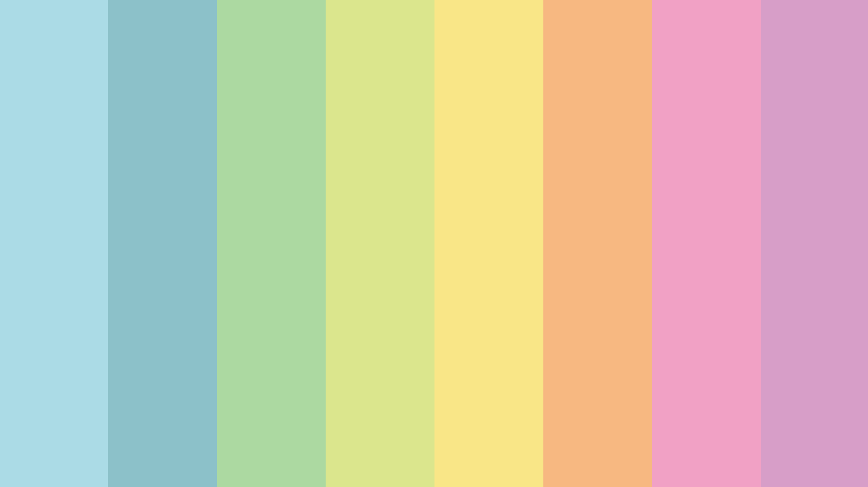
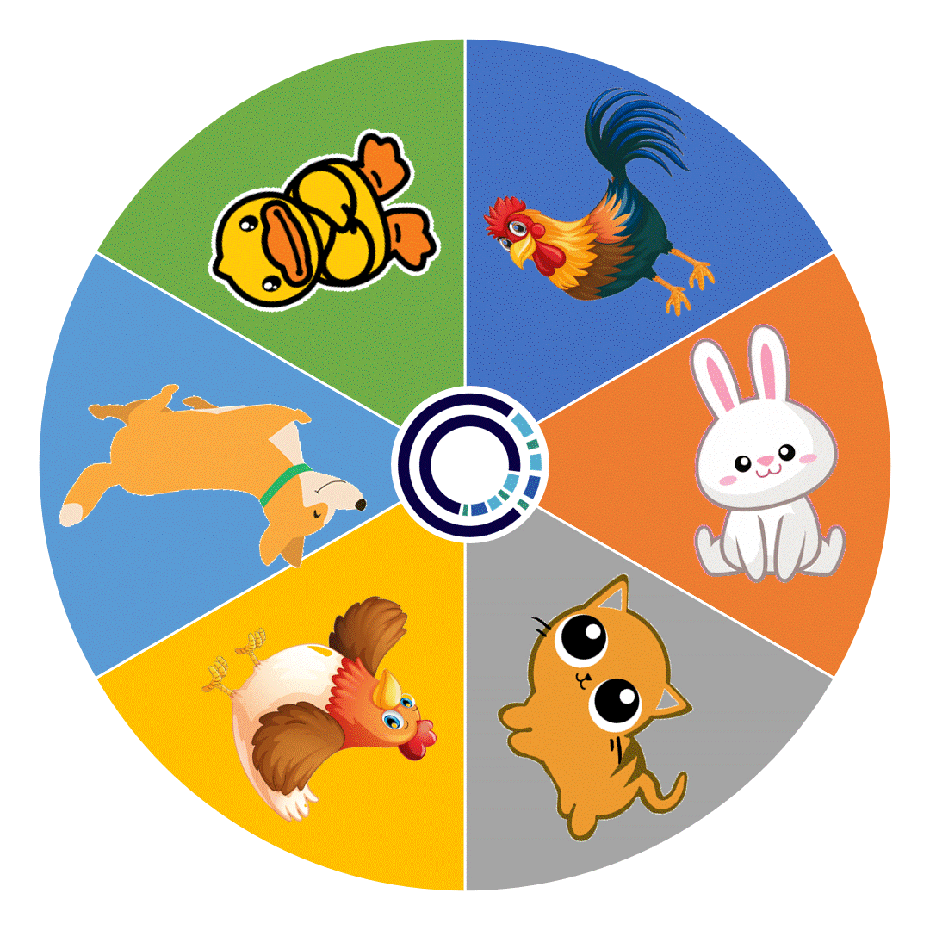
LUCKY
CIRCLE
CLICK
Notes:
THANH YEN TRAN 0967 255 149 FB Thanhyentran

Slide 18
Listen to the sound and choose right answer
N-n-nose
O-o- octopus
N-n-nut
O-o- orange
Notes:
THANH YEN TRAN 0967 255 149 FB Thanhyentran

Slide 19
LUCKY
CIRCLE
CLICK
Notes:
THANH YEN TRAN 0967 255 149 FB Thanhyentran

Slide 20
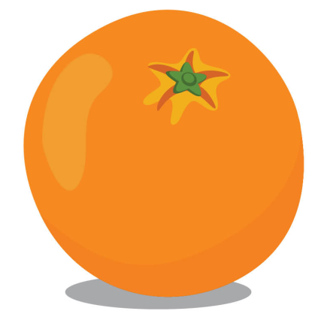
This is a orange.
This is a nose.
This is an orange.
This is a nut.
Notes:
THANH YEN TRAN 0967 255 149 FB Thanhyentran

Slide 21
LUCKY
CIRCLE
CLICK
Notes:
THANH YEN TRAN 0967 255 149 FB Thanhyentran

Slide 22
Listen to the sound and choose right answer
N-n-nut
O-o- orange
N-n-nose
O-o- octopus
Notes:
THANH YEN TRAN 0967 255 149 FB Thanhyentran

Slide 23
LUCKY
CIRCLE
CLICK
Notes:
THANH YEN TRAN 0967 255 149 FB Thanhyentran

Slide 24
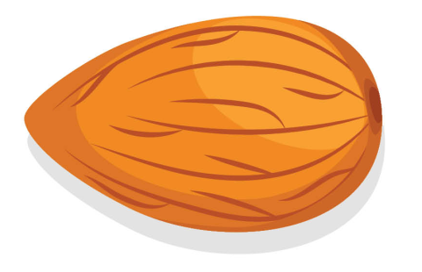
This is a nut.
This is a nose.
This is an nut.
This is a nose.
Notes:
THANH YEN TRAN 0967 255 149 FB Thanhyentran

Slide 25
LUCKY
CIRCLE
CLICK
Notes:
THANH YEN TRAN 0967 255 149 FB Thanhyentran

Slide 26
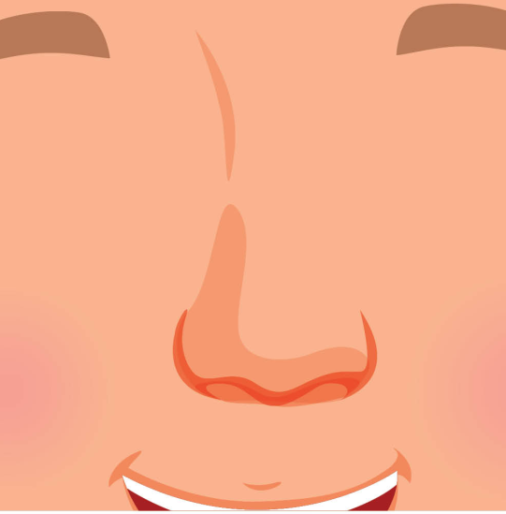
Listen to the sound and choose right answer
Notes:
THANH YEN TRAN 0967 255 149 FB Thanhyentran

Slide 27
LUCKY
CIRCLE
CLICK

Slide 28
Listen to the sound and choose right answer
Notes:
THANH YEN TRAN 0967 255 149 FB Thanhyentran

Slide 29
01
GOODBYE

Slide 30
01

