Slide 1
Unit 1
THANH YEN TRAN 0967 255 149 FB Thanhyentran
Feeling
Lesson 3

Slide 2
WARM UP
THANH YEN TRAN 0967 255 149 FB Thanhyentran

Slide 3
THANH YEN TRAN 0967 255 149 FB Thanhyentran

Slide 4
REVIEW

Slide 5
happy
fine/OK
sad
great
nut
nose
octopus
orange

Slide 6
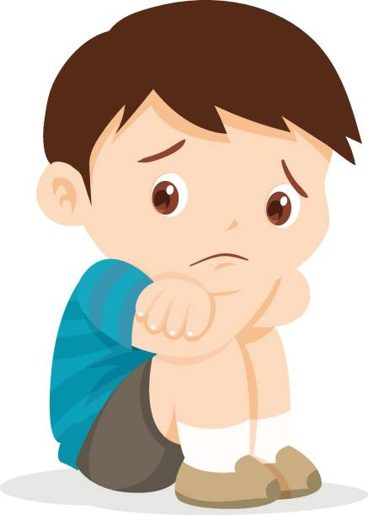
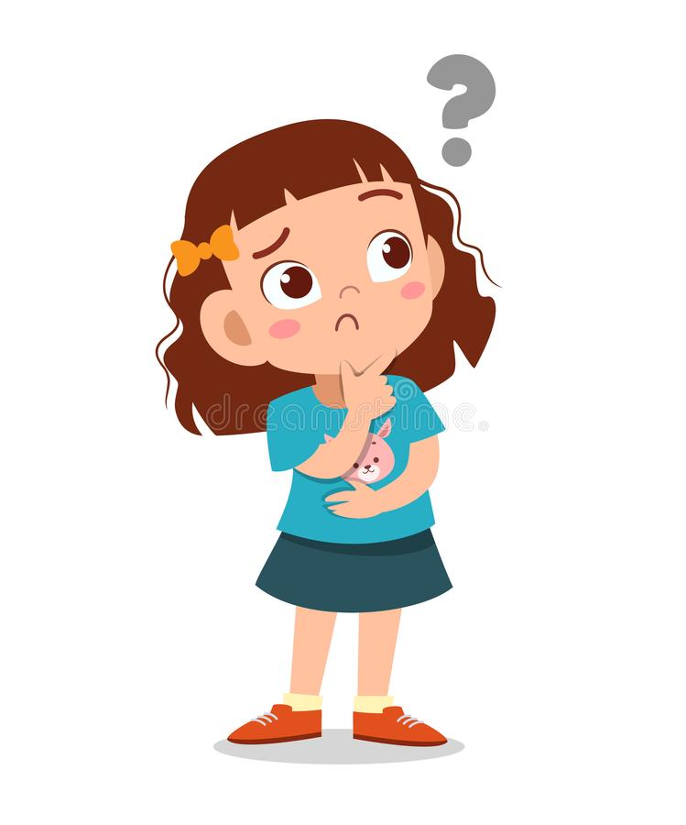
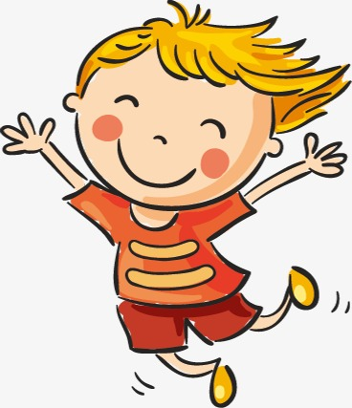
How are you?
Sing
Q
Q
I am …...
1
2
3
4

Slide 7
VOCABULARY

Slide 8
scared

Slide 9
bored

Slide 10
hungry

Slide 11
thirsty

Slide 12
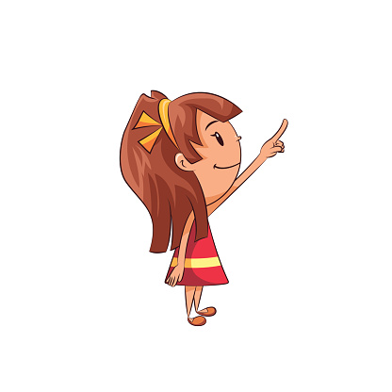
happy
scared
bored
hungry
thirsty

Slide 14
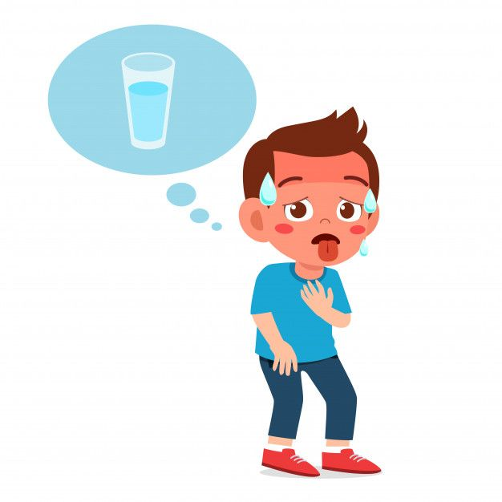
SING
This is a
Minh’s thirsty.

Slide 16
SPEAKING PRACTICE

Slide 17
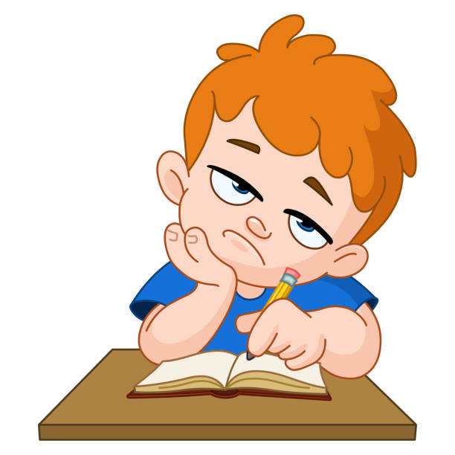
SING
This is a
Nam’s bored.

Slide 18
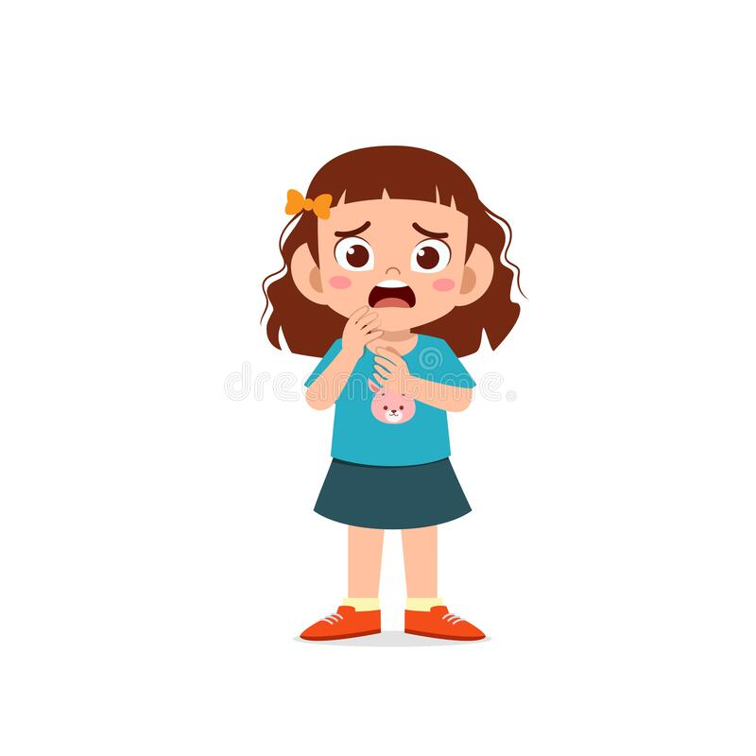
SING
This is a
Vy’s scared.

Slide 19
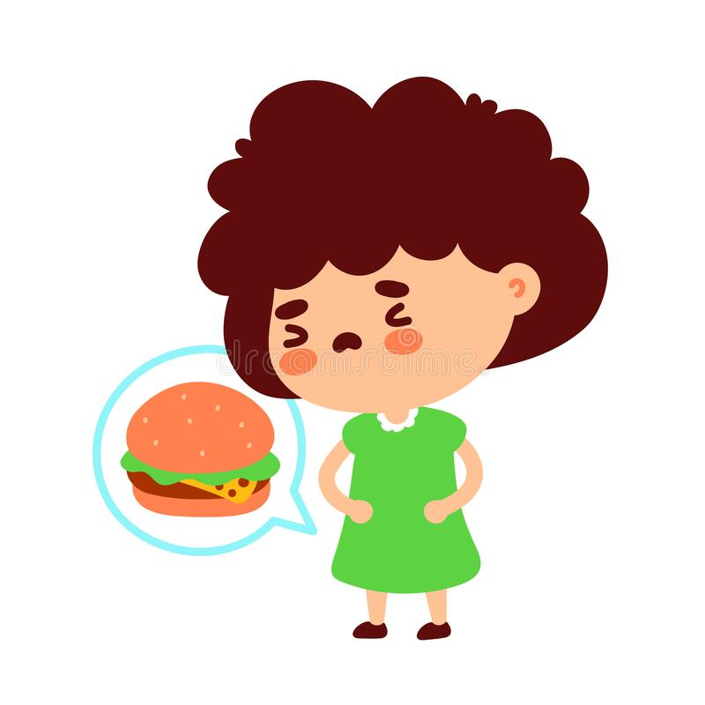
SING
This is a
Lan’s hungry.

Slide 20
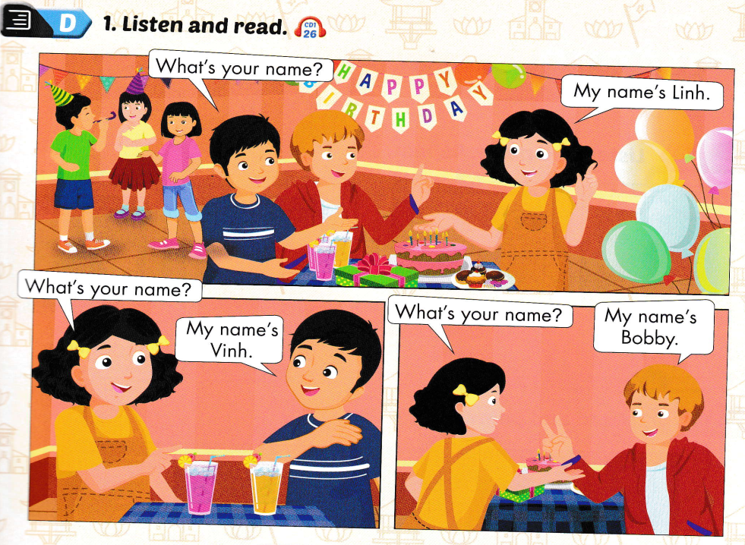
01

Slide 21
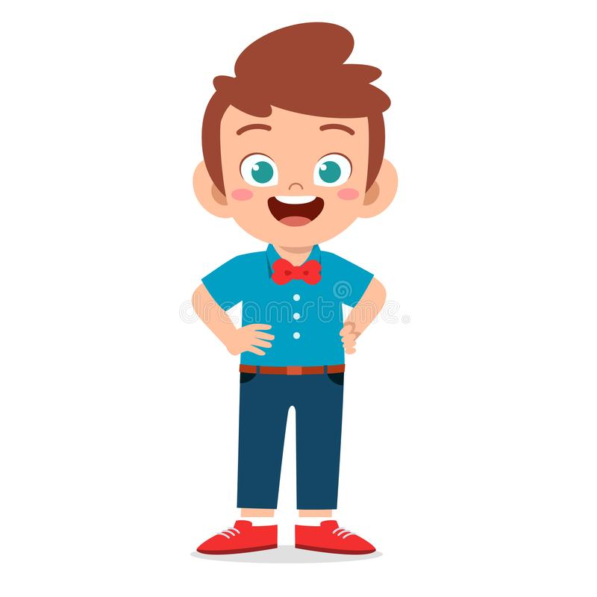
01
My name’s
Vinh.
What’s your
name ?

Slide 22
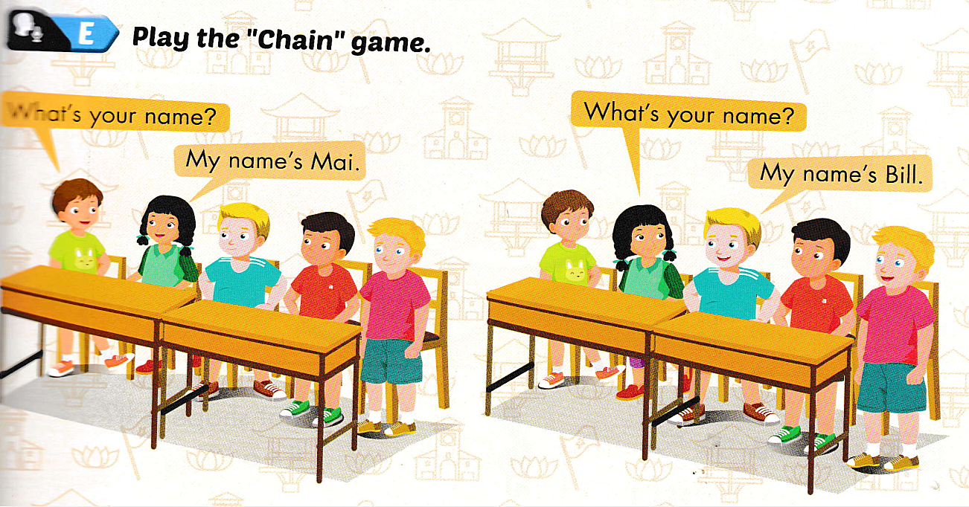
01

Slide 23
01
GAME

Slide 24
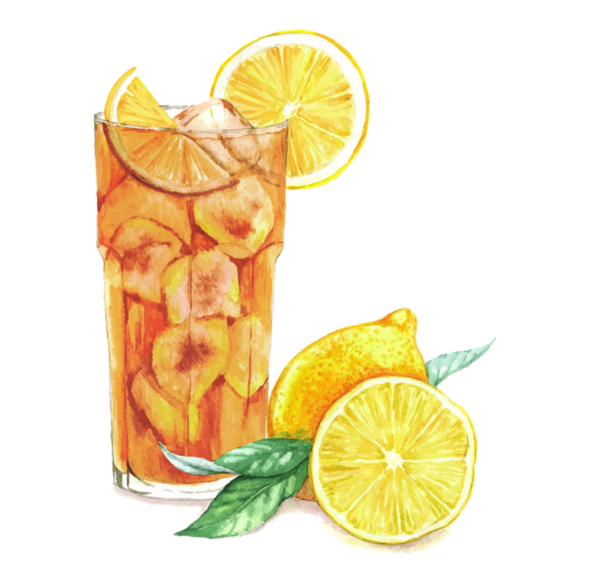
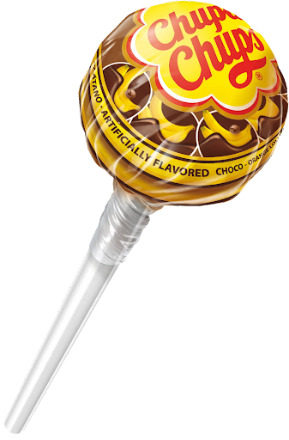
THANH YEN TRAN 0967 255 149 FB Thanhyentran
THANH YEN TRAN 0967 255 149 FB Thanhyentran

Slide 25
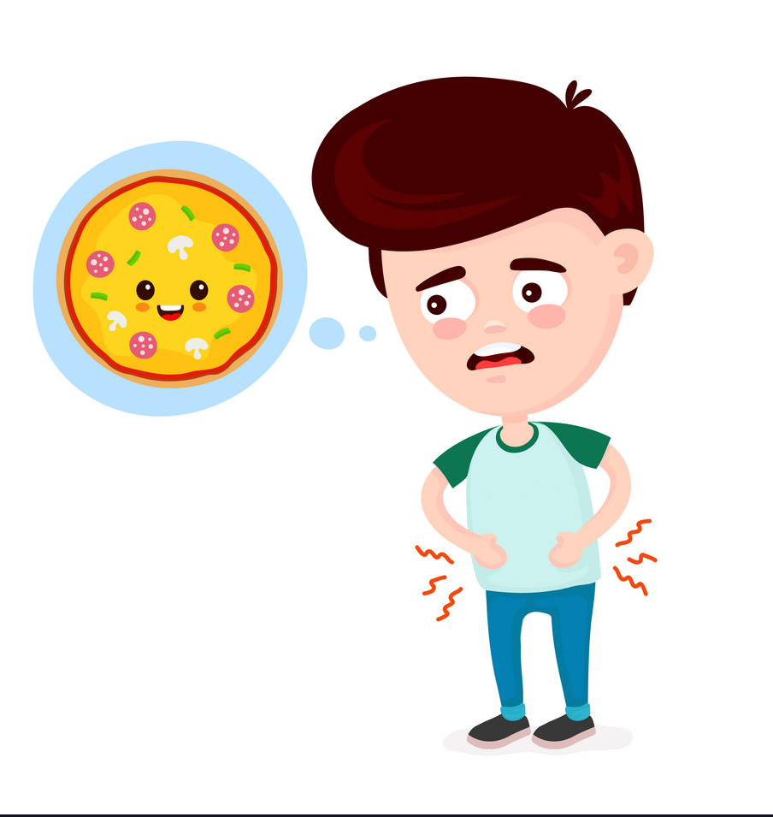
Look and choose the right answer.
hungry
thirsty
bored
scared

Slide 26
Listen and choose the right answer.
He’s thirty.
She’s hungry.
She’s thirty.
He’s hungry.

Slide 27
Look and choose the right answer.
She’s thirty.
She’s scared.
She’s hungry.
She’s bored.

Slide 28
Listen and choose the right answer.
He’s thirsty
He’s bored.
He’s hungry.
He’s happy.

Slide 29
What’s your name ?
She’s is Lan.
I’m Ok.
I’m great.
My name’s Nam.

Slide 30
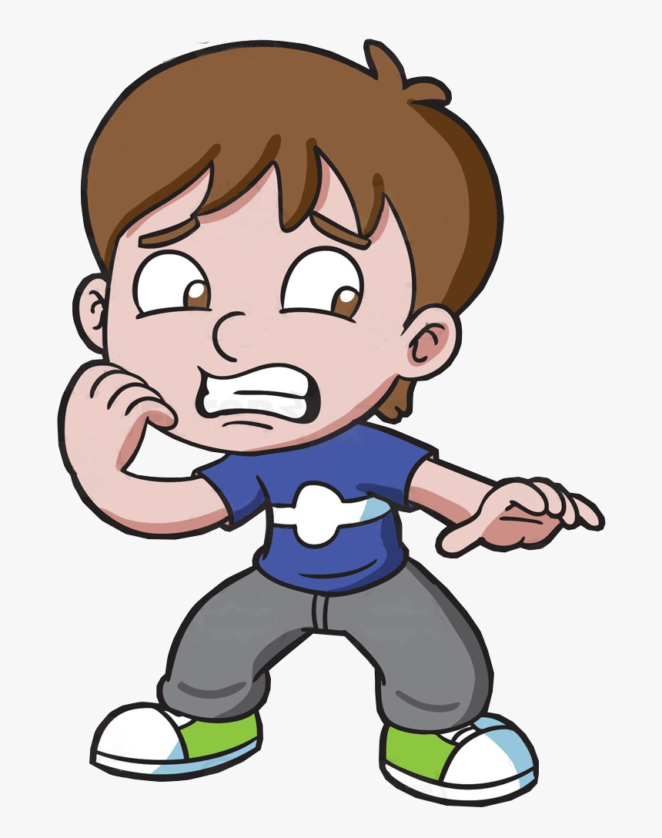
Look and choose the right answer.
Vinh is sad.
Vinh is scared.
Vinh is bored
Vinh scared is.

Slide 31
01
GOODBYE

