Slide 1
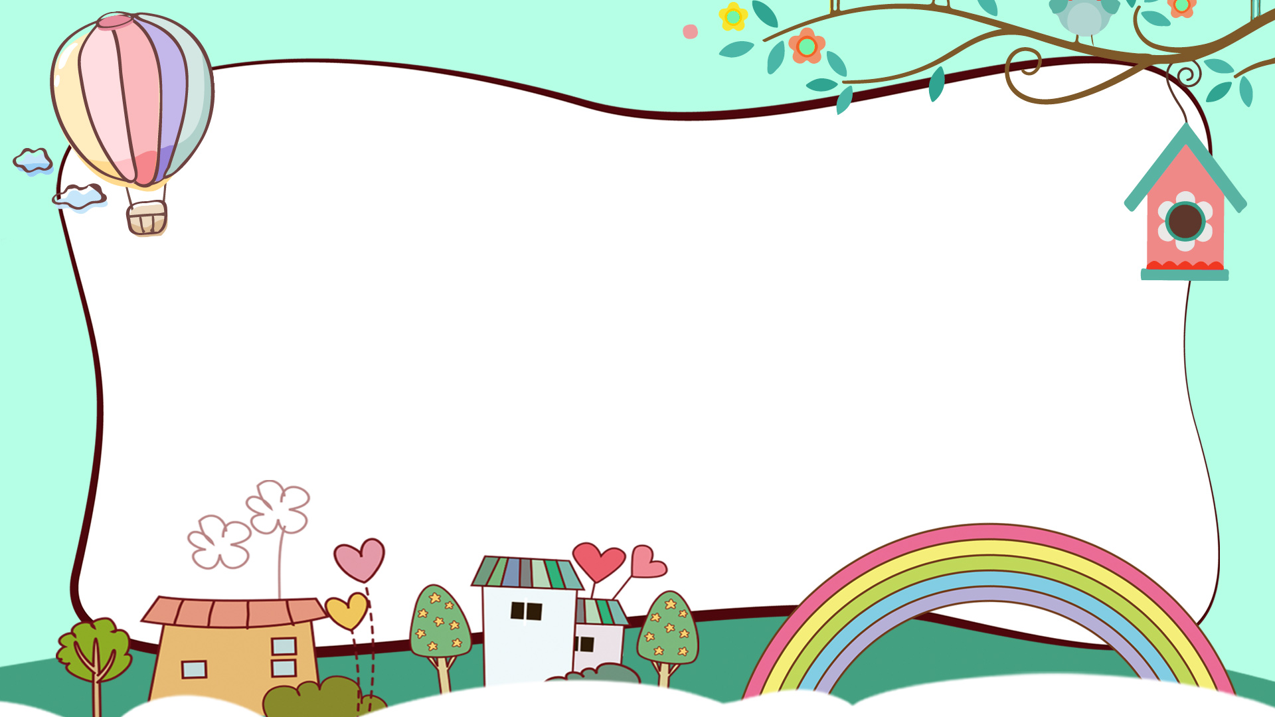

Thanh Yến Trần 0967 255 149 zalo/ FB https://www.facebook.com/thanhyentrananhngutaymy
NUMBER
Lesson 1
Notes:
Thanh Yến Trần 0967 255 149 zalo/ FB https://www.facebook.com/thanhyentrananhngutaymy

Slide 2
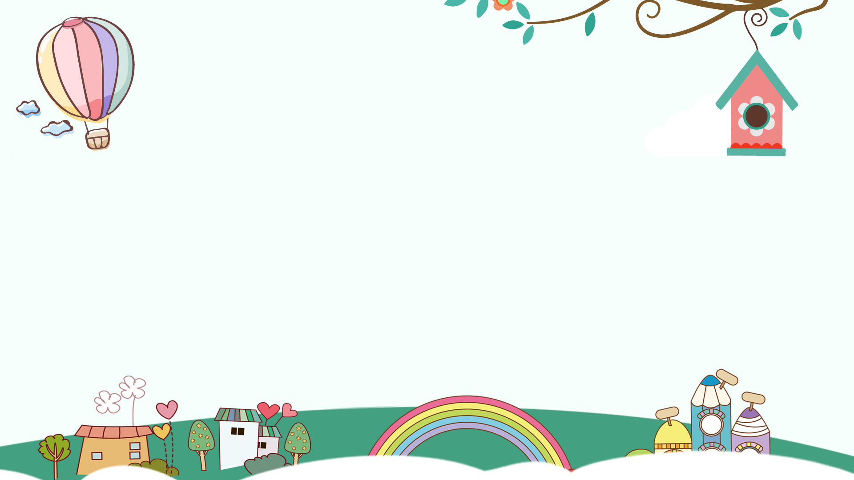
WARM UP
VOCABULARY
CONTENTS
SENTENCE
SPEAKING PRACTISE
GAME REVIEW
Notes:
Thanh Yến Trần 0967 255 149 zalo/ FB https://www.facebook.com/thanhyentrananhngutaymy

Slide 3
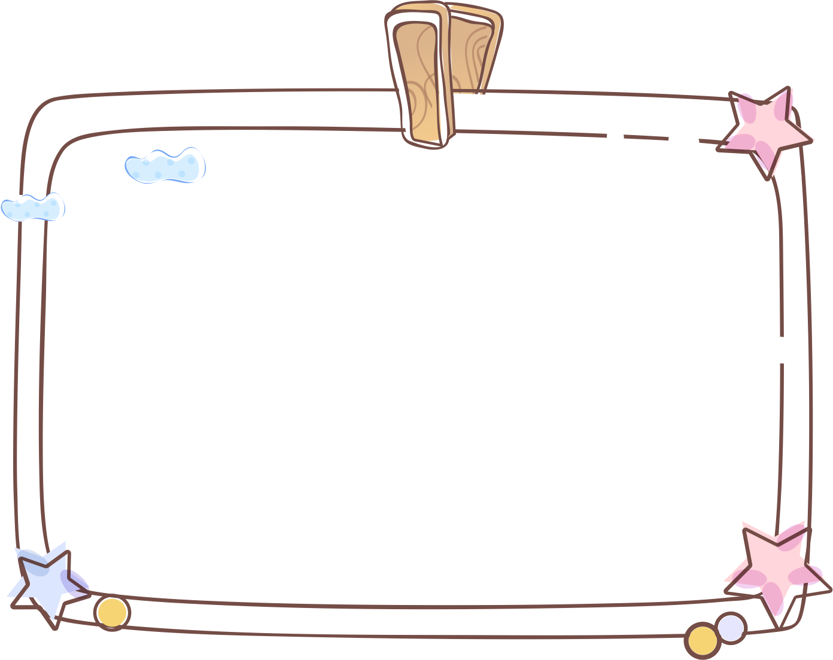
WARM UP
1

Slide 4
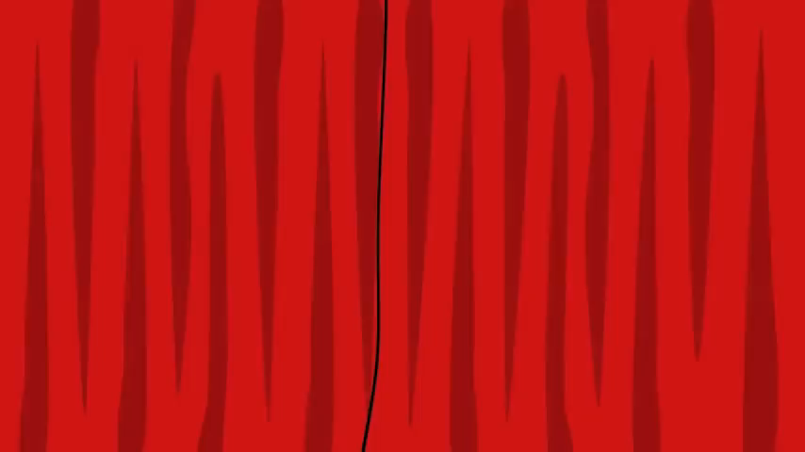
1

Slide 5
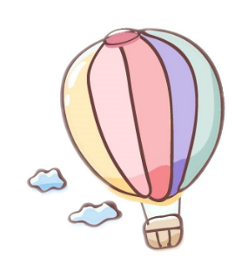


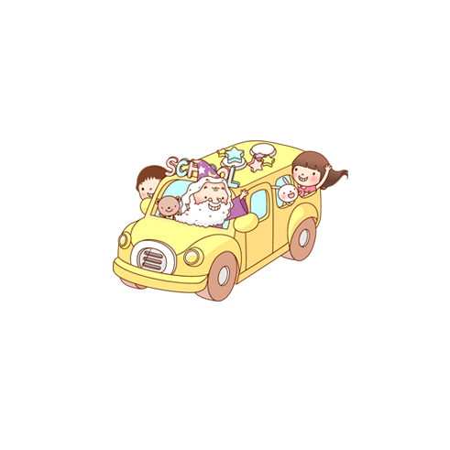
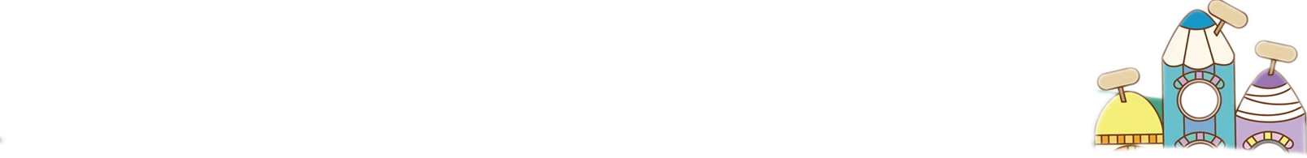

VOCABULARY

Slide 6

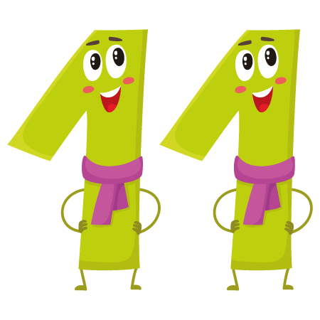
eleven

Slide 7
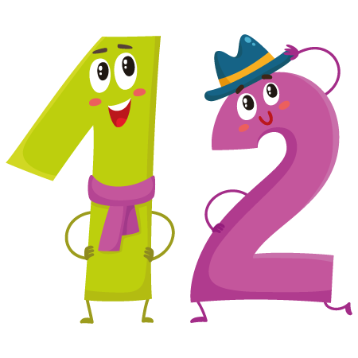
twelve

Slide 8
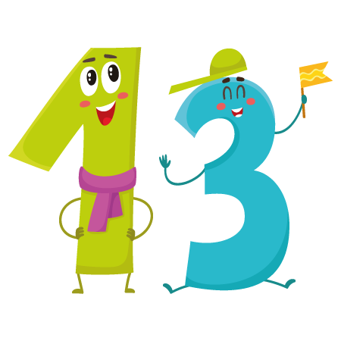
thirteen

Slide 9
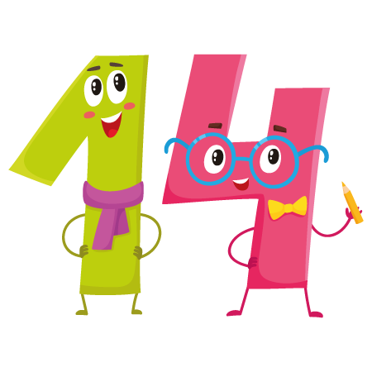
fourteen

Slide 10
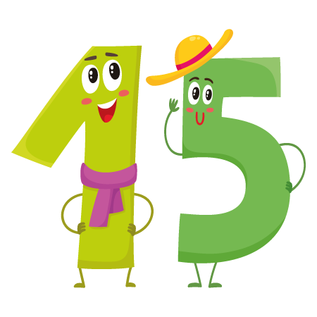
fifteen

Slide 11

eleven
twelve
thirteen
fourteen
fifteen

Slide 12


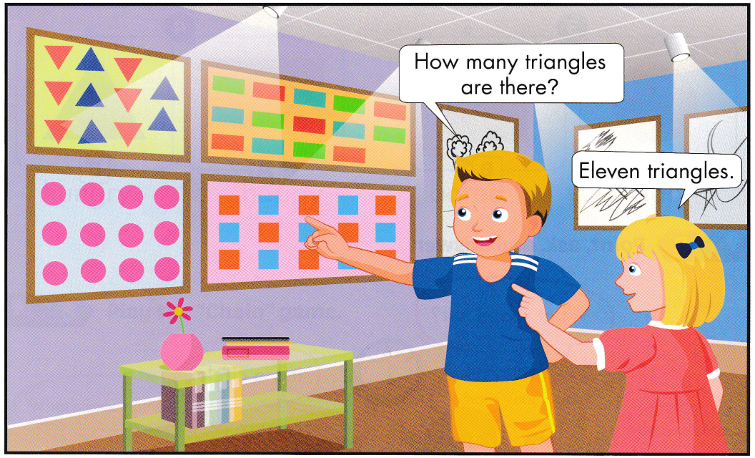
14
11
12
15

Slide 13
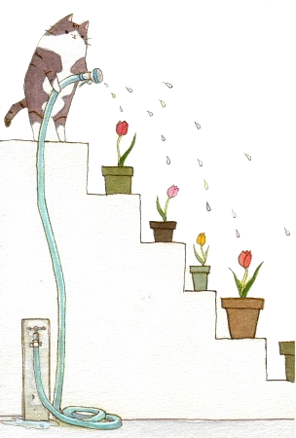
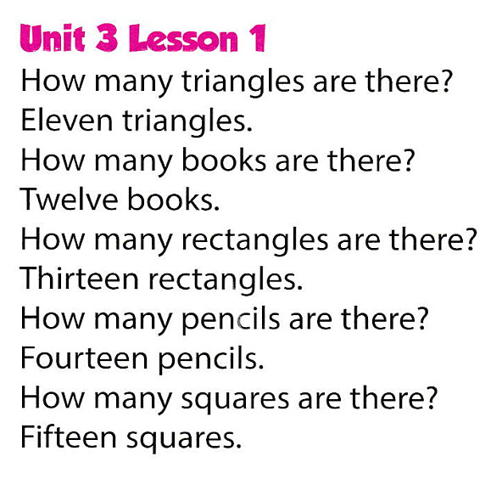
Sing

Slide 14
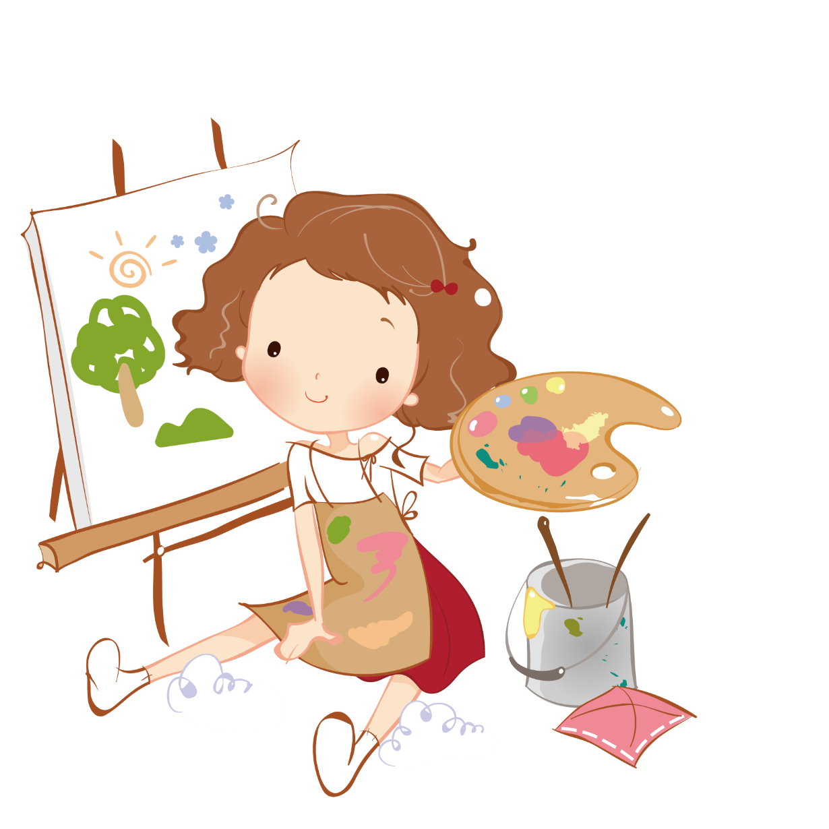
SENTENCES

Slide 15
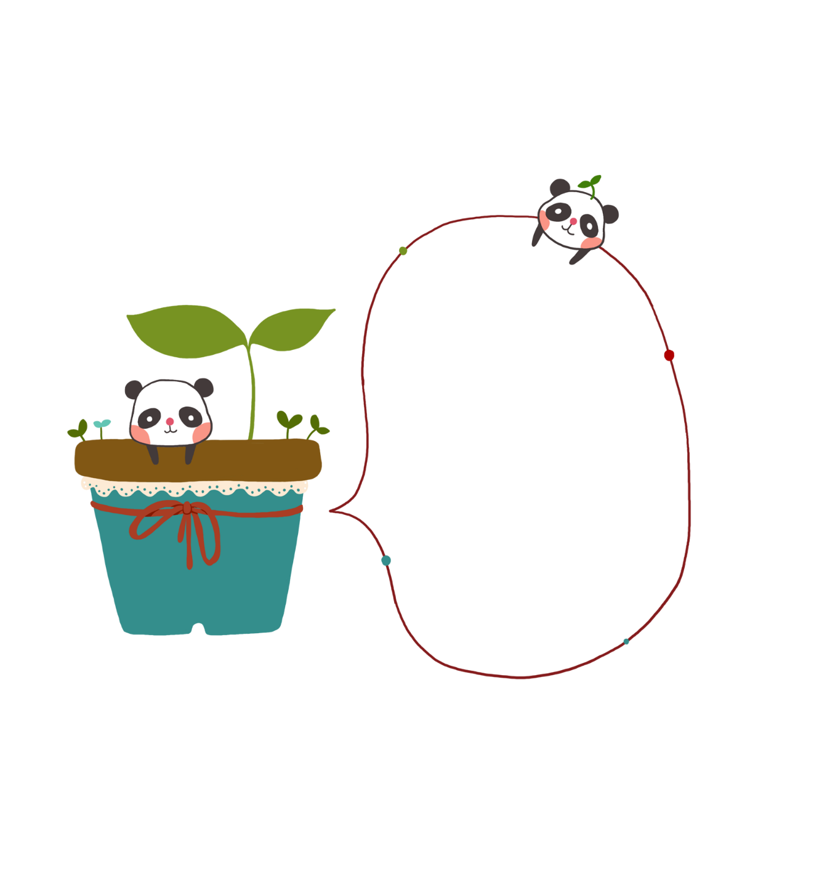

How many squares are there?
Eleven squares

Slide 16
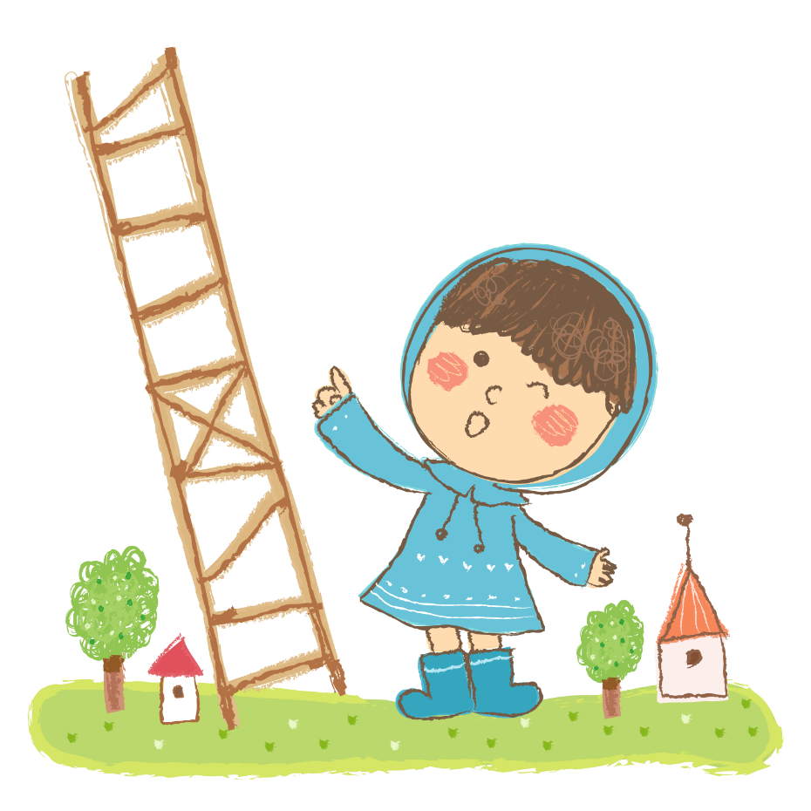
SPEAKING
PRACTISE
Notes:
Thanh Yến Trần 0967 255 149 zalo/ FB https://www.facebook.com/thanhyentrananhngutaymy

Slide 17
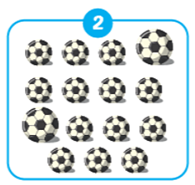

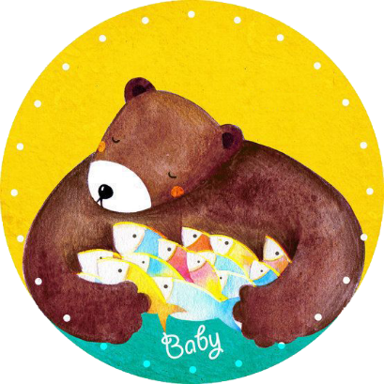
How many
balls are
there?
Fifteen
balls.
Notes:
Thanh Yến Trần 0967 255 149 zalo/ FB https://www.facebook.com/thanhyentrananhngutaymy

Slide 18
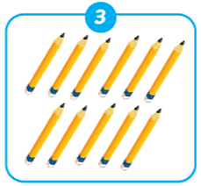
How many
pencils are
there?
Eleven
pencils.

Slide 19
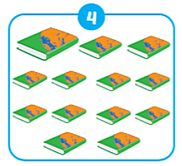
How many
books are
there?
Thirteen
books.

Slide 20
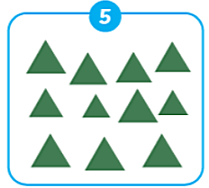
How many
triangles are
there?
Eleven
triangles.

Slide 21
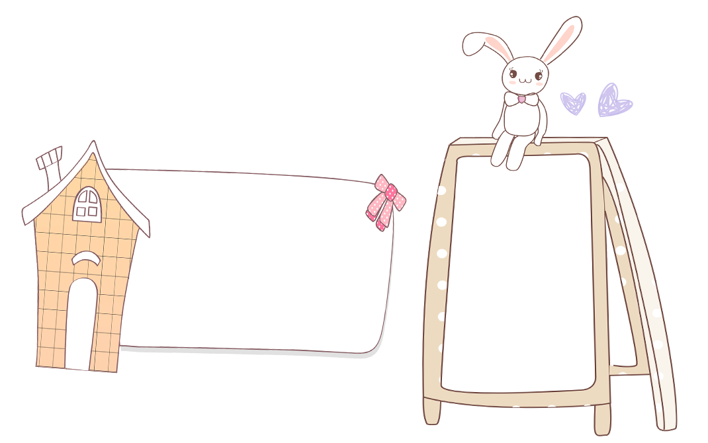
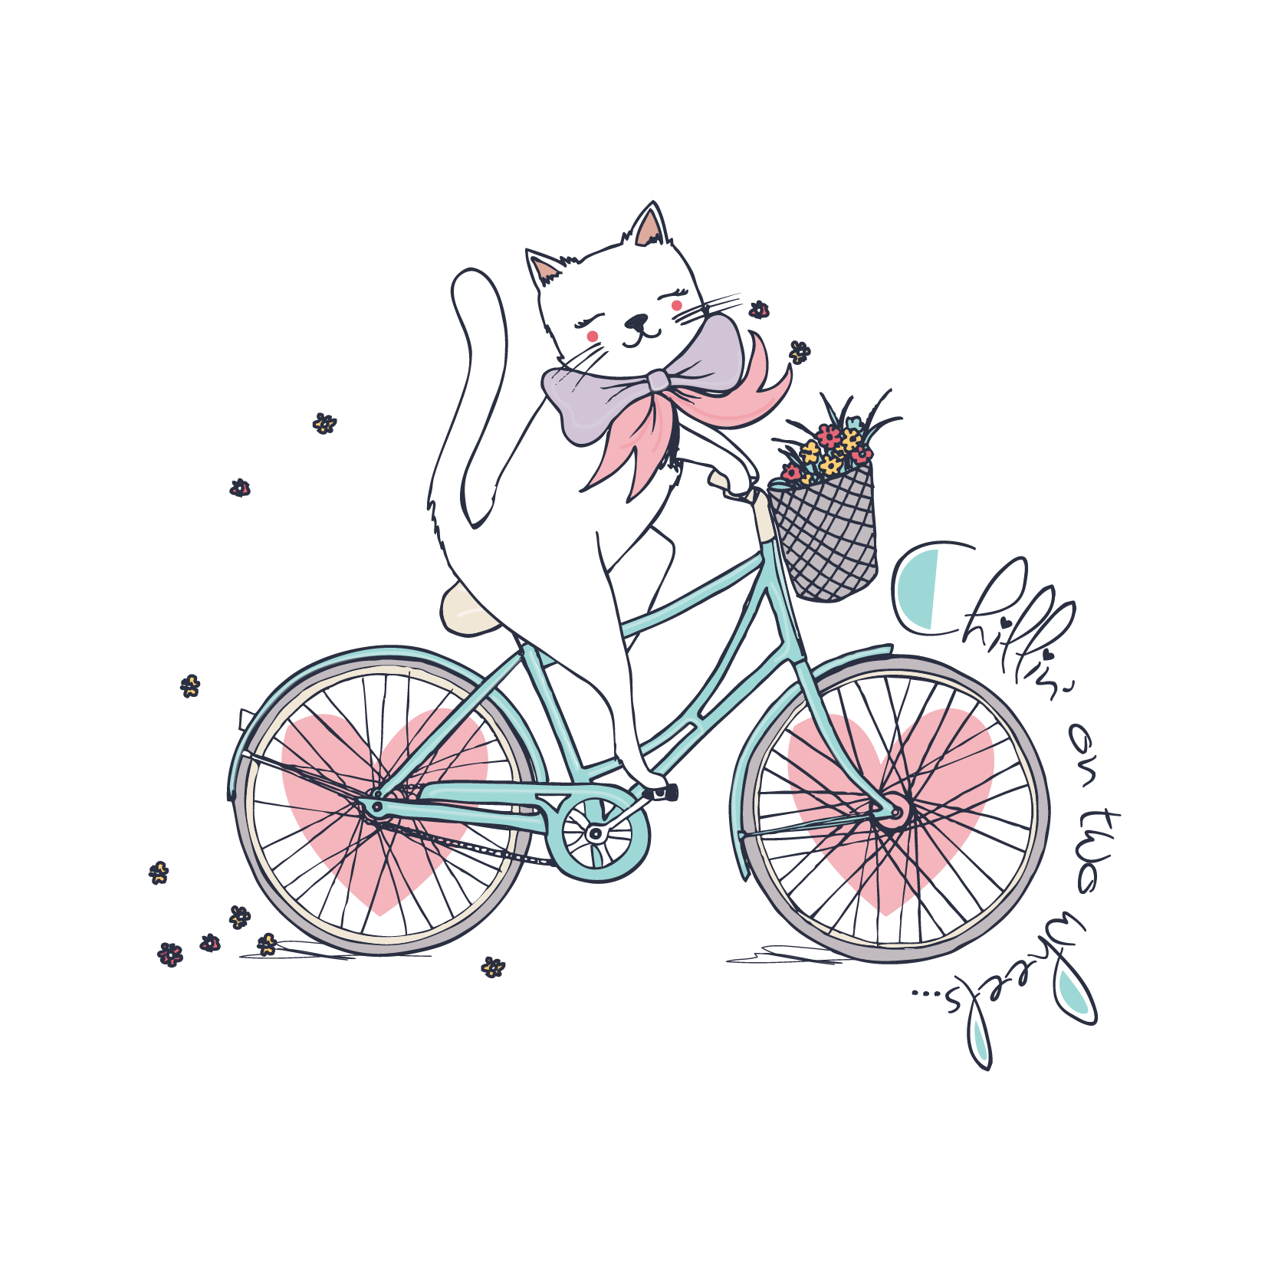
GAME

Slide 22














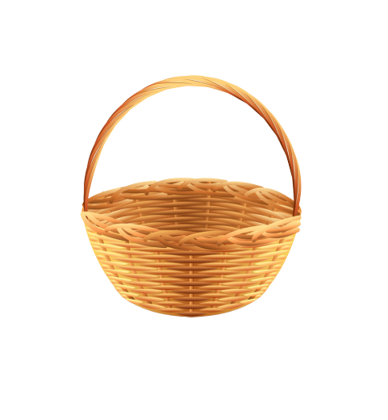
Apple
Picking

Slide 23
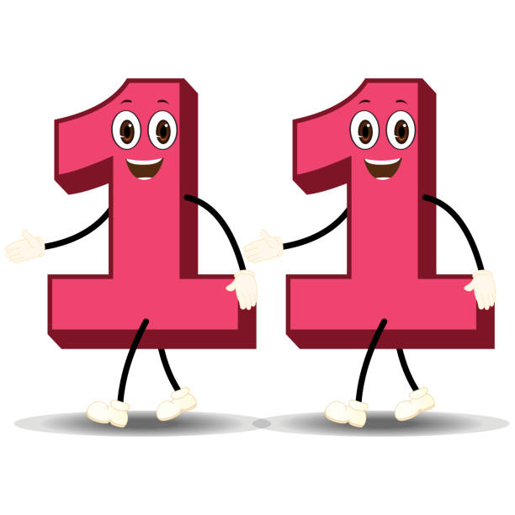

twelve
A
eleven
B
thirteen
What number is it ?
C

Slide 24
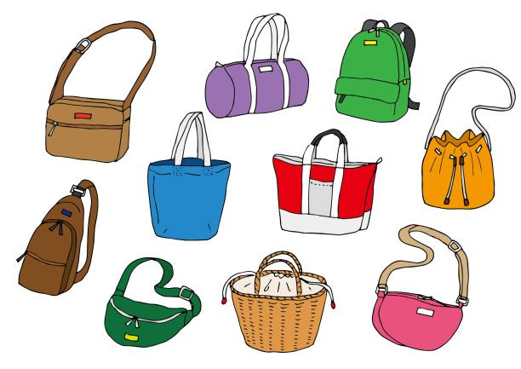
11
A
12
B
10
C

Slide 25
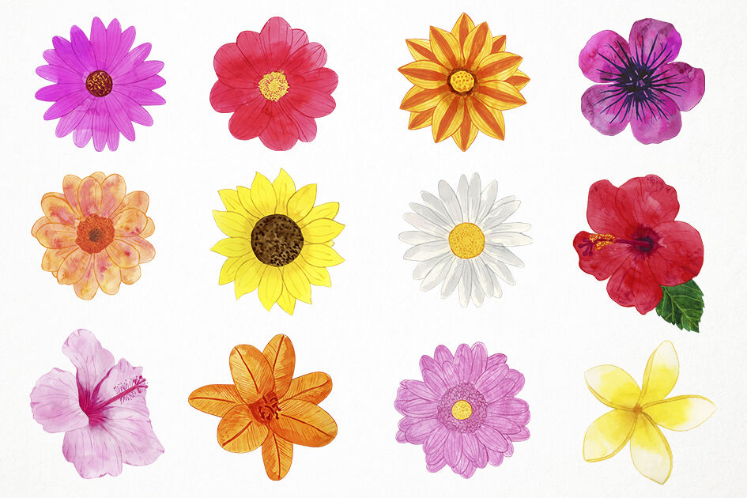
twelve
A
fourteen
B
thirteen
How many flowers are there?
C

Slide 26

fourteen
A
thirteen
B
fifteen
How many circle are there?
C

Slide 27


Ten books
A
Thirteen books
B
Twelve books
C

Slide 28
How there many
queens are?
A
How/ there/ many /queens/ are?
How many
there queens are ?
B
How many
queens are there?
C

Slide 29
How there many
bags are there?
A
Listen and choose correct
sentence
How there many
books are there?
B
How there many
pens are there?
C

Slide 30
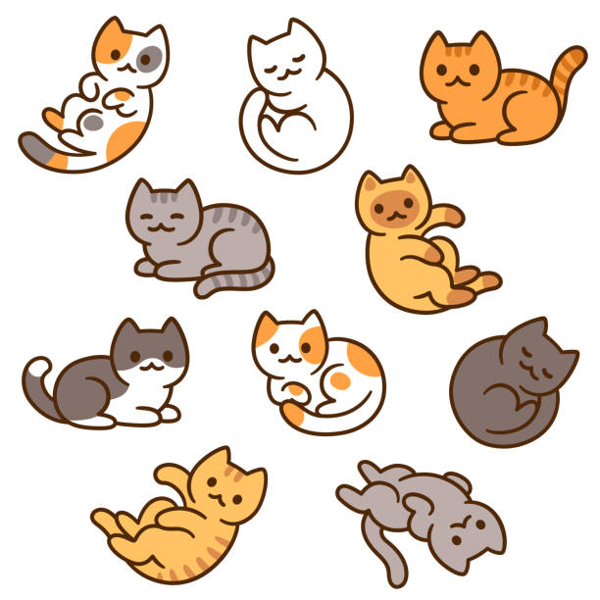
Ten cats
A
Eleven cats
B
Twelve cats
C

Slide 31
GOODBYE

