Slide 1

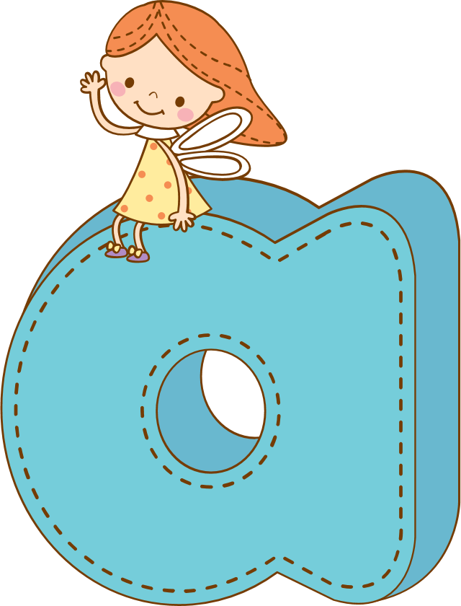
Thanh Yên Trần 0967 255 149 zalo/ FB https://www.facebook.com/thanhyentrananhngutaymy
THEME3
phonic

Slide 2
Warm Up

Slide 3


Slide 4
Review

Slide 5
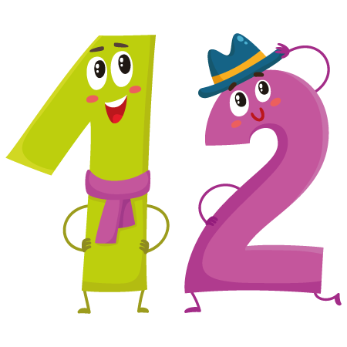




eleven
twelve
thirteen
fourteen
fifteen

Slide 6


fourteen
balls.
How many
balls are
there?

Slide 7
Phonic

Slide 8



a

Slide 9




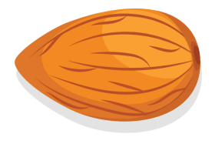
a

Slide 10

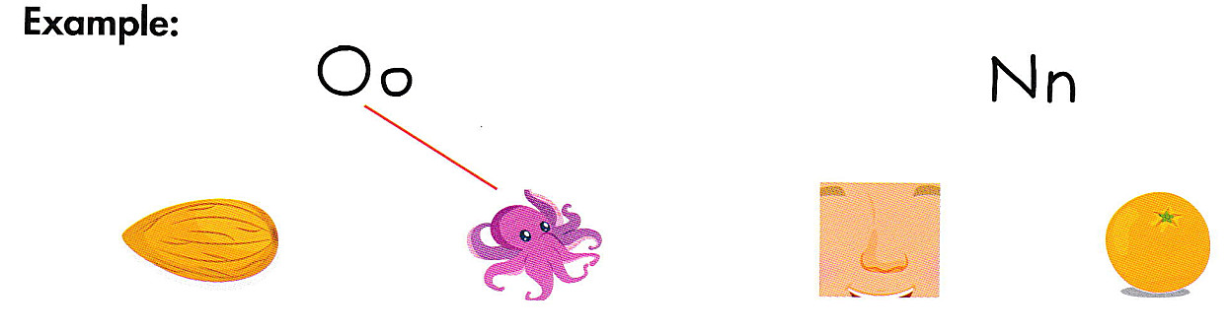
a

Slide 11



a

Slide 12


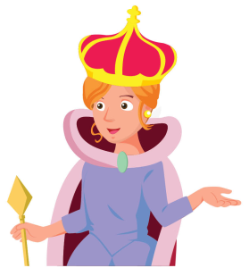


a

Slide 13


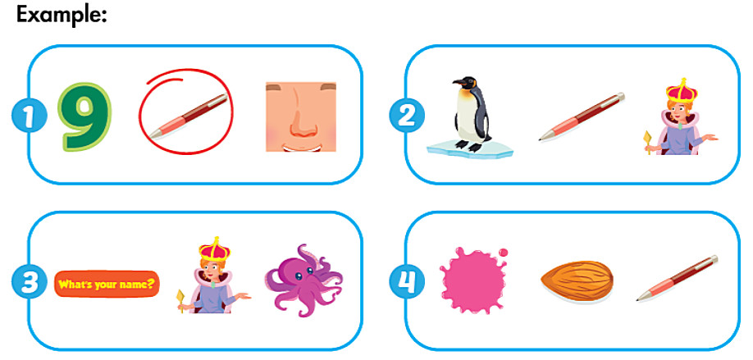
a

Slide 14
GAME
Open sildes game
Notes:
Thanh Yên Trần 0967 255 149 zalo/ FB https://www.facebook.com/thanhyentrananhngutaymy

Slide 15
GOODBYE

