Slide 1
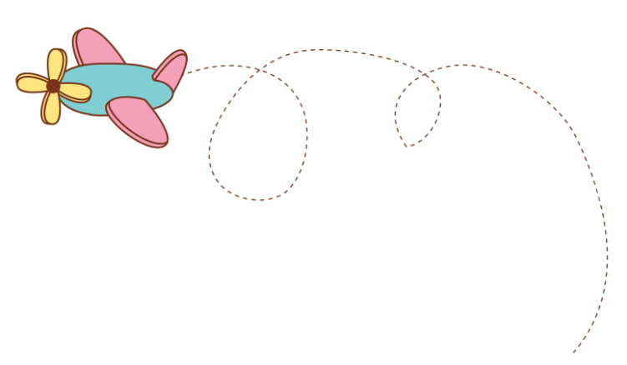










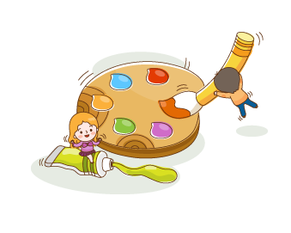
Thanh Yến Trần 0967 255 149 zalo/ FB https://www.facebook.com/thanhyentrananhngutaymy
Theme 3
NUMBER
Lesson 1
Notes:
Thanh Yến Trần 0967 255 149 zalo/ FB https://www.facebook.com/thanhyentrananhngutaymy

Slide 2
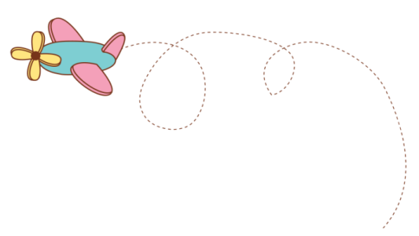
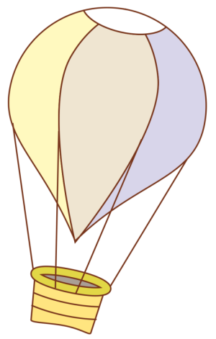

WARM UP
REVIEW
CONTENTS
NEW LESSON
GAME

Slide 3



WARM UP
Notes:
更多模板123图文旗舰店：666

Slide 4

Notes:
更多模板123图文旗舰店：666

Slide 5



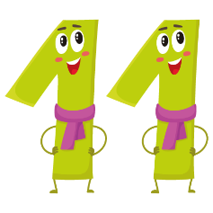


eleven
twelve
thirteen
fourteen
fifteen
Notes:
更多模板123图文旗舰店：666

Slide 6


How many
balls are
there?
fourteen
balls.

Slide 7
VOCABULARY
Notes:
更多模板123图文旗舰店：666

Slide 8

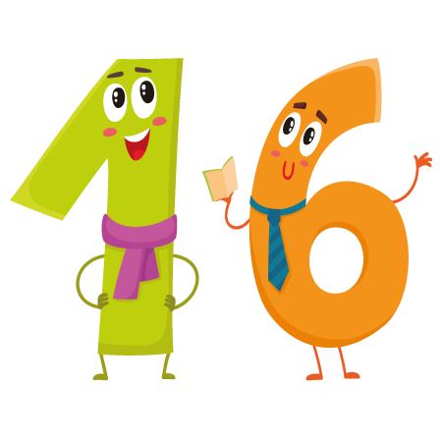
sixteen

Slide 9

seventeen

Slide 10

eighteen

Slide 11

nineteen

Slide 12

twenty

Slide 13

seventeen
eighteen
sixteen
nineteen
twenty

Slide 14

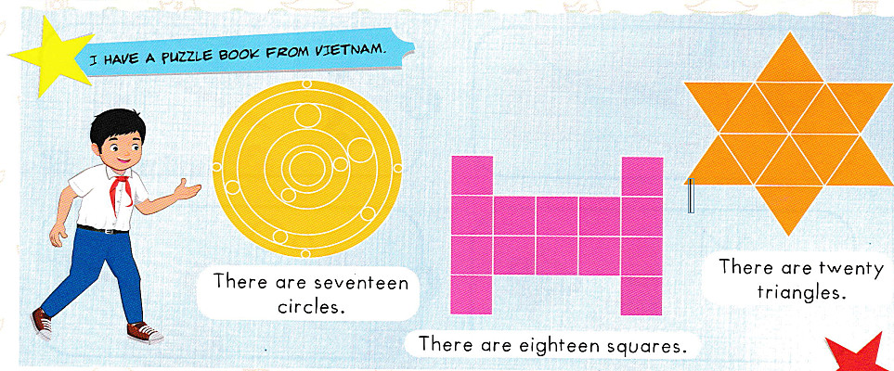

Slide 15

There are sixteen triangles.
Notes:
更多模板123图文旗舰店：666

Slide 16
STORY
Notes:
更多模板123图文旗舰店：666

Slide 17

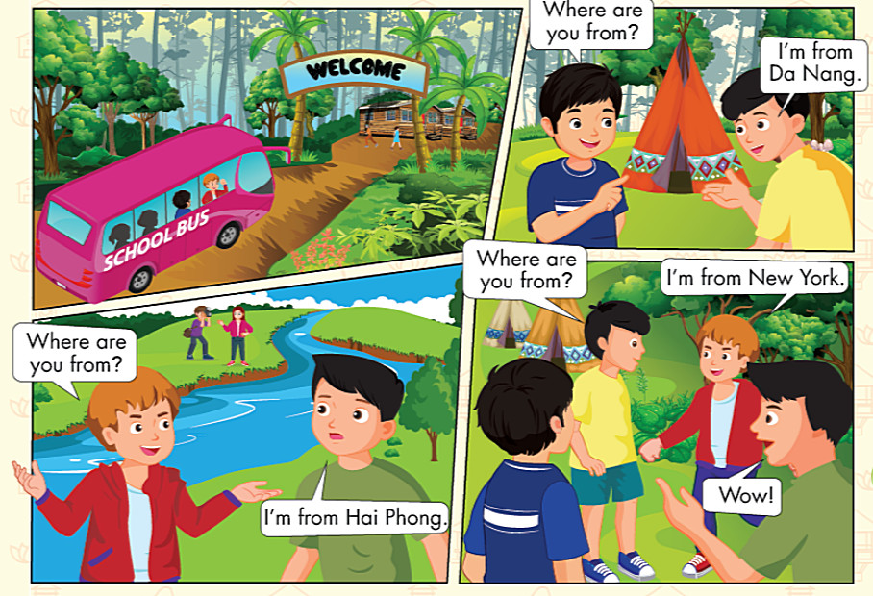
Notes:
更多模板123图文旗舰店：666

Slide 18
SENTENCE
Notes:
更多模板123图文旗舰店：666

Slide 19
Where are you from?
I’m from………

Slide 20



Where are
you from?
I’m from
Ha Noi.

Slide 21


Where are
you from?
I’m from
Hai Phong.

Slide 22


Where are
you from?
I’m from
Nha Trang

Slide 23


Where are
you from?
I’m from
Da Nang.

Slide 24

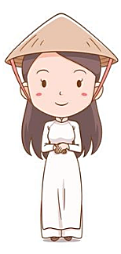
Where are
you from?
I’m from
Hue.

Slide 25


I’m from
Ho Chi Minh city.
Where are
you from?

Slide 26


Where are
you from?
I’m from
Dalat.

Slide 27








FEEDING GOLDFISH
Mỗi câu trả lời đúng là
CÂU THẦN CHÚ giúp cá Vàng
ngoi lên mặt nước nhận thức ăn.
Nào chúng mình cùng giúp
bạn nhỏ cho cá Vàng ăn nhé!
START

Slide 28

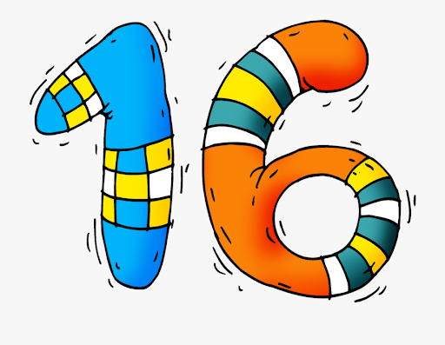


Next
seventeen.
sixteen.
eighteen.

Slide 29

Where are you from?
Next
I’m from Hue.
I’m from Hai Phong.
I’m from Da Nang.

Slide 30
Listen and choose
Next
19.
20.
18.

Slide 31
Where are you from?
Next
I'm from Ha Noi.
I'm from Da Lat.
I'm from Da Nang.

Slide 32

Next
am/ I/ Ho/ Minh/ city/ Chi
I am from Ho Chi Minh city
I am Ho Chi Minh city from
I Ho am Chi Minh city from

Slide 33
Next
seventeen
eighteen
sixteen

Slide 34


Where are you from?
Next

Slide 35

Next
Notes:
.

Slide 36
Next
I’m from………………
Ha noi
Da Nang
Da Lat

Slide 37
THANK YOU!
Next
Notes:
.

Slide 38
GOOD BYE

