Slide 1
Unit 2 Our names
Lesson 1.2
Thanh Yến Trần 0967 255 149 zalo/ FB https://www.facebook.com/thanhyentrananhngutaymy/
Notes:
Thanh Yến Trần 0967 255 149 zalo/ FB https://www.facebook.com/thanhyentrananhngutaymy/

Slide 2
Warm-up

Slide 3
BALLOONS
GAMES
START
Notes:
Thanh Yến Trần 0967 255 149 zalo/ FB https://www.facebook.com/thanhyentrananhngutaymy/

Slide 4
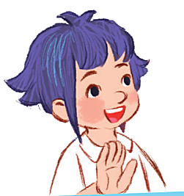
My name is Minh
My name is Linh
My name is Mary
Look and
choose
Notes:
Thanh Yến Trần 0967 255 149 zalo/ FB https://www.facebook.com/thanhyentrananhngutaymy/

Slide 5
Lucy
Tony
Mary
My name is ………..
Notes:
Thanh Yến Trần 0967 255 149 zalo/ FB https://www.facebook.com/thanhyentrananhngutaymy/

Slide 6
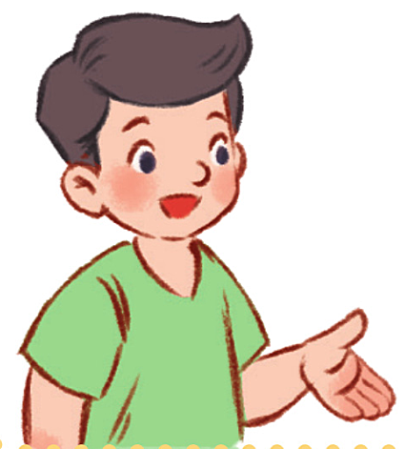
What is you name?
What your name?
What’s your name?
Look and
choose
Notes:
Thanh Yến Trần 0967 255 149 zalo/ FB https://www.facebook.com/thanhyentrananhngutaymy/

Slide 7
My name is Lucy
My is name Lucy
Lucy is name my
Reorder the words:
name – Lucy- My - is
Notes:
Thanh Yến Trần 0967 255 149 zalo/ FB https://www.facebook.com/thanhyentrananhngutaymy/

Slide 8
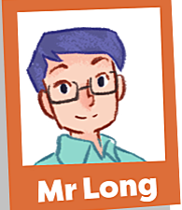
Mr Long
Mr Log
Mr Loc
My name is ……..

Slide 9
is
What’s
your
Find redundant word:
What’s is your name?

Slide 10
my
name
it
Find the mistake in sentence:
My name it Mai.

Slide 11
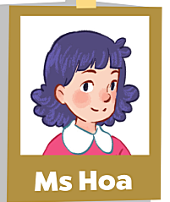
Ms Hoa
Ms Ha
Mr Hoa
My name is ………..

Slide 12
Listening and reading

Slide 13
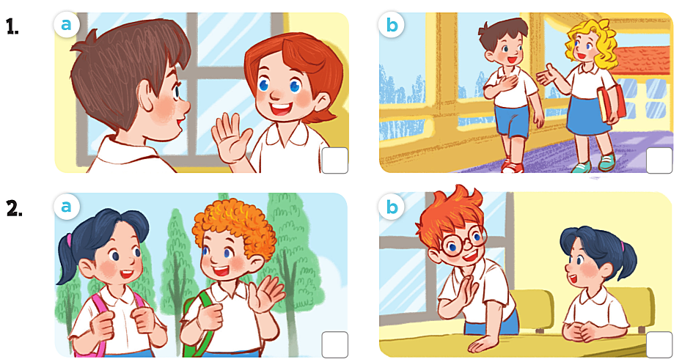
1.Minh: Hi, I’m Minh. What’s your name?
Mary: Hello, Minh. My name’s Mary.
1.Mai: Hi. I’m Mai. What’s your name?
Bill: Hello, Mai. My name’s Bill.

Slide 14
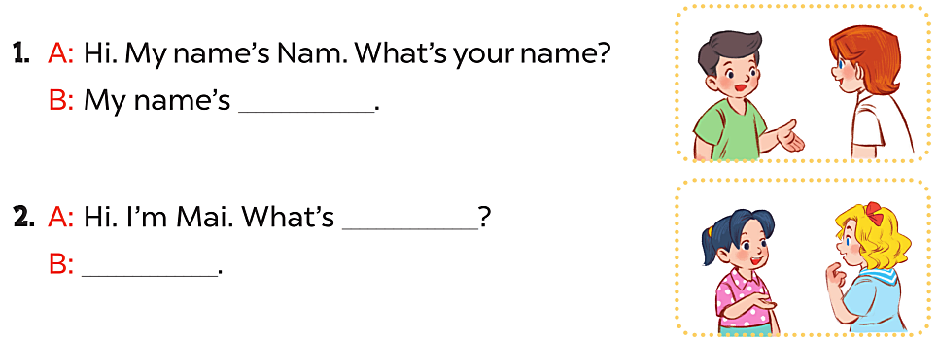
Lucy
your name?
My name’s Mary.

Slide 15
