Slide 1
Thanh Yến Trần 0967 255 149 zalo/ FB https://www.facebook.com/thanhyentrananhngutaymy/
UNIT 6
OUR SCHOOL
Lesson 2 – Period 3
Notes:
Thanh Yến Trần 0967 255 149 zalo/ FB https://www.facebook.com/thanhyentrananhngutaymy/

Slide 2
REVIEW

Slide 3

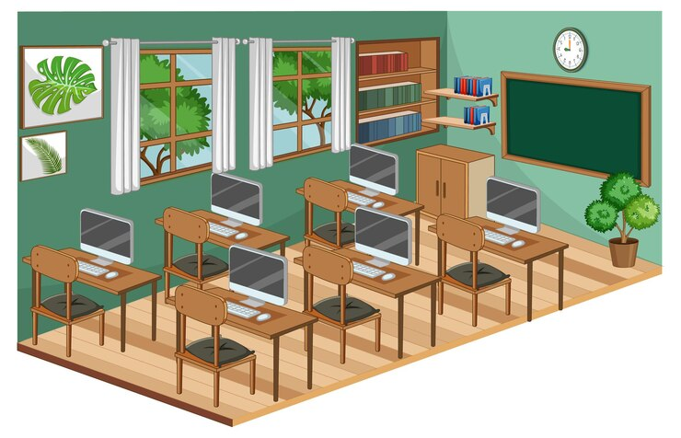
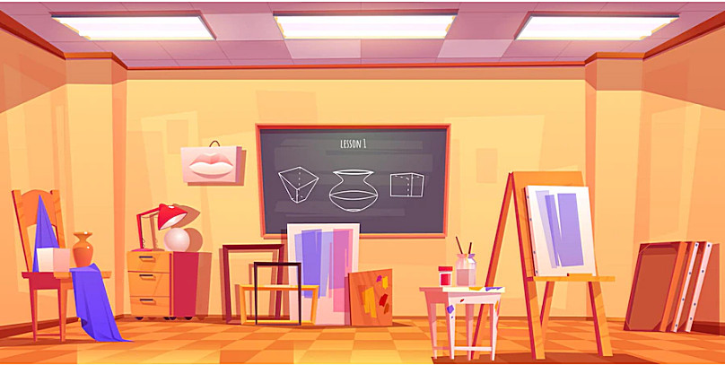
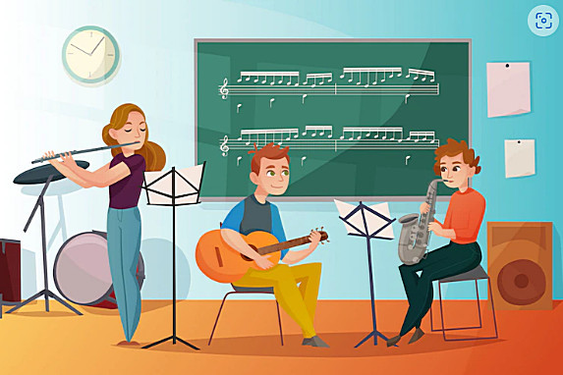
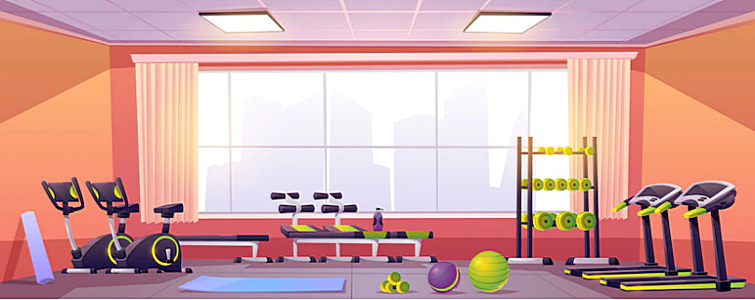
Click to picture to hear the sound
computer room
art room
music room
gym

Slide 4

Let’s go to the ………
OK, let’s go.

Slide 5
WARM UP

Slide 6



QUIZ

Slide 7


Select the Correct
Word
music
room
gym
school

Slide 8
Select the Correct
Word
gym
computer room
class room

Slide 9


Select the Correct
picture

Slide 10


Select the Correct
answer
All are correct

Slide 11
Select the Correct
sentence
Let’s go to the gym.
Let’s go to the classroom.
Let’s go to the computer room.

Slide 12

Select the Correct
word
lribary
lirbary
library

Slide 13

Select the Correct
word
we
us
is

Slide 14


Select the Correct
Word
playground
groundplay
playgruond

Slide 15

Select the Correct
letters
a - o
o –a
o - o

Slide 16
Select the Correct
Word
gym
computer room
class room

Slide 17
Listening
Reading

Slide 18
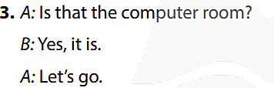

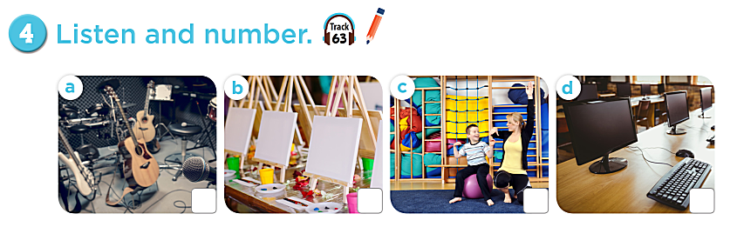



4
2
1
3

Slide 19
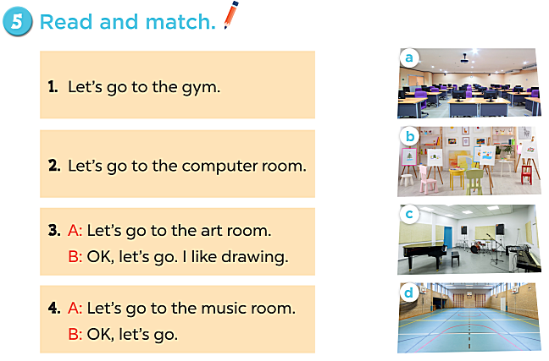


Slide 20
Class activity

Slide 21
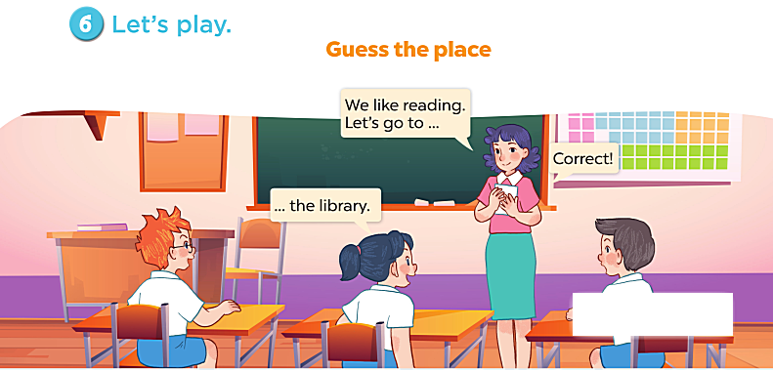

Slide 22


