Slide 1
UNIT 6 OUR SCHOOL
Thanh Yến Trần 0967 255 149 zalo/ FB https://www.facebook.com/thanhyentrananhngutaymy/
Lessson 3.2
Notes:
Thanh Yến Trần 0967 255 149 zalo/ FB https://www.facebook.com/thanhyentrananhngutaymy/

Slide 2
Contents
01
02
03
WARM UP
NEW LESSON
GAME TIME

Slide 3
01
Warm Up

Slide 5
02
New Lesson

Slide 6
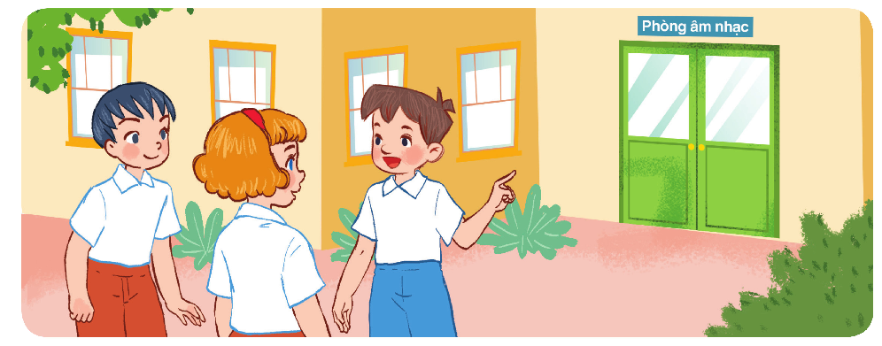
classroom
art
go
our

Slide 8
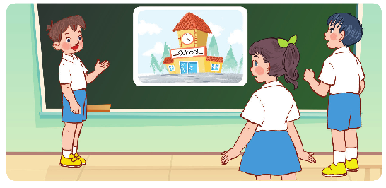

Slide 9
03
Game Time

Slide 10
review quiz

Slide 11
Question 1
Where you can find these things.
computer room
gym
music room
Oh no!
Correct
Next question
Try Again

Slide 12
Question 2
We can read books in this room.
library
gym
music room
Oh no!
Correct
Next question
Try Again

Slide 13
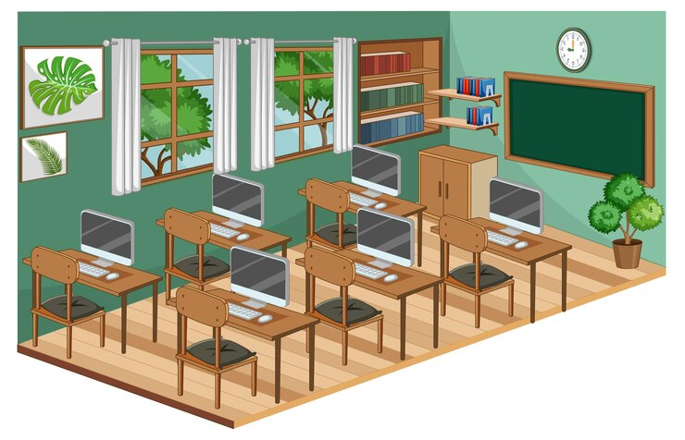
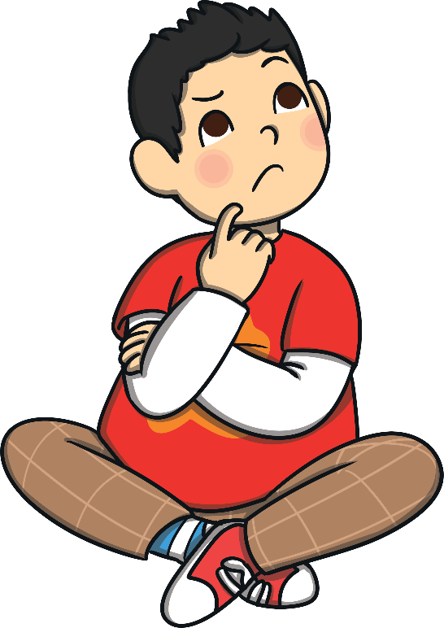
Question 3
Is this a computer room?
Yes, it isn't.
No, it isn't.
Yes, it is.
Correct
Next question
Oh no!
Try Again

Slide 14
Question 4
art/ Let's/ to/ the/ go/ room.
Let's go the to art room.
Oh no!
Correct
Next question
Try Again
Let's go to the room art.
Let's go to the art room.

Slide 15
Question 4
We can meet our teachers and friends here.
school
kitchen
house
Oh no!
Correct
Next question
Try Again

Slide 16
Question 5
Which is the missing letter of this word? __assroom
cl
pl
sc
Oh no!
Correct
Next question
Try Again

Slide 17
Question 6
We can do excercise in this room.
^{music}
school
gym
Oh no!
Correct
Next question
Try Again

Slide 18
Question 7
Which is the missing letter of this word? __ayground
qu
cl
pl
Oh no!
Correct
Next question
Try Again

Slide 19
Question 8
I can draw pictures in this room. Which room is it?
art room
math room
music room
Oh no!
Correct
Next question
Try Again

Slide 20
Question 9
I can sing, play the piano or the guitar in this room? Which room is it?
music room
art room
computer room
Oh no!
Correct
Next question
Try Again

Slide 21
Question 9
o l o s h c
What place is it?
^{library}
^{school}
^{gym}
Oh no!
Correct
Next question
Try Again

Slide 22
Question10
Which room can you hear?
Oh no!
Correct
Next question
Try Again

Slide 23
GOOD BYE

