Slide 1
UNIT 8 My School Things
Thanh Yến Trần 0967 255 149 zalo/ FB https://www.facebook.com/thanhyentrananhngutaymy/
LESSON 1.1
Notes:
Thanh Yến Trần 0967 255 149 zalo/ FB https://www.facebook.com/thanhyentrananhngutaymy/

Slide 2
Table of contents
01
02
Warm up
Vocabulary
03
04
Game Time
Sentence
05
Activy Class

Slide 3
01. Warm Up

Slide 4
Contents of this template
Here’s what you’ll find in this Slidesgo template:
A slide structure based on a multi-purpose presentation, which you can easily adapt to your needs. For more info on how to edit the template, please visit Slidesgo School or read our FAQs.
An assortment of illustrations that are suitable for use in the presentation can be found in the alternative resources slide.
A thanks slide, which you must keep so that proper credits for our design are given.
A resources slide, where you’ll find links to all the elements used in the template.
Instructions for use.
Final slides with:
The fonts and colors used in the template.
A selection of illustrations. You can also customize and animate them as you wish with the online editor. Visit Stories by Freepik to find more.
More infographic resources, whose size and color can be edited.
Sets of customizable icons of the following themes: general, business, avatar, creative process, education, help & support, medical, nature, performing arts, SEO & marketing, and teamwork.
You can delete this slide when you’re done editing the presentation.

Slide 5
02. Vocabulary

Slide 6
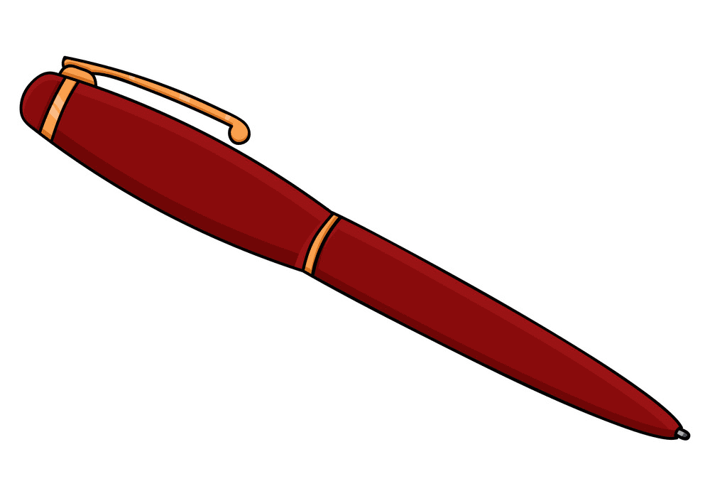
pen

Slide 7
ruler

Slide 8
school bag

Slide 9
book

Slide 10
03.
Game Time

Slide 11
Notes:
Thanh Yến Trần 0967 255 149 zalo/ FB https://www.facebook.com/thanhyentrananhngutaymy/

Slide 12
What could I be?
?
?
?
?
?
?
A pencil!
answer
Notes:
Thanh Yến Trần 0967 255 149 zalo/ FB https://www.facebook.com/thanhyentrananhngutaymy/

Slide 13
What could I be?
?
?
?
?
?
?
A ruler!
answer
Notes:
Thanh Yến Trần 0967 255 149 zalo/ FB https://www.facebook.com/thanhyentrananhngutaymy/

Slide 14
What could I be?
?
?
?
?
?
?
g
a school bag
answer
Notes:
Thanh Yến Trần 0967 255 149 zalo/ FB https://www.facebook.com/thanhyentrananhngutaymy/

Slide 15
What could I be?
?
?
?
?
?
?
A pen!
answer
Notes:
Thanh Yến Trần 0967 255 149 zalo/ FB https://www.facebook.com/thanhyentrananhngutaymy/

Slide 16
What could I be?
?
?
?
?
?
?
An eraser!
answer
Notes:
Thanh Yến Trần 0967 255 149 zalo/ FB https://www.facebook.com/thanhyentrananhngutaymy/

Slide 17
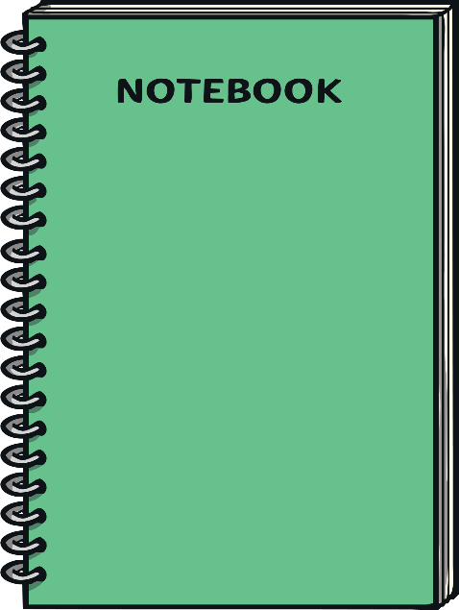
What could I be?
?
?
?
?
?
?
book
answer

Slide 18
04. Sentence

Slide 19
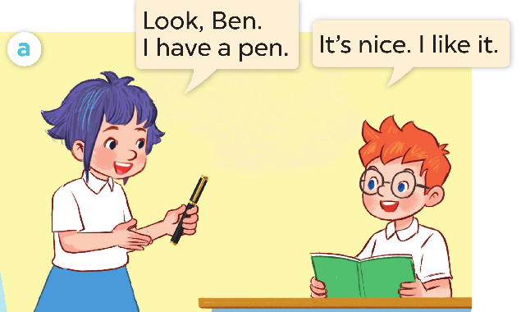
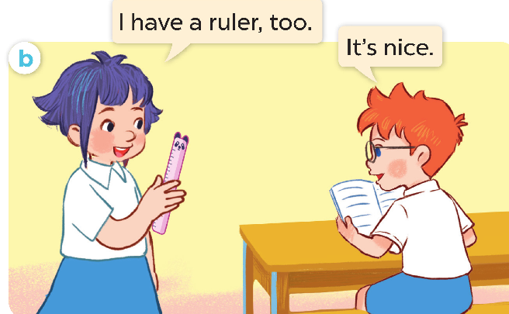

Slide 20
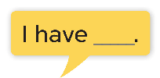

Slide 21
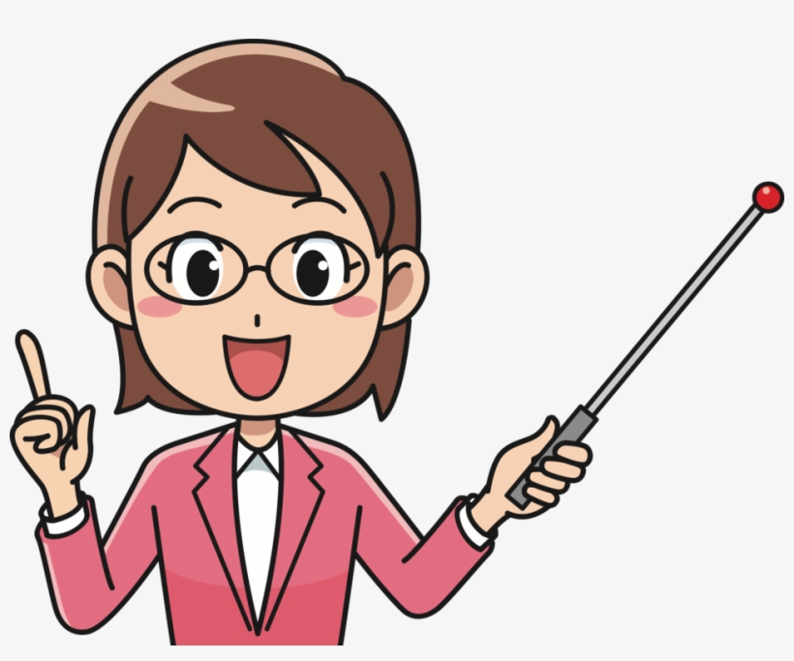
Structure
Look, I have + Noun

Slide 22
a pencil case
a pencil
a book
an eraser
I have….
a pen
a ruler

Slide 23
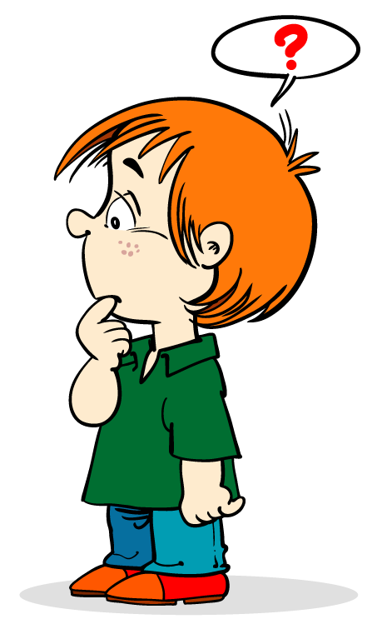

Slide 24
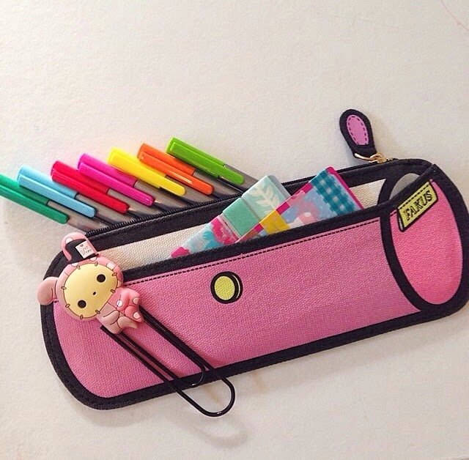
I have a book.
A
B
C
Click to a, b or c icon
Notes:
Click to a, b or c icon

Slide 25
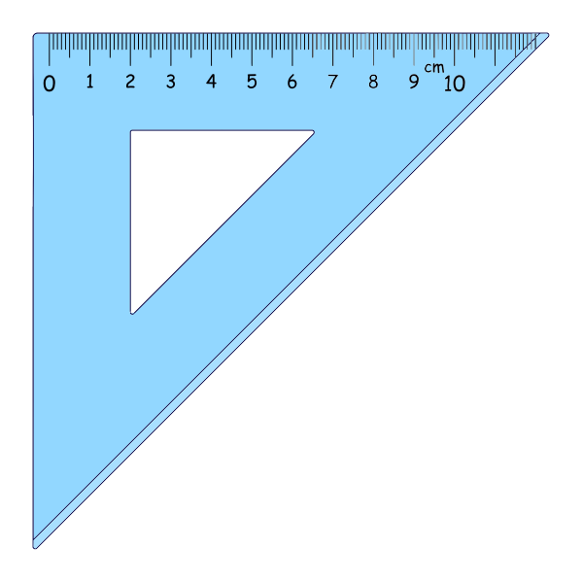
I have.....
A
B
C

Slide 26
have/ a/ I/ pencil.
A
B
C
I a have pencil.
I have a pencil.
I a have pencil.

Slide 27
A
B
C
I have a pencil.
I have a ruler.
I have a notebook..

Slide 28
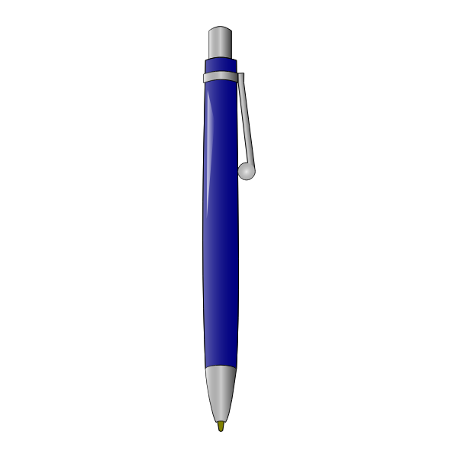
I have.....
A
B
C

Slide 29
THANKS!

Slide 30
05.
Activity Class

Slide 31
