Slide 1
UNIT 8
My School Things
Thanh Yến Trần 0967 255 149 zalo/ FB https://www.facebook.com/thanhyentrananhngutaymy/
LESSON 1.2
Notes:
Thanh Yến Trần 0967 255 149 zalo/ FB https://www.facebook.com/thanhyentrananhngutaymy/

Slide 2
Table of contents
01
02
Warm up
Vocabulary
03
04
Sentence
Practice

Slide 3
01.
Warm Up

Slide 4
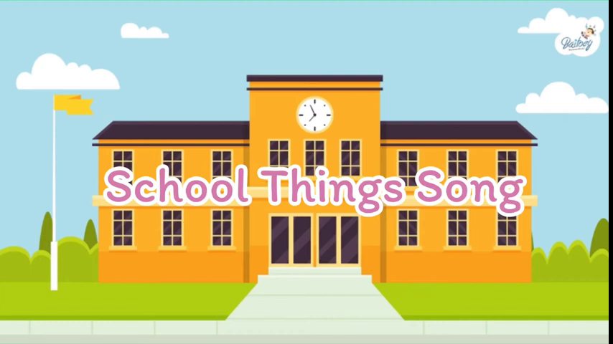
Contents of this template
Here’s what you’ll find in this Slidesgo template:
A slide structure based on a multi-purpose presentation, which you can easily adapt to your needs. For more info on how to edit the template, please visit Slidesgo School or read our FAQs.
An assortment of illustrations that are suitable for use in the presentation can be found in the alternative resources slide.
A thanks slide, which you must keep so that proper credits for our design are given.
A resources slide, where you’ll find links to all the elements used in the template.
Instructions for use.
Final slides with:
The fonts and colors used in the template.
A selection of illustrations. You can also customize and animate them as you wish with the online editor. Visit Stories by Freepik to find more.
More infographic resources, whose size and color can be edited.
Sets of customizable icons of the following themes: general, business, avatar, creative process, education, help & support, medical, nature, performing arts, SEO & marketing, and teamwork.
You can delete this slide when you’re done editing the presentation.

Slide 5
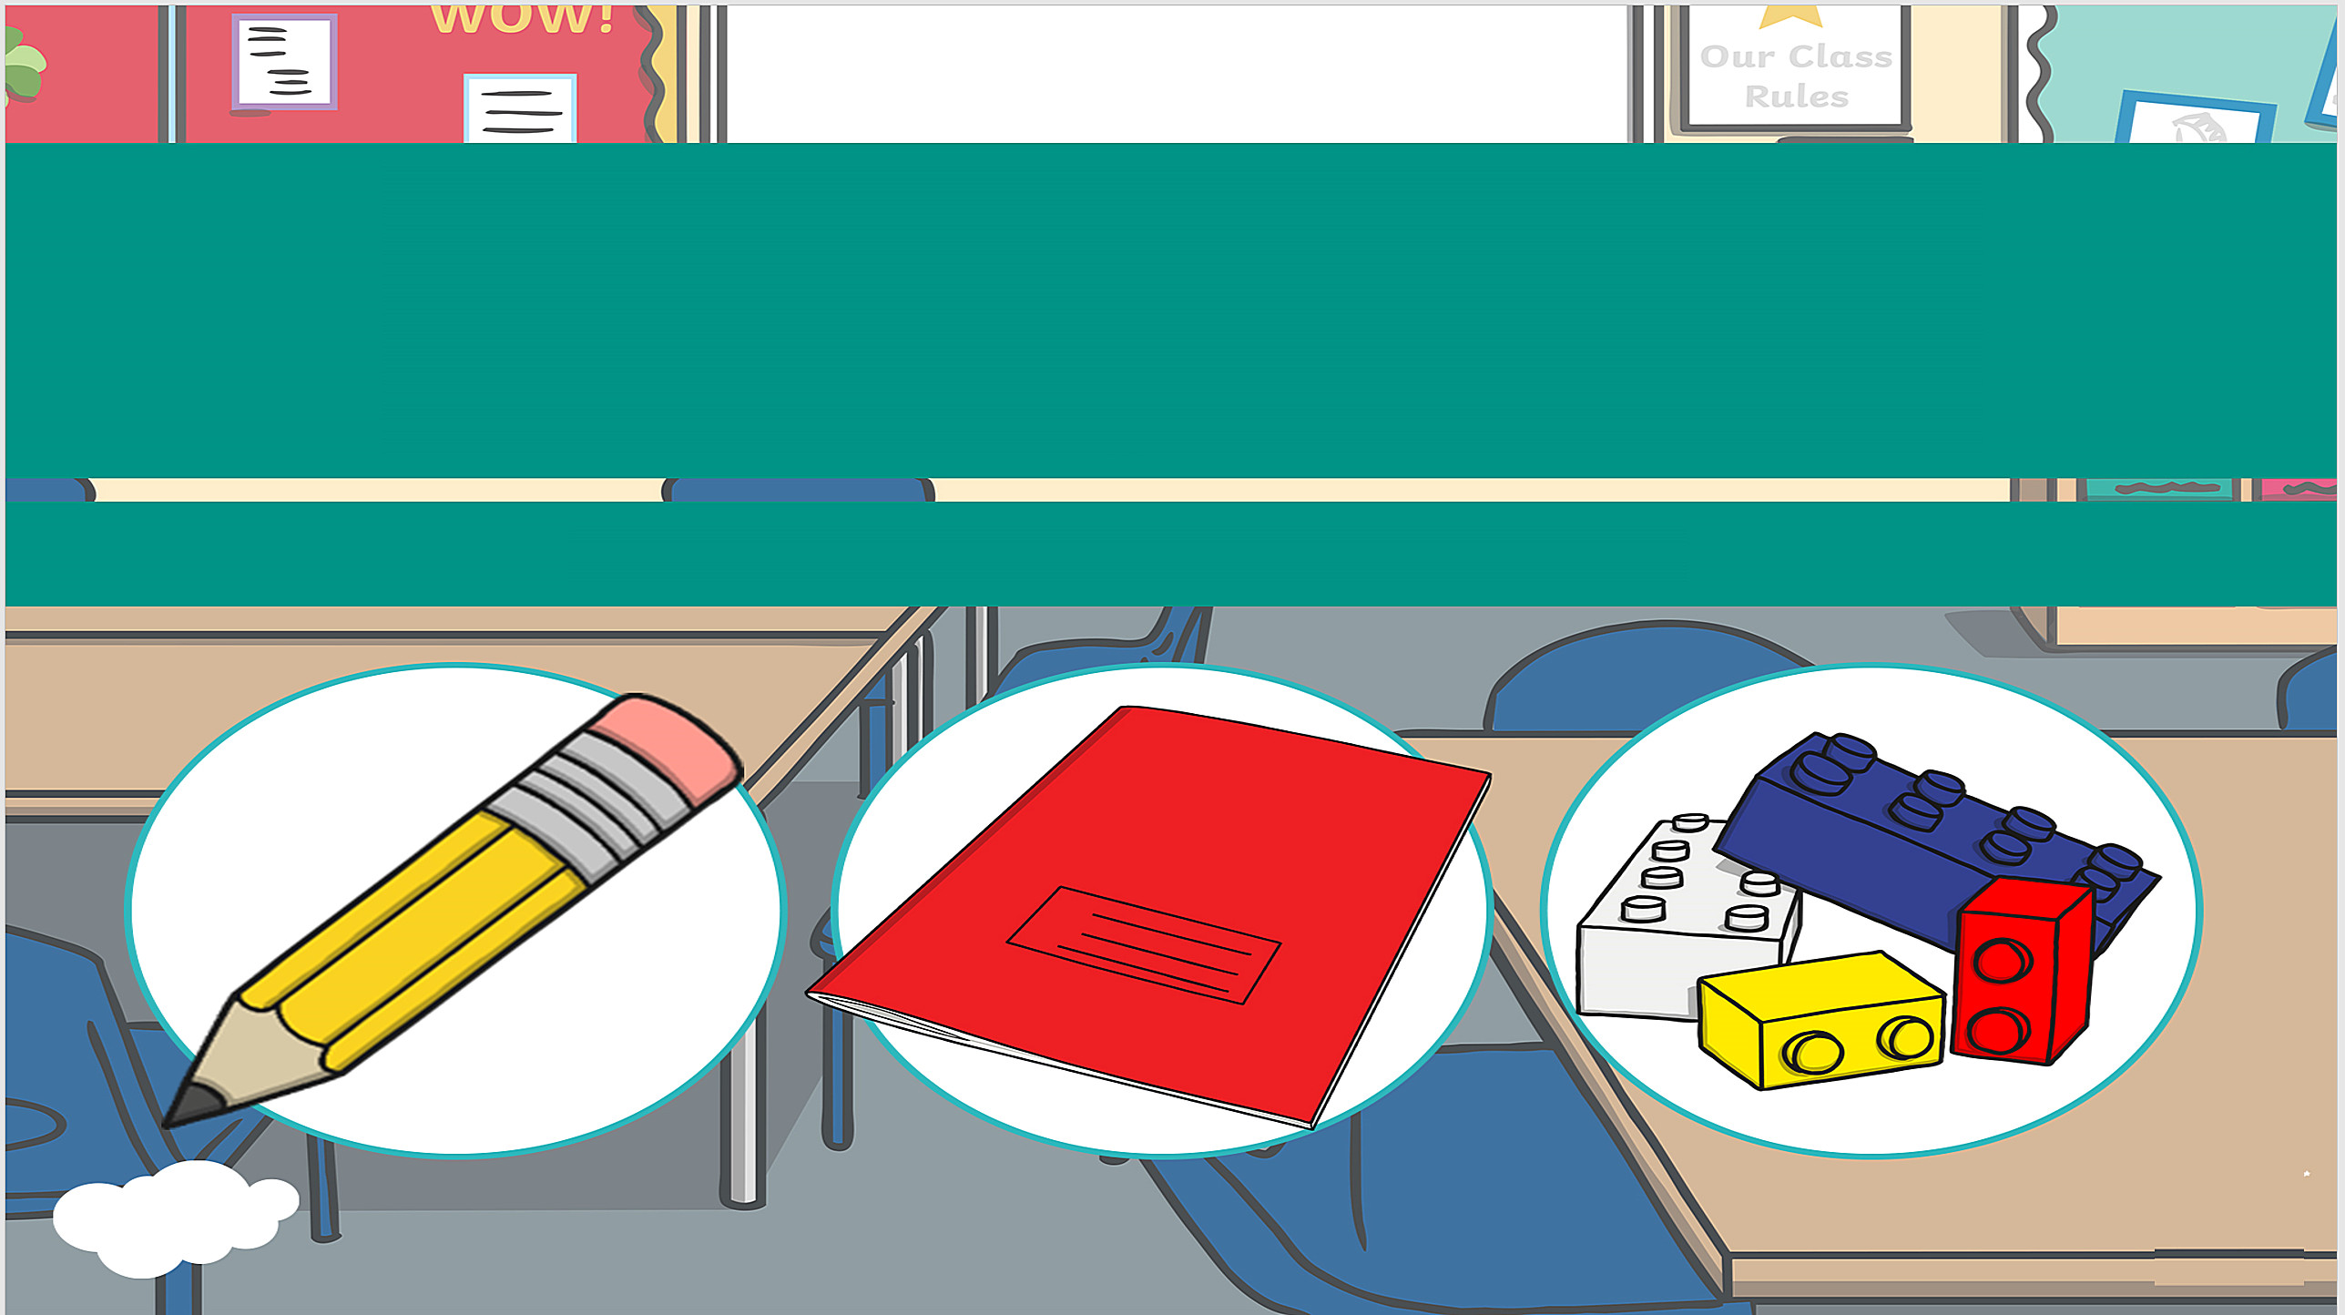
Can you find….?
Notes:
Thanh Yến Trần 0967 255 149 zalo/ FB https://www.facebook.com/thanhyentrananhngutaymy/

Slide 6





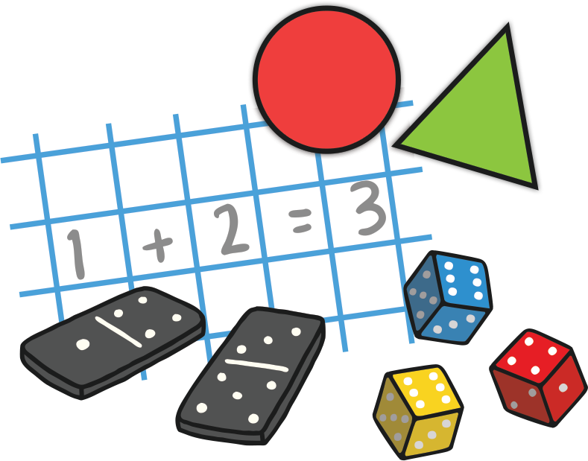

How to Play
On each slide there will be something you need to find. Your job is to find that object or place in the classroom.
Have fun!
Notes:
Thanh Yến Trần 0967 255 149 zalo/ FB https://www.facebook.com/thanhyentrananhngutaymy/

Slide 7
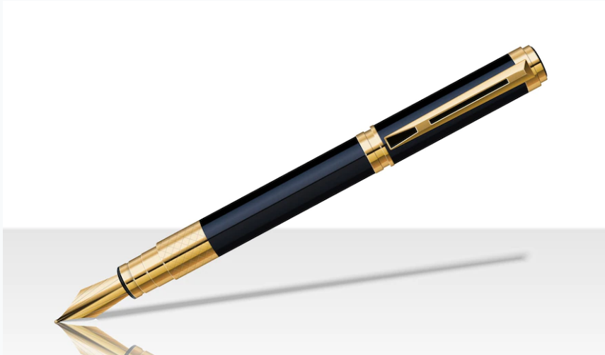
Can you find…
A purple pen?
Notes:
Thanh Yến Trần 0967 255 149 zalo/ FB https://www.facebook.com/thanhyentrananhngutaymy/

Slide 8

Can you find…
something blue?

Slide 9
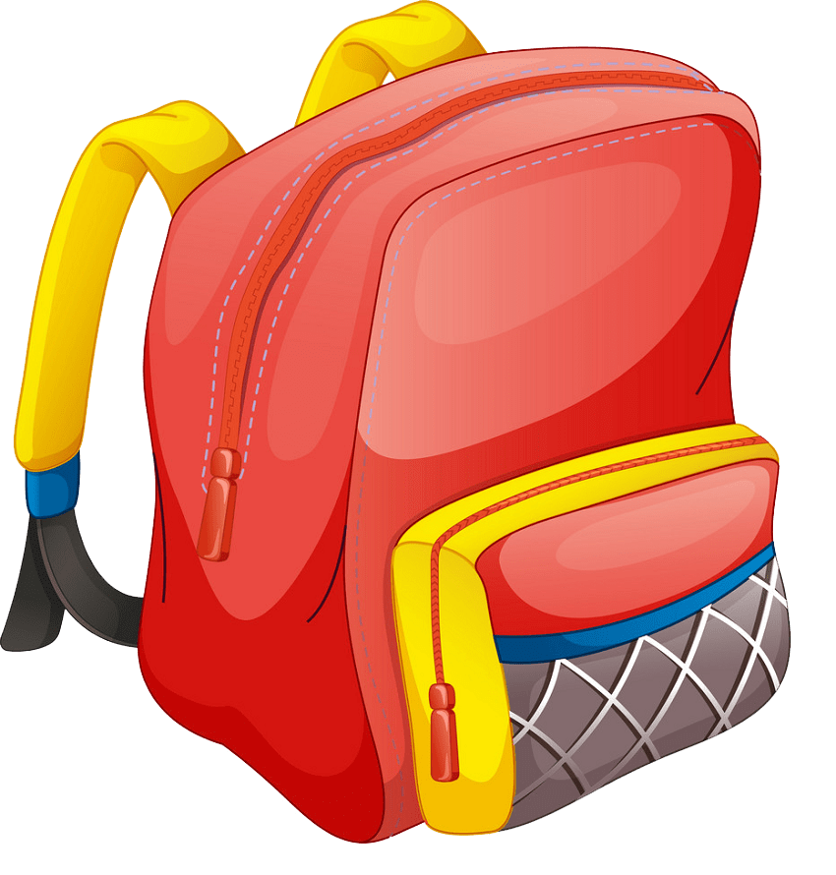
Can you find…
A pink eraser

Slide 10
Can you find…
A pencil?

Slide 11

Can you find…
a book?

Slide 12
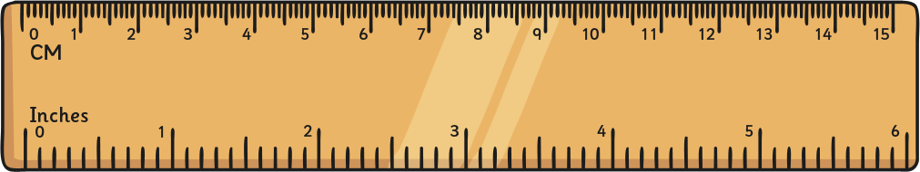
Can you find…
a ruler?

Slide 13
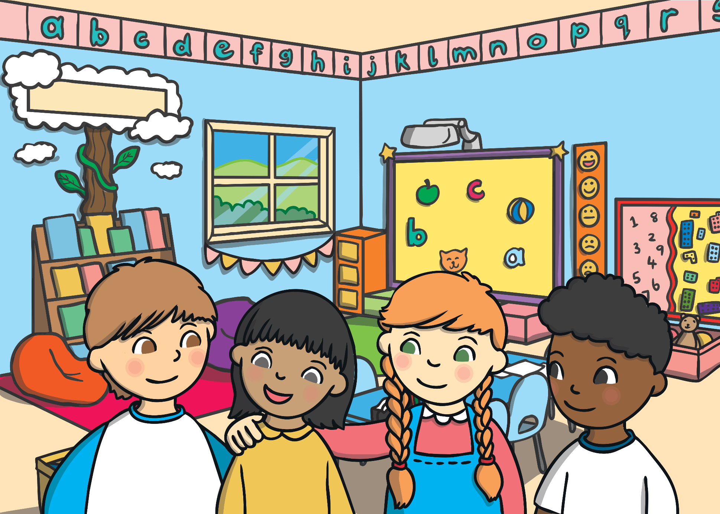
Well Done!

Slide 14

Review Game

Slide 15



pencli
Great!
pencil
e-p-n-c-l-i
pincel

Slide 16


e
o
Great!
bo…k
i

Slide 17



pen
book
ruler
Great!

Slide 18
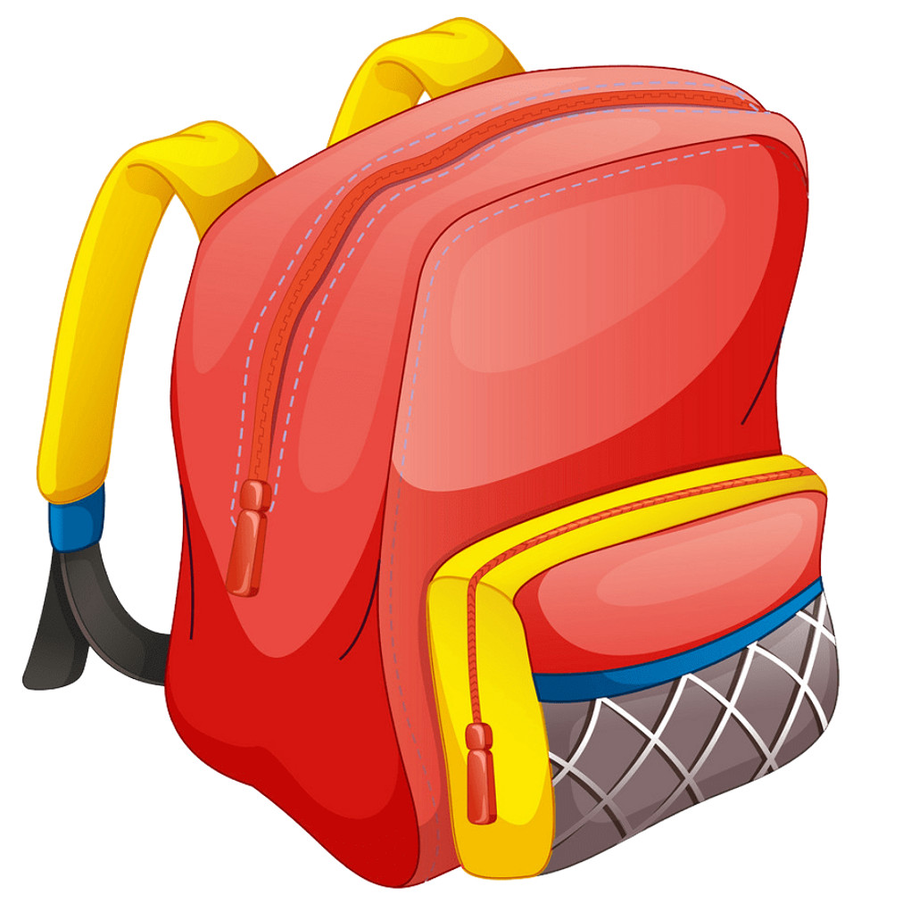


School bag
Great!

Slide 19
02.
Listen & Reading

Slide 20



I have + Noun
I have a school bag.

Slide 21



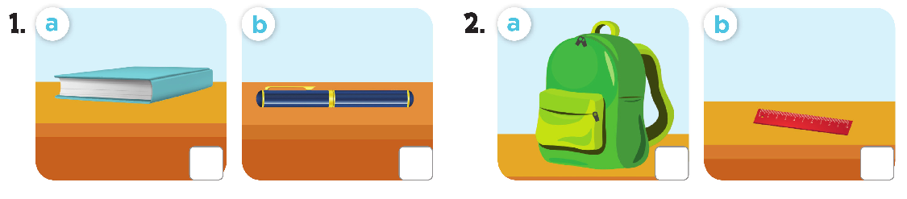



Slide 22

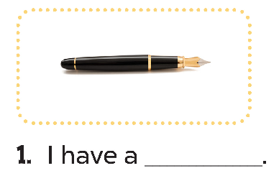
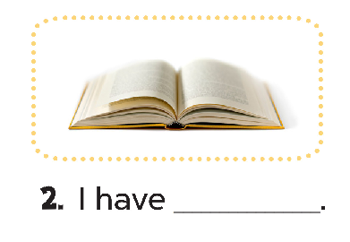
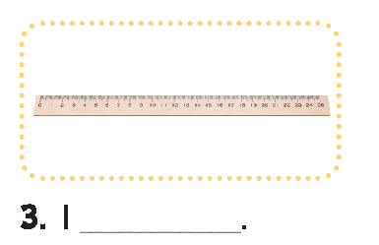
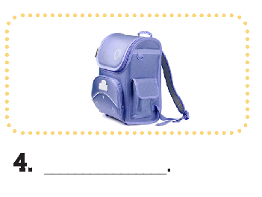
pen
a book
I have a school bag.
have a ruler.

Slide 23
03.
Singing Time

Slide 24

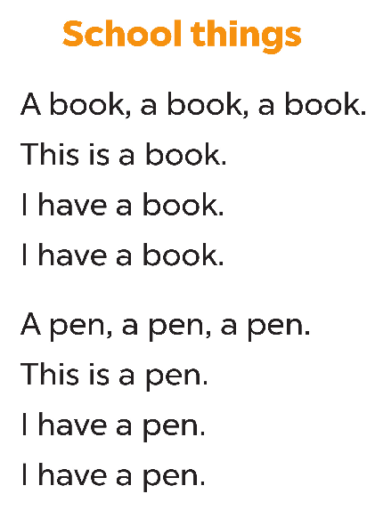

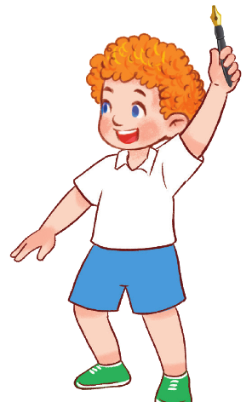



Slide 25



