Slide 1
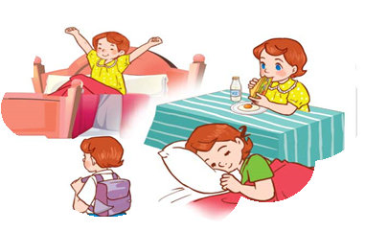
Monday, May 10th 2023
Unit
2
Time and daily routines
Facebook: Bùi Liễu
0968142780
Lesson 1 (1+2+3)

Slide 2
Warm-up

Slide 3
Let’s sing!

Slide 5
Contents
Look, listen and repeat.
Listen, point and say.
Let’s talk.

Slide 6
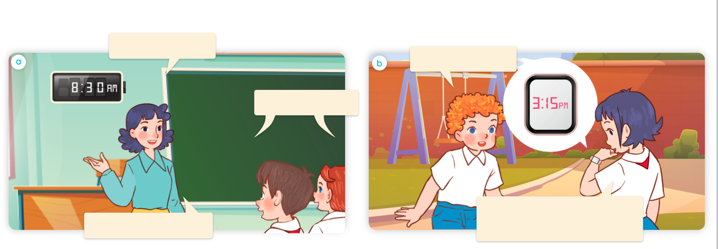
1. Look, listen and repeat.
What time is it?
What time is it?
It’s eight thirty.
It’s three fifteen. Let’s
go into the classroom.
Let’s have a break.
Where are they?
Who are they?
What are they doing?
Click on the sentences to hear the sound.

Slide 7
Vocabulary

Slide 8
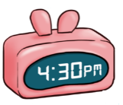
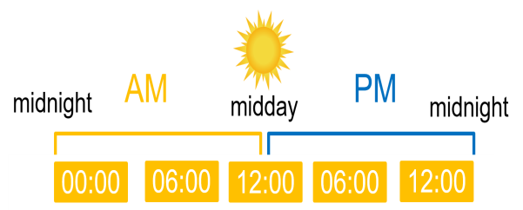
fifteen
/ˌfɪfˈtiːn/
số 15
thirty
/ˈθɜːti/
số 30
forty-five
/fɔːti ˈfaɪv/
số 45
AM
/ˈeɪ em/
giờ sáng
PM
/ˈpɪ em/
giờ chiều/tối
o’clock
/əˈklɒk/
giờ (chẵn)

Slide 9
Look and match.
30
15
45
1
2
3
4
fifteen
thirty
forty-five
o’clock
a
b
c
d

Slide 10
Structures

Slide 11
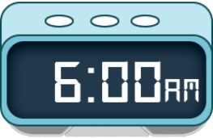
Cách hỏi thời gian.
What time is it?
(Bây giờ là mấy giờ?)
It’s = it is
It’s _______.
(Bây giờ là____.)
Ex:
What time is it?
It’s six o’clock.

Slide 12
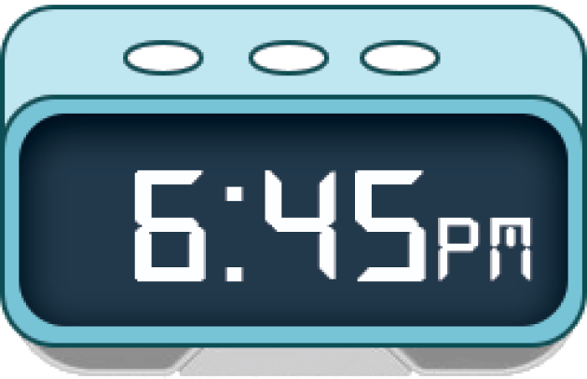
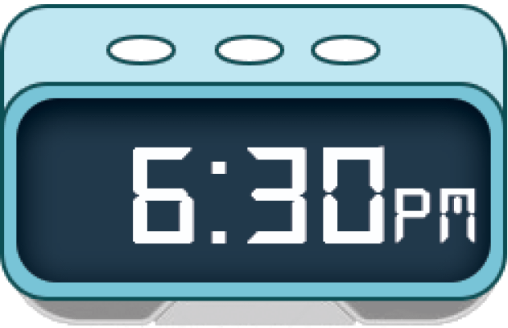
Unit 2 lesson 1
What time is it?
It’s _______.
it’s = it is
Bùi Liễu
0968142780
six o’clock
six forty- five
six fifteen
six thirty

Slide 13
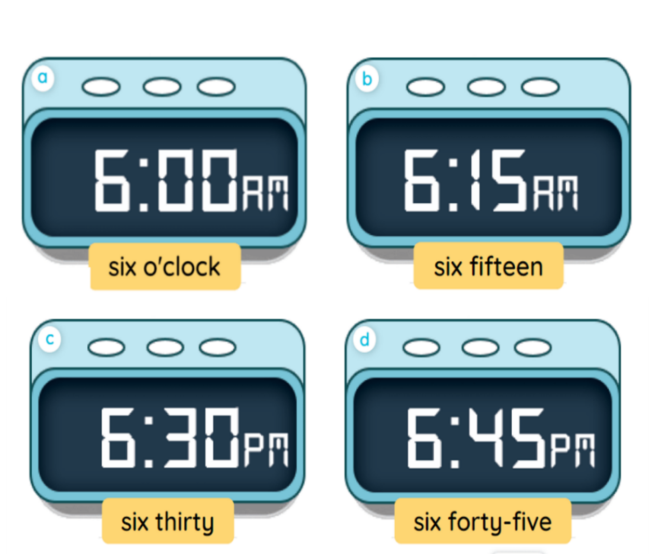
2. Listen, point and say.
a
b
What time is it?
It’s __________.
c
d

Slide 14
2. Listen, point and say.
What time is it?
It’s six o’clock.

Slide 15
2. Listen, point and say.
What time is it?
It’s six fifteen.

Slide 16
2. Listen, point and say.
What time is it?
It’s six thirty.

Slide 17
2. Listen, point and say.
What time is it?
It’s six forty-five.

Slide 18
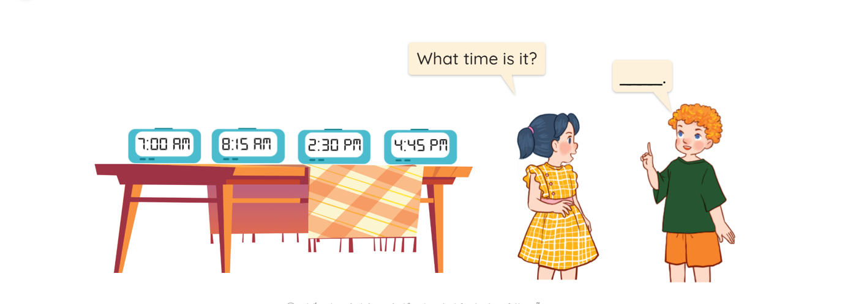
3. Let’s talk.

Slide 19
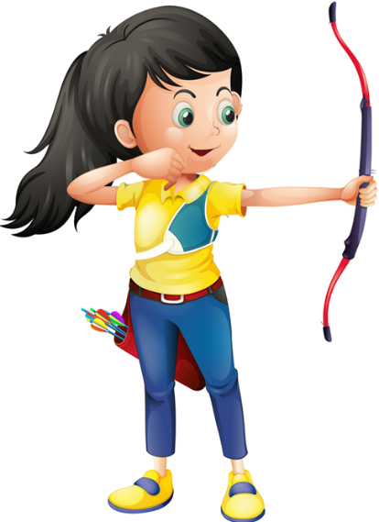
Ms Huyền Phạm
0936.082.789

Slide 20
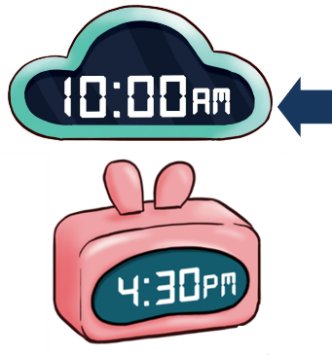
A. o’clock
B. It’s ten o’clock.
Ms Huyền Phạm
0936.082.789

Slide 21
A. It’s six fifteen.
B. It’s seven fifty.
Ms Huyền Phạm
0936.082.789

Slide 22
A. It’s two fifty.
B. It’s one fifteen.
Ms Huyền Phạm
0936.082.789

Slide 23
A. It’s six ten.
B. It’s six o’clock.
Ms Huyền Phạm
0936.082.789

Slide 24
A. It’s three thirteen.
B. It’s three thirty.
Ms Huyền Phạm
0936.082.789

Slide 25
Facebook : Bùi Liễu
Mobile phone: 0968142780
What time __ it?
It’s six thirty.
A. are
B. is
Ms Huyền Phạm
0936.082.789

Slide 26
____ time is it?
It’s six o’clock.
A. What
B. Where
Ms Huyền Phạm
0936.082.789

Slide 27
What ____ is it?
_____ nine o’clock.
A. time - They
B. time – It’s
Ms Huyền Phạm
0936.082.789

Slide 28
A.
What time is it?
It’s six o’clock.
B.
Ms Huyền Phạm
0936.082.789

Slide 29
What time ___ ___?
A. is it
B. are they
Ms Huyền Phạm
0936.082.789
Notes:
Facebook : Bùi Liễu
Mobile phone: 0968142780

Slide 30
Good job!
Ms Huyền Phạm
0936.082.789

Slide 31
Wrap up

Slide 32
Unit 2 lesson 1
What time is it?
It’s _______.
it’s = it is
Bùi Liễu
0968142780
six o’clock
six forty- five
six fifteen
six thirty

Slide 33
Homework
Learn by heart all the new words.
Read again the dialogue in part 1.

Slide 34
Thank you!

