Slide 1
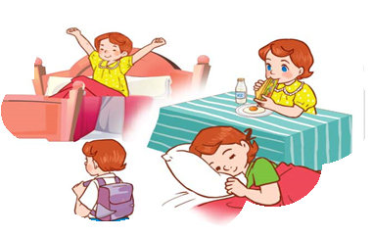
Monday, May 10th 2023
Unit
2
Time and daily routines
Facebook : Bùi Liễu
0968142780
Lesson 2 (1+2+3)

Slide 2
Warm-up

Slide 3
Let’s play!

Slide 4
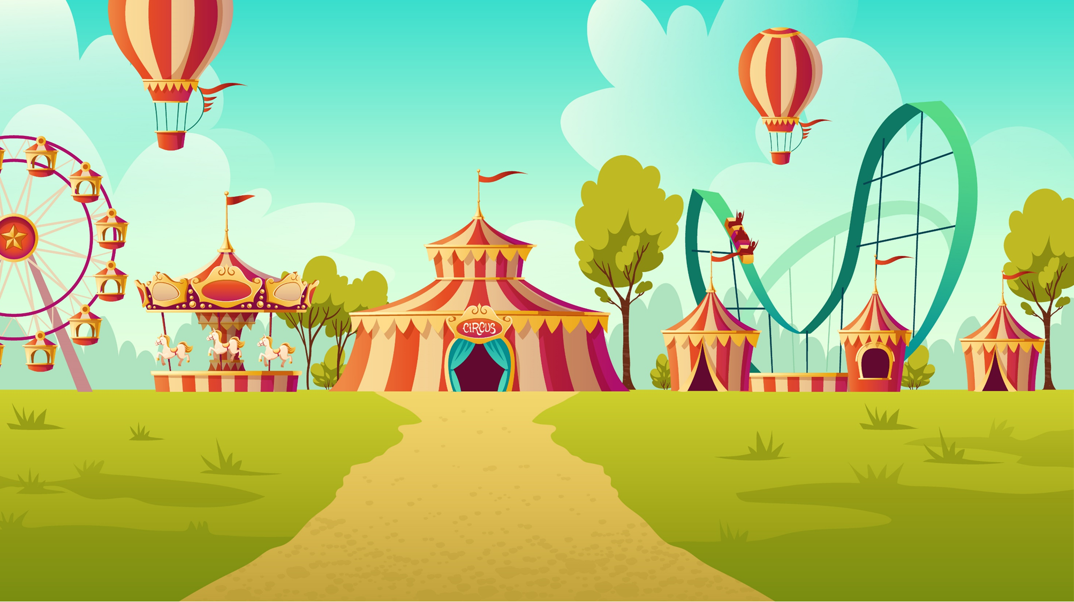
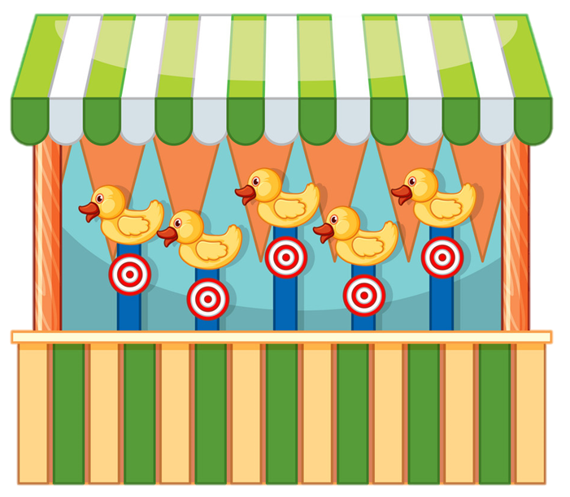
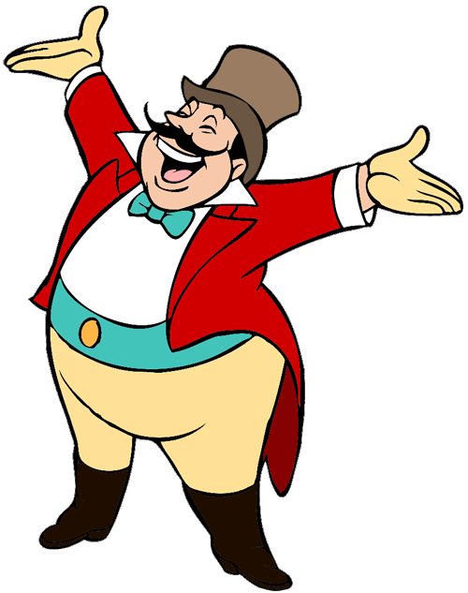
Facebook : Bùi Liễu
0968142780
START

Slide 5
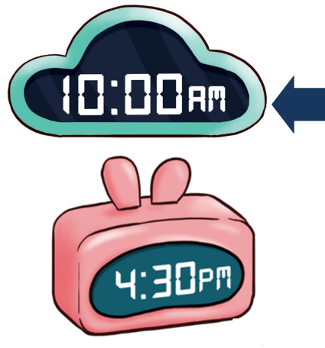
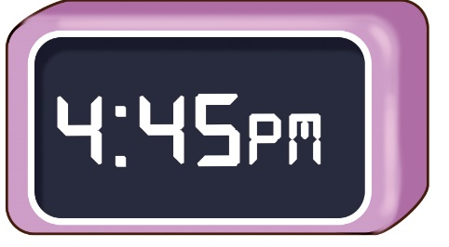
A.
B.
C.

Slide 6
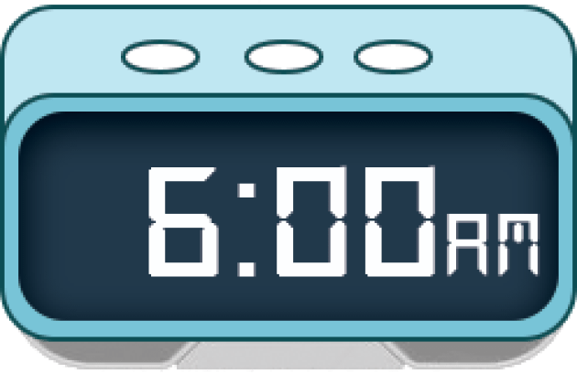
A.
B.
C.
Click on the letters A, B or C (not pictures) to choose the answer.

Slide 7
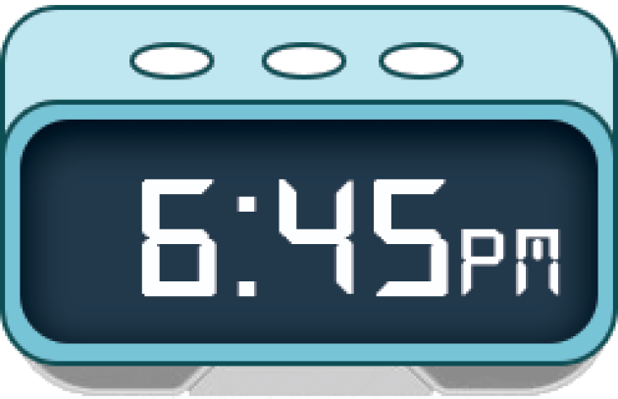
Facebook : Bùi Liễu
0968142780
A.
B.
C.
Click on the letters A, B or C (not pictures) to choose the answer.

Slide 8
A.
B.
C.
Next

Slide 9
What time is it?
A. It’s ten o’clock.
B. It’s eight o’clock.
C. It’s ten fifteen.
Next

Slide 10
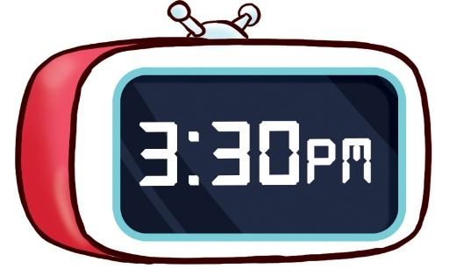
What time is it?
A. It’s five thirty.
B. It’s three thirty.
C. It’s three twenty.
Notes:
Facebook : Bùi Liễu 0968142780

Slide 11
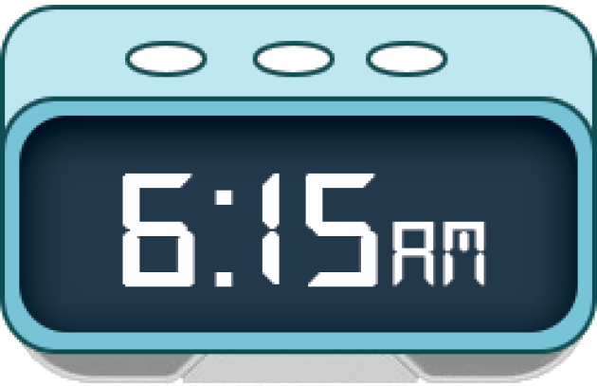
_____ time is it?
A. What
B. Where
C. When
Next

Slide 12
What time is it?
A. It’s one forty five.
B. It’s one fifty.
C. It’s one fifteen.

Slide 13
It’s four _____.
A. thirty
B. forty
C . fifteen

Slide 14
It’s four ________.
A. forty five
B. fifty five
Next

Slide 15
Well done!

Slide 16
Contents
1
2
3
Look, listen and repeat.
Listen, point and say.
Let’s talk.

Slide 17
1. Look, listen and repeat.
What time do you get up?
What time do you have breakfast?
I get up at six
o’clock. And you?
At six fifteen.
At five forty-five.
What are they doing?
Where are they?
Who are they?
Click on the sentences to hear the sound.

Slide 18
Vocabulary

Slide 19
I get up at 6:00 AM
at
/ət/, /æt/
lúc, ở

Slide 20
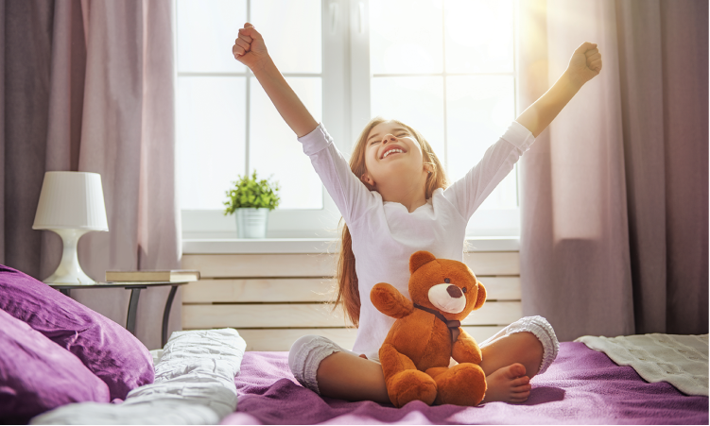
get up
/ɡet ˈʌp/
thức dậy

Slide 21
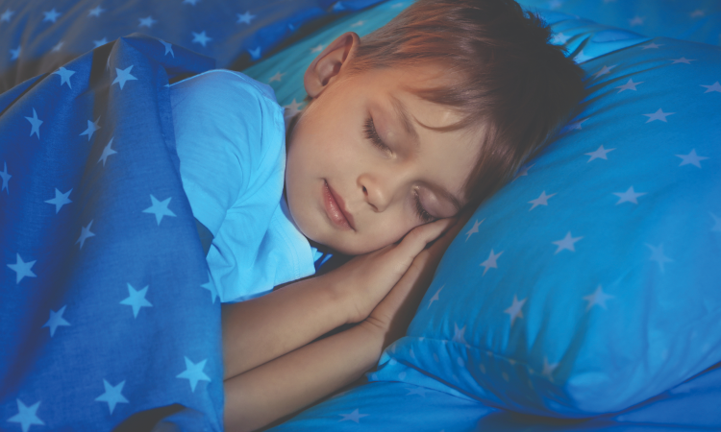
go to bed
/’ɡəʊ tə ’bed/
đi ngủ

Slide 22
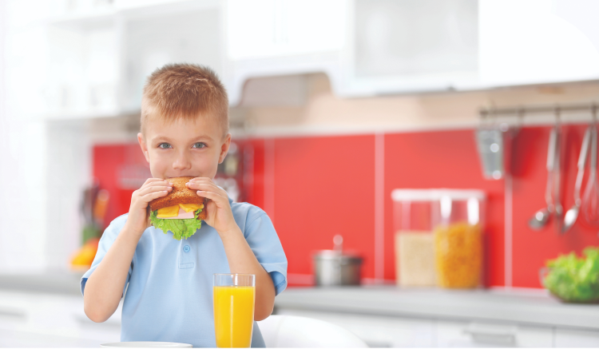
have breakfast
/hæv ˈbrekfəst/
ăn sáng

Slide 23
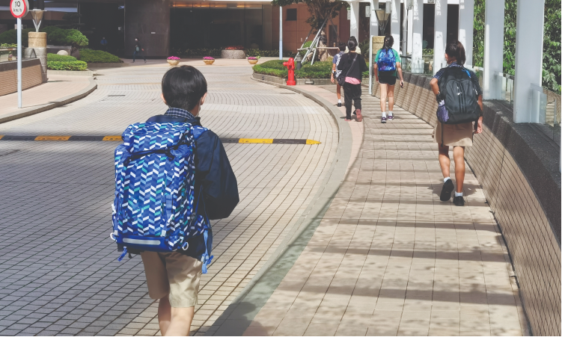
go to school
/ ˈɡəʊ tə ˈskuːl/
đi học

Slide 24
Review
get up
go to bed
have breakfast
go to school

Slide 25
Write down your notebooks.
get up
thức dậy
go to bed
đi ngủ
have breakfast
ăn sáng
go to school
đi học

Slide 26
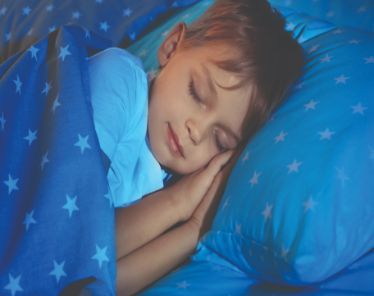
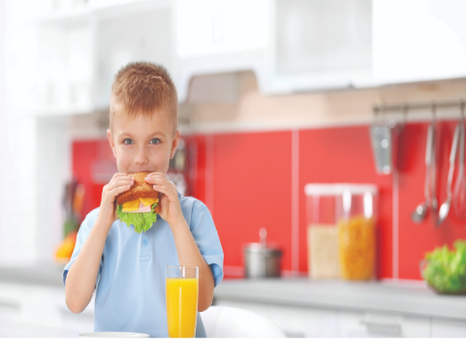
Look and match.
1
2
3
4
go to school
go to bed
have breakfast
get up

Slide 27
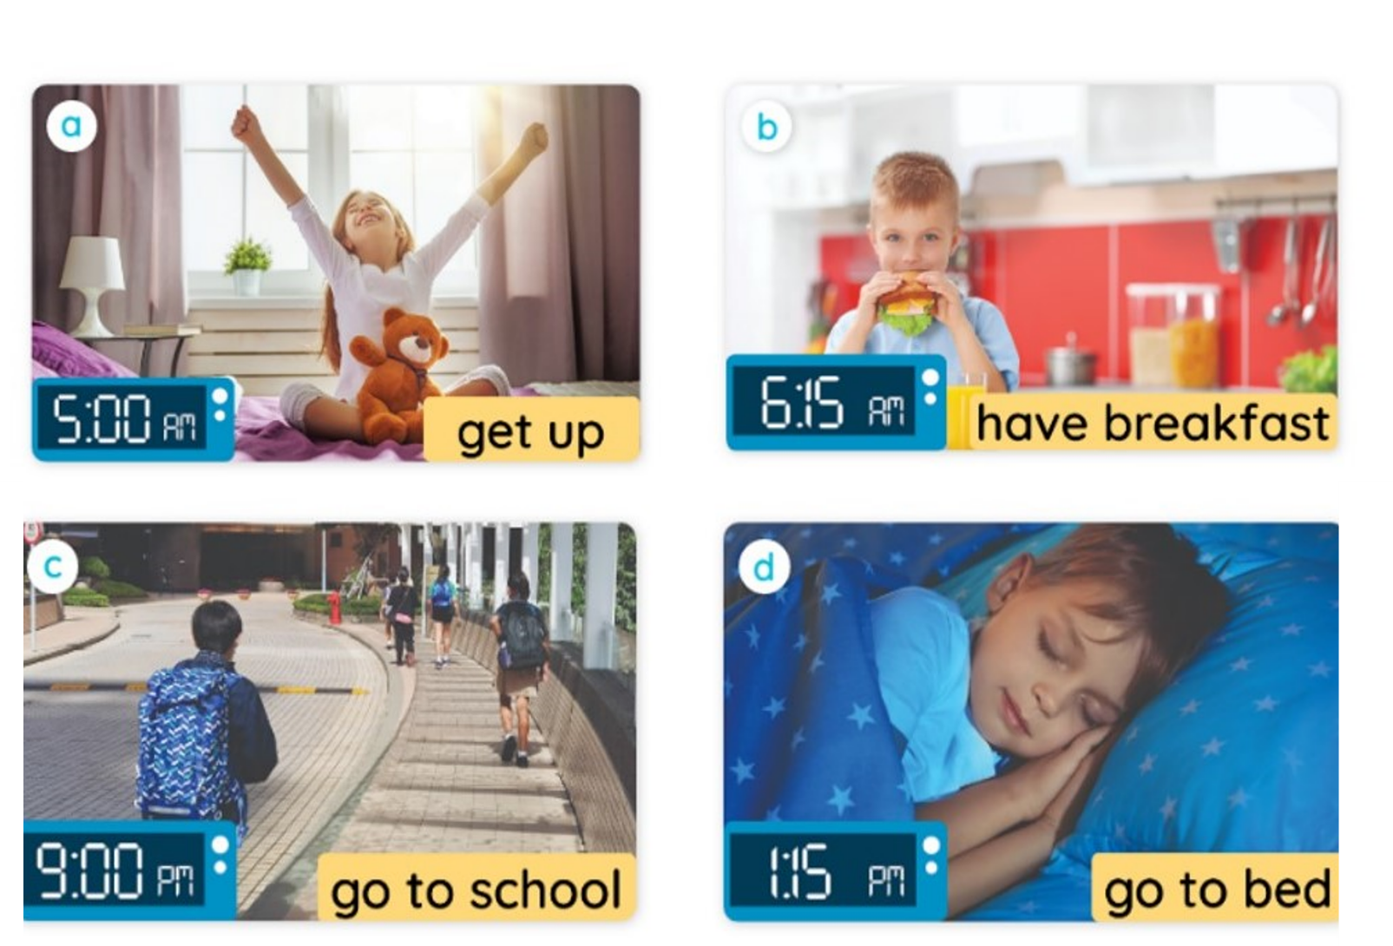
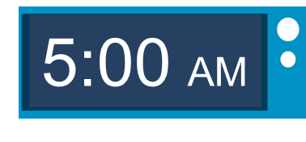
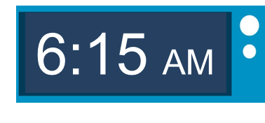
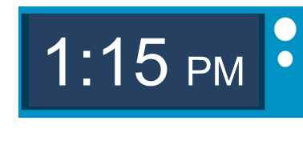
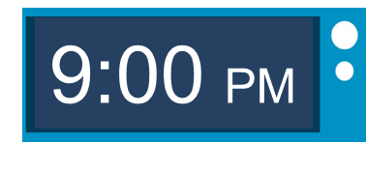
2. Listen, point and say.
a
b
What time do you ____?
I _____ at ___.
c
d

Slide 28
2. Listen, point and say.
What time do you get up?
I get up at five o’clock.

Slide 29
2. Listen, point and say.
What time do you have breakfast?
I have breakfast at six fifteen.

Slide 30
2. Listen, point and say.
What time do you go to school?
I go to school at one fifteen.

Slide 31
2. Listen, point and say.
What time do you go to bed?
I go to bed at nine o’clock.

Slide 32
Structures

Slide 33
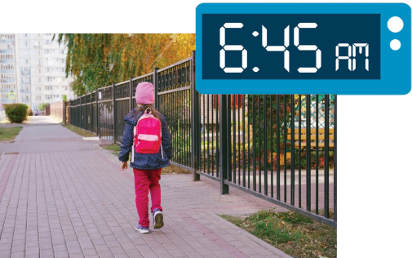
Cách hỏi ai đó làm gì lúc mấy giờ.
What time do you ______?
(Bạn _____ lúc mấy giờ?)
I _____ at _____.
(Tớ ____ lúc ____.)
Ex:
What time do you go to school?
I go to school at six forty-five.

Slide 34
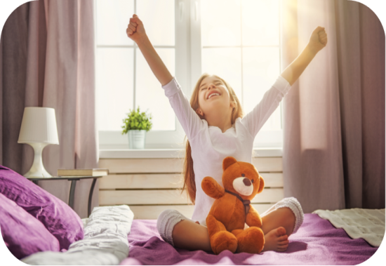
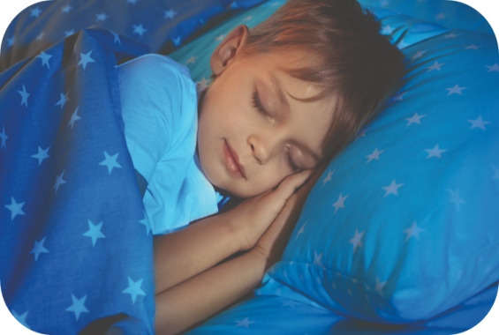
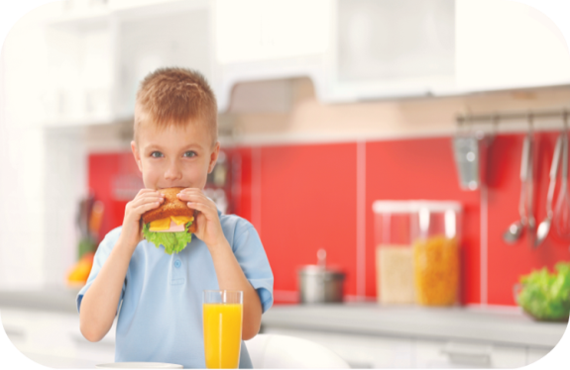
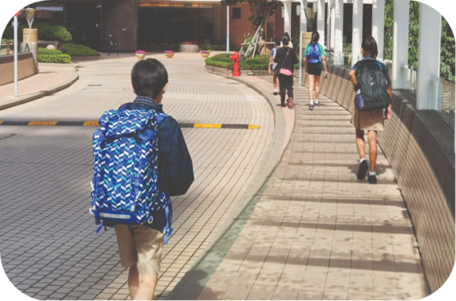
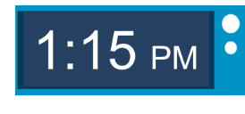
Unit 2 lesson 2
What time do you _____?
I ____ at ____.
Bùi Liễu
0968142780
get up
go to bed
have breakfast
go to school

Slide 35
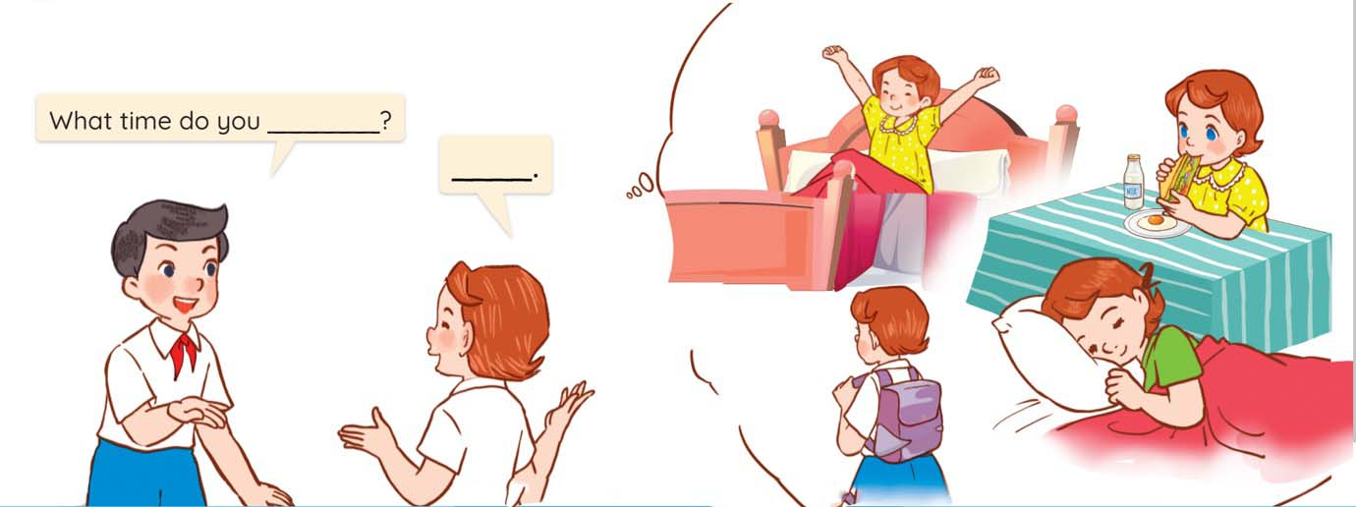
3. Let’s talk.

Slide 36
Wrap up

Slide 37
Unit 2 lesson 2
What time do you _____?
I ____ at ____.
Bùi Liễu
0968142780
get up
go to bed
have breakfast
go to school

Slide 38
Homework
Learn by heart all the new words.
Read again the dialogue in part 1.

Slide 39
Thank you!

