Slide 1
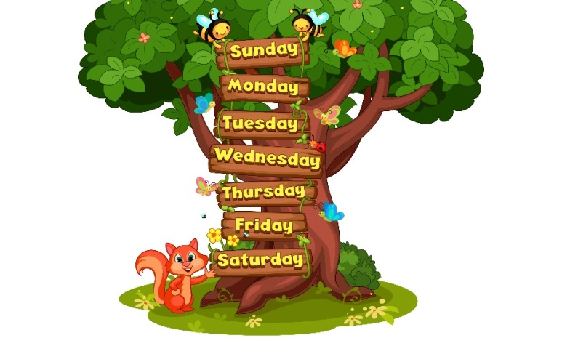
Monday, May 10th 2023
My week
Unit
3
Lesson 2 (1 + 2 + 3)
Facebook: Bùi Liễu
0968142780

Slide 2
Warm-up

Slide 3
Let’s sing!

Slide 5
Contents
3
2
3
1
2
1
Look, listen and repeat.
Listen, point and say.
Let’s talk.

Slide 6
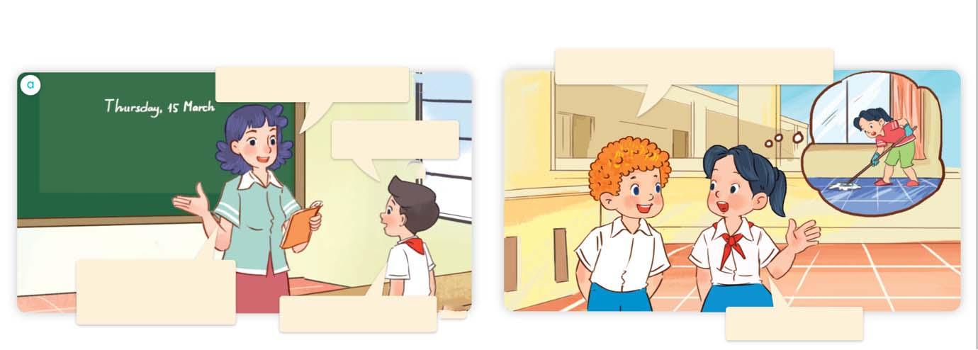
1. Look, listen and repeat.
What do you do on Saturdays?
What day is it today?
It’s Thursday.
What do you do on Thursdays?
I study at school.
I do housework.
Where are they?
Who are they?
What are they doing?
Click on the sentences to hear the sound.

Slide 7
Vocabulary

Slide 8
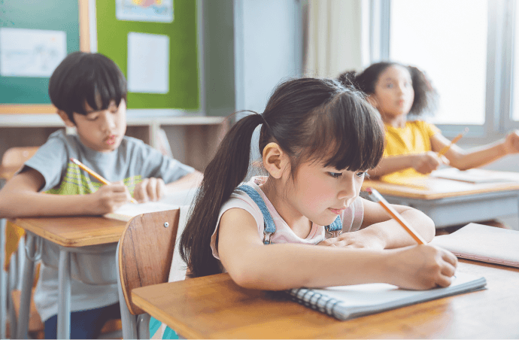
study at school
/ˈstʌdi ət skuːl/
học ở trường

Slide 9
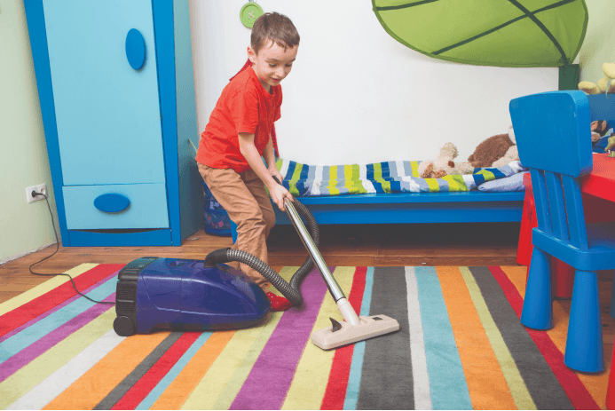
do housework
/dʊ ˈhaʊswɜːk/
làm việc nhà

Slide 10
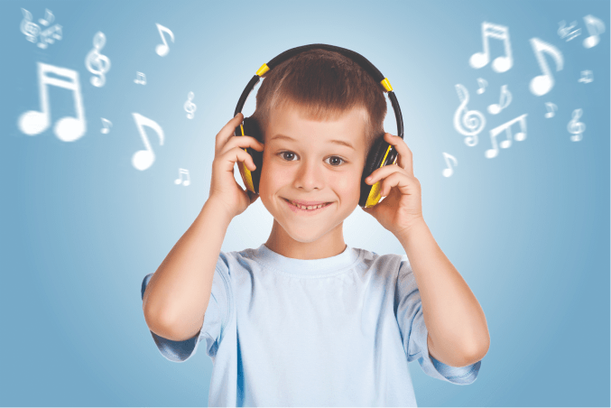
listen to music
/ˈlɪsn tə ˈmjuːzɪk/
nghe nhạc

Slide 11
Review
study
at school
do
housework
listen
to music

Slide 12
Look and match.
1
2
3
listen to music
do housework
study at school
Bùi Liễu 0968142780

Slide 13
study at school
: học ở trường
do housework
: làm việc nhà
listen to music
: nghe nhạc

Slide 14
Structures

Slide 15
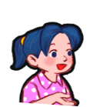
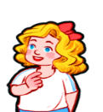
Cách hỏi bạn làm gì vào các thứ trong tuần.
What do you do on _____?
(Bạn làm gì vào ____?)
I _______.
(Tớ ____.)
Ex:
What do you do on Mondays?
I study at school.
Mondays / study
at school

Slide 16
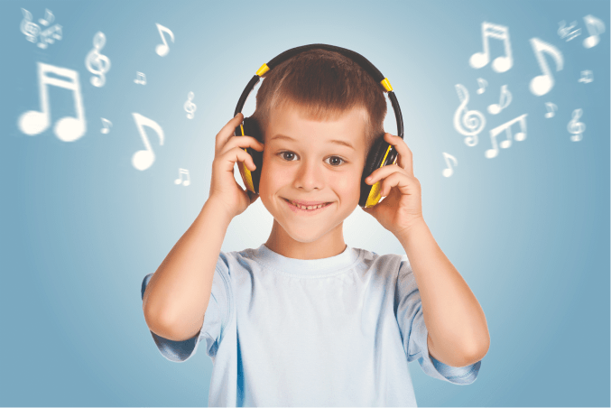
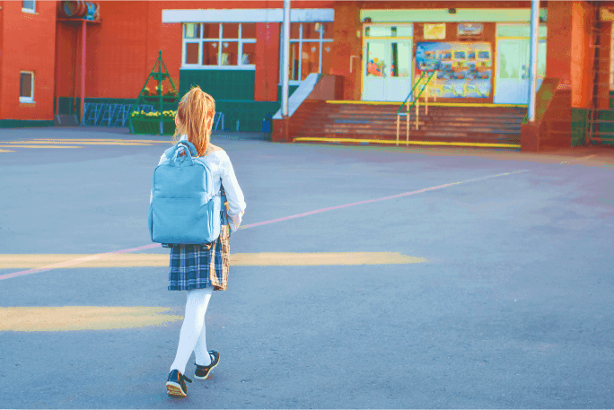
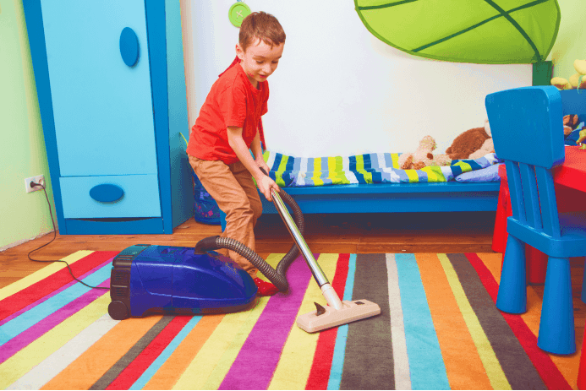
Unit 3 lesson 2
What do you do on ____?
I _______.
Bùi Liễu 0968142780
Mondays /
study at school
Sundays /
listen to music
Wednesdays / go
to school
Saturdays /
do housework

Slide 17
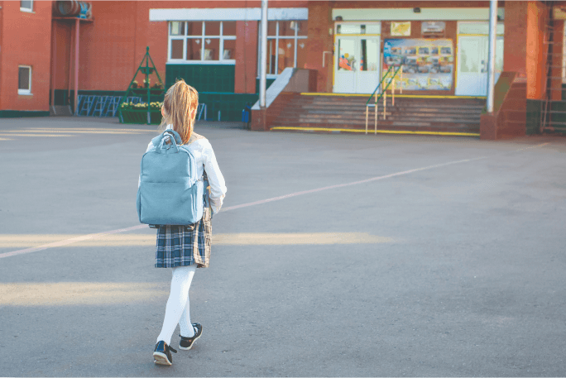
2. Listen, point and say.
a
b
What do you
do on _________?
Mondays / study
at school
Wednesdays / go
to school
c
d
I__________.
Saturdays / do housework
Sundays / listen to music

Slide 18
2. Listen, point and say.
a
Mondays / study at school
What do you do on Mondays?
I study at school.

Slide 19
2. Listen, point and say.
b
Wednesdays / go to school
What do you do on Wednesdays?
I go to school.

Slide 20
2. Listen, point and say.
c
Saturdays / do housework
What do you do on Saturdays?
I do housework.

Slide 21
2. Listen, point and say.
d
Sundays / listen to music
What do you do on Sundays?
I listen to music.

Slide 22
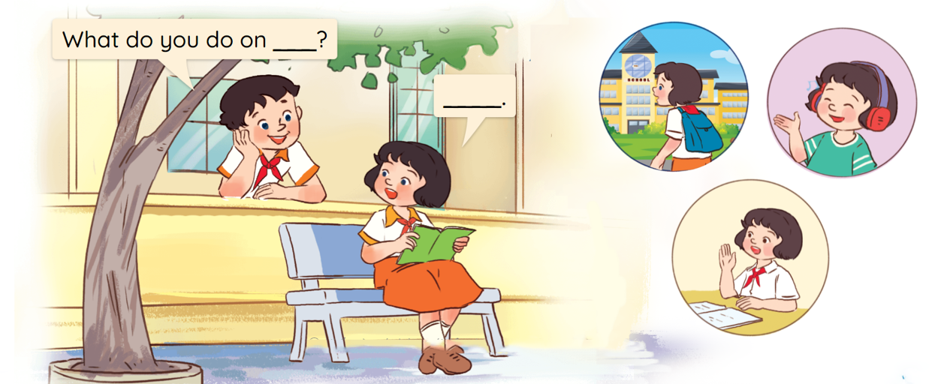
3. Let’s talk.

Slide 23
Let’s play!

Slide 24
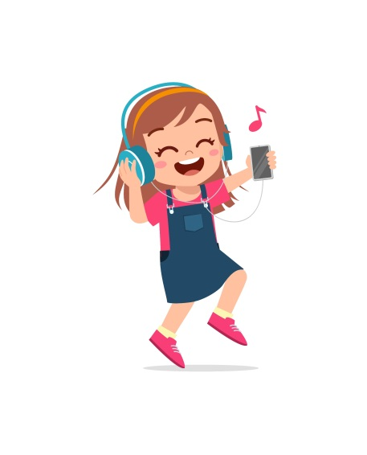
A. listen to music
B. go to school
C. do housework

Slide 25
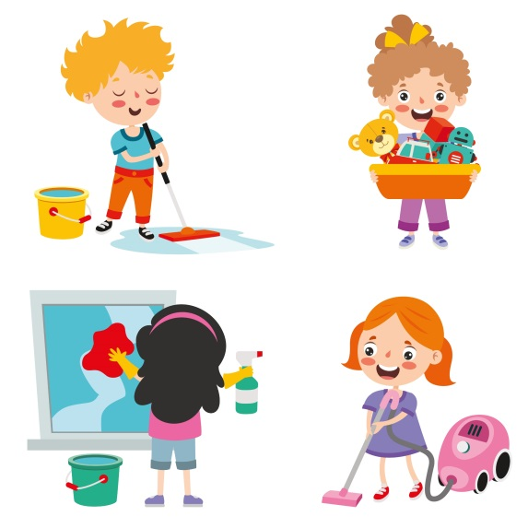
A. go to school
B. do housework
C. study at school

Slide 26
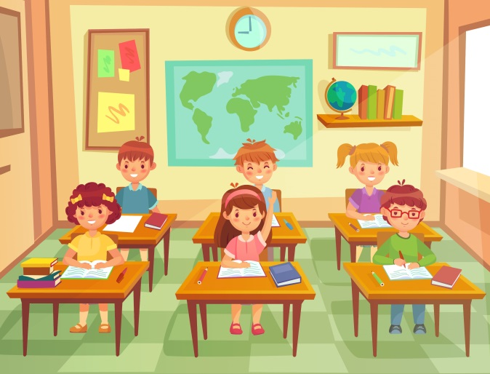
A. study at school
B. listen to music
C. go to school

Slide 27
A. listen to music
B. do housework
C. go to school

Slide 28
A. listen to
B. do
______ school
C. go to

Slide 29
A. do
B. go
___ housework
C. listen

Slide 30
A. do
B. go to
____ at school
C. study

Slide 31
A. hause
B. house
do _______work
C. home

Slide 32
A. It’s Thursday.
What day is it today?
B. It’s Tuesday.
C. It’s Tuesdays.

Slide 33
A. It’s Thursday.
What day is it today?
B. It’s Sunday.
C. It’s Thursdays.

Slide 34
Thank you!

Slide 35
Wrap up

Slide 36
Unit 3 lesson 2
What do you do on ____?
I _______.
Bùi Liễu 0968142780
Mondays /
study at school
Sundays /
listen to music
Wednesdays / go
to school
Saturdays /
do housework

Slide 37
Homework
Learn by heart all the new words.
Read again the dialogue in part 1.

Slide 38
Bùi Liễu
0968142780
Thank you!

