Slide 1
Thanh Yến Trần 0967 255 149 zalo/ FB https://www.facebook.com/thanhyentrananhngutaymy/
Unit 10
Unit 10
MY HOUSE
MY HOUSE
Lesson 1

Slide 2
CONTENT
1
3
WARM UP
SENTENCE
2
4
VOCABULARY
GAME TIME
Notes:
Thanh Yến Trần 0967 255 149 zalo/ FB https://www.facebook.com/thanhyentrananhngutaymy/

Slide 3
1
Warm Up
Notes:
Thanh Yến Trần 0967 255 149 zalo/ FB https://www.facebook.com/thanhyentrananhngutaymy/

Slide 5
2
Vocabulary
Notes:
Thanh Yến Trần 0967 255 149 zalo/ FB https://www.facebook.com/thanhyentrananhngutaymy/

Slide 6
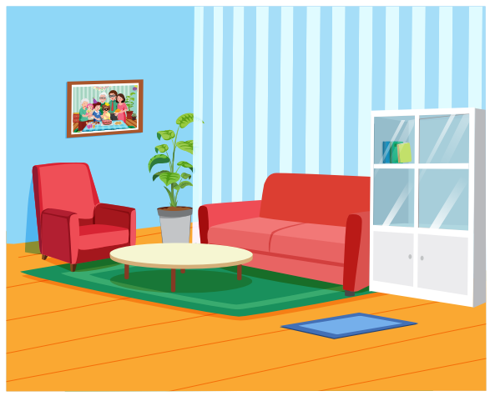

Slide 7
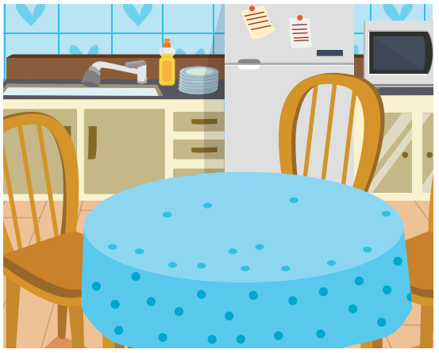

Slide 10
3
Sentence

Slide 11
This is my living room.

Slide 12
This is my kitchen.

Slide 13
This is my bedroom.

Slide 14
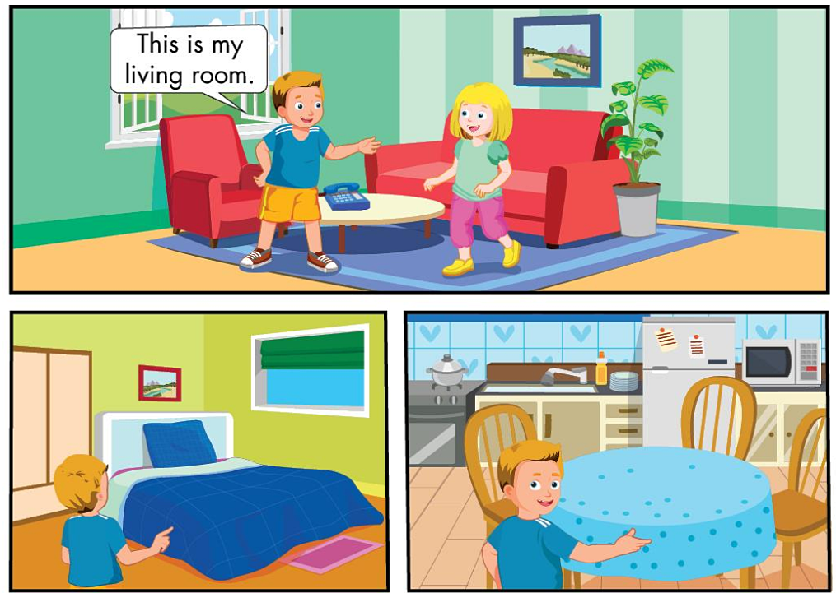

Slide 15
This is my living room.
This is my kitchen.
This is my bedroom.

Slide 17
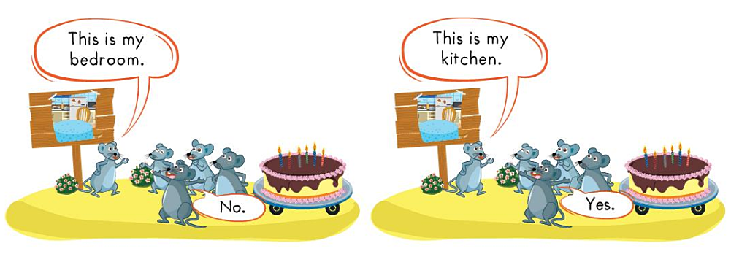

Slide 18
3
Game Time

Slide 19
Notes:
Thanh Yến Trần 0967 255 149 zalo/ FB https://www.facebook.com/thanhyentrananhngutaymy/

Slide 20
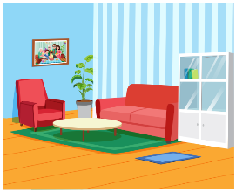
What is it?
kitchen
bedroom
living room
next
Notes:
Thanh Yến Trần 0967 255 149 zalo/ FB https://www.facebook.com/thanhyentrananhngutaymy/

Slide 21
Listen and choose
kitchen
living room
bedroom
next
Notes:
Thanh Yến Trần 0967 255 149 zalo/ FB https://www.facebook.com/thanhyentrananhngutaymy/

Slide 22
This is my………..
bedroom
kitchen
living room
next
Notes:
Thanh Yến Trần 0967 255 149 zalo/ FB https://www.facebook.com/thanhyentrananhngutaymy/

Slide 23
kitchen
bedroom
living room
next

Slide 24
Find the missing letter of the
word : k…tch…n
i-e
i-a
e-i
next

Slide 25
Uncreamble: r-o-b-e-o-m-d
berdoom
next
bedrmoo
bedroom

Slide 26
Listen and choose
This is my livingroom.
This is my kitchen.
This is my bedroom.
next

Slide 27
Reorder: is –This-living room-my
This my is livingroom.
This is livingroom my.
This is my livingroom.
next

Slide 28
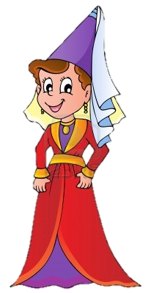
The End
He is
so brave!

Slide 29
Bye Bye

