Slide 1
Unit 10
Day of the week
Lesson 1
Notes:
Thanh Yến Trần 0967 255 149 zalo/ FB https://www.facebook.com/thanhyentrananhngutaymy/

Slide 2
Content
WARM
UP
VOCABULARY
SENTENCE
GAME TIME

Slide 3
WARM UP

Slide 5
VOCABULARY
Notes:
Thanh Yến Trần 0967 255 149 zalo/ FB https://www.facebook.com/thanhyentrananhngutaymy/

Slide 6
。
Monday

Slide 7
。
Tuesday

Slide 8
。
Wednesday

Slide 9
。
Thursday
Thursday

Slide 10
。
Friday
Friday

Slide 11
。
Saturday
Saturday

Slide 12
。
Sunday

Slide 13
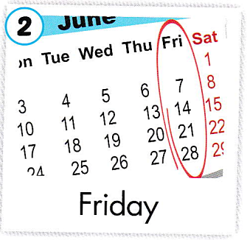
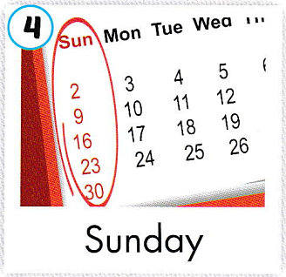
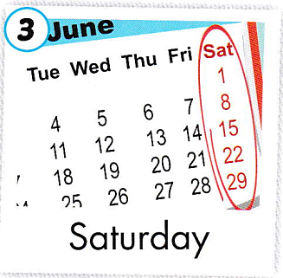
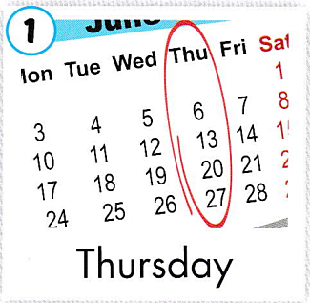
我的生活

Slide 14
Review words
Notes:
Thanh Yến Trần 0967 255 149 zalo/ FB https://www.facebook.com/thanhyentrananhngutaymy/

Slide 15
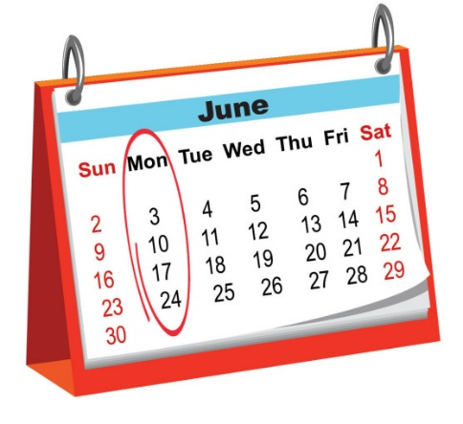
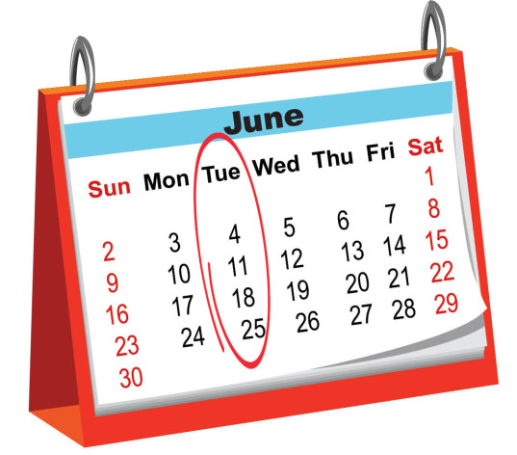
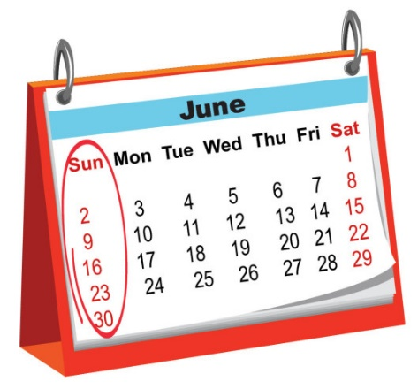
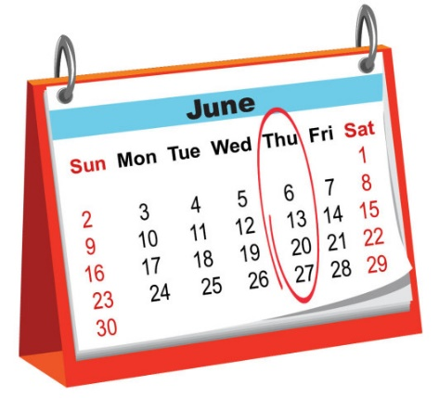
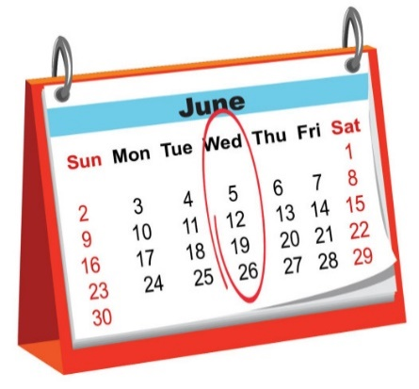
Notes:
Thanh Yến Trần 0967 255 149 zalo/ FB https://www.facebook.com/thanhyentrananhngutaymy/

Slide 16
Notes:
Thanh Yến Trần 0967 255 149 zalo/ FB https://www.facebook.com/thanhyentrananhngutaymy/

Slide 17
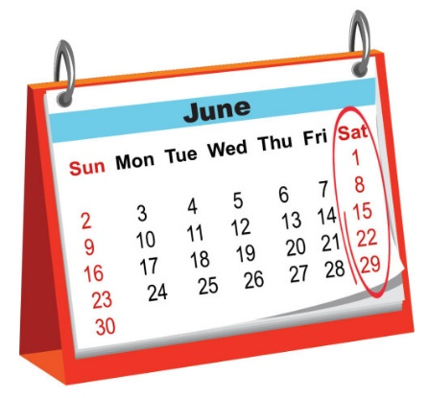

Slide 19
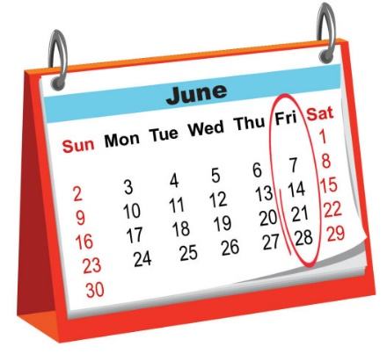

Slide 22
SENTENCE

Slide 23
What day is it today?
It’s + day

Slide 24
What day is it today?
Thursday
It’s………….

Slide 25
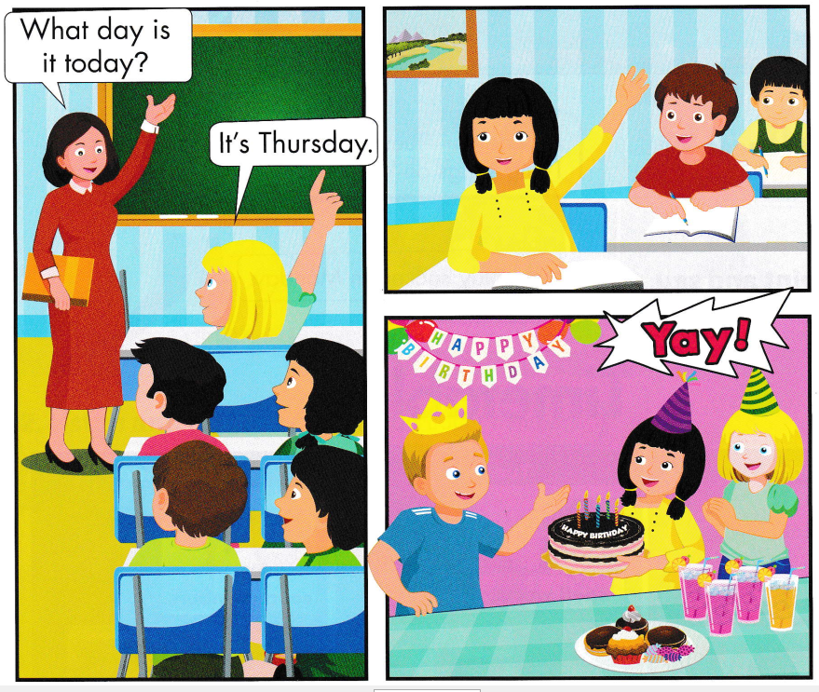

Slide 26
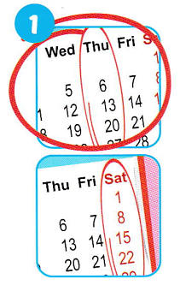
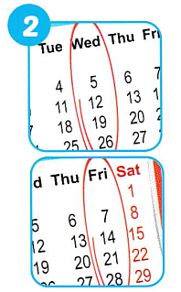
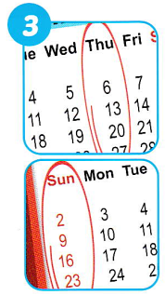

Slide 27
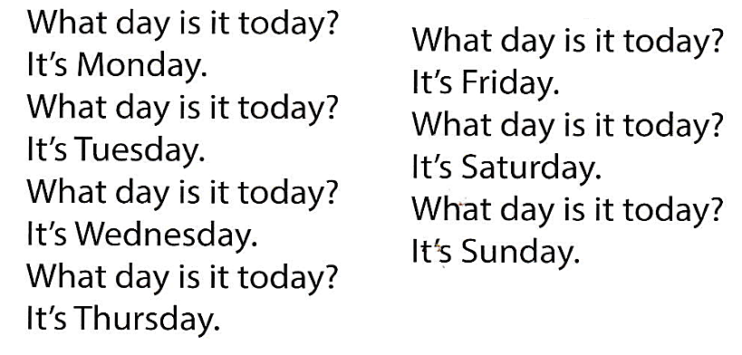

Slide 28
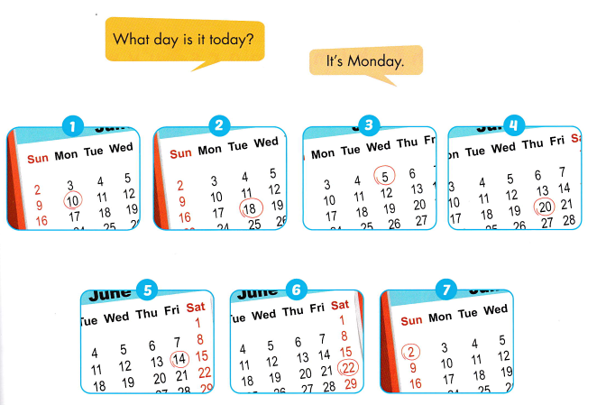

Slide 29
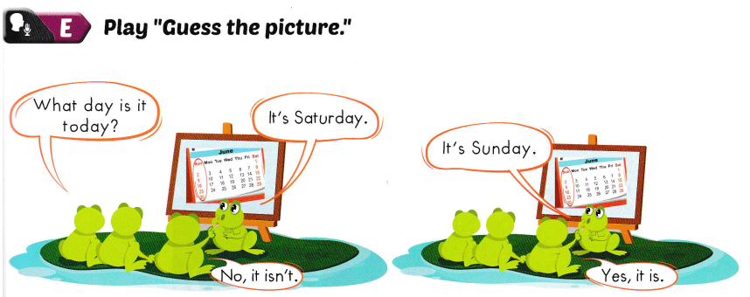

Slide 30
GAME TIME

Slide 31
Thanh Yến Trần 0967 255 149 zalo/ FB https://www.facebook.com/thanhyentrananhngutaymy/
Notes:
Thanh Yến Trần 0967 255 149 zalo/ FB https://www.facebook.com/thanhyentrananhngutaymy/

Slide 32
What day is it today? It’s………………………..
Thanh Yến Trần 0967 255 149 zalo/ FB https://www.facebook.com/thanhyentrananhngutaymy/
Notes:
Thanh Yến Trần 0967 255 149 zalo/ FB https://www.facebook.com/thanhyentrananhngutaymy/

Slide 33
What day is it today? It’s……………
Notes:
Thanh Yến Trần 0967 255 149 zalo/ FB https://www.facebook.com/thanhyentrananhngutaymy/

Slide 34
What day is it today? It’s……………(unSdayn)
Notes:
Thanh Yến Trần 0967 255 149 zalo/ FB https://www.facebook.com/thanhyentrananhngutaymy/

Slide 35
What day is it today? It’s……………
Notes:
Thanh Yến Trần 0967 255 149 zalo/ FB https://www.facebook.com/thanhyentrananhngutaymy/

Slide 36
What day is it today? It’s…………………

Slide 37
What day is it today? It’s…………………(neWedsayd)
Notes:
Thanh Yến Trần 0967 255 149 zalo/ FB https://www.facebook.com/thanhyentrananhngutaymy/

Slide 38
What day is it today? It’s…………………
Notes:
Thanh Yến Trần 0967 255 149 zalo/ FB https://www.facebook.com/thanhyentrananhngutaymy/

Slide 39
GOOD BYE

