Slide 1
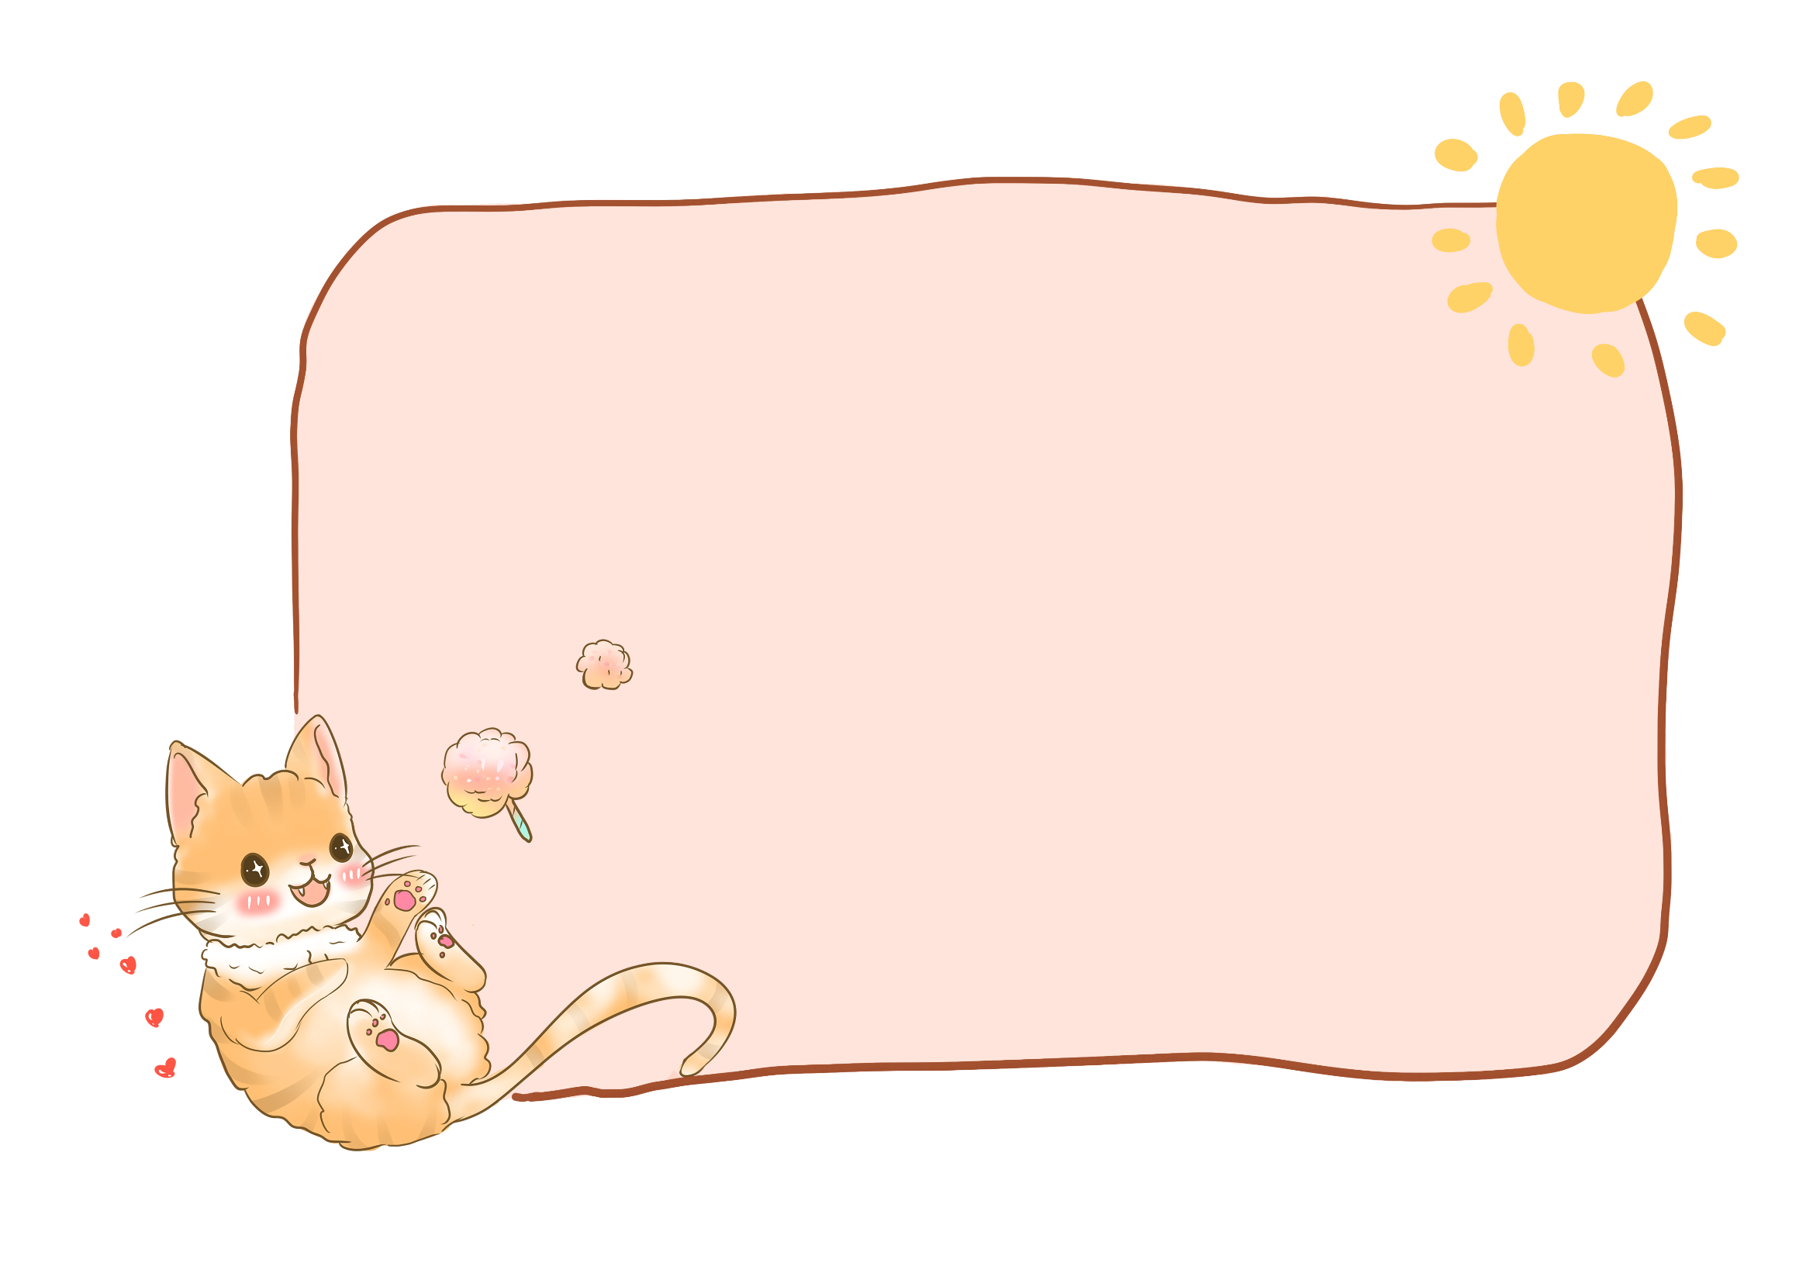
Theme 8
PHONIC
Lesson 1

Slide 2
Content
01
WARM UP
02
REVIEW
03
PHONICS
04
GAME TIME

Slide 3
1
WARM
UP

Slide 4
bus

Slide 5
motorbike

Slide 6
boat

Slide 7
plane

Slide 8
2
REVIEW

Slide 9
a
Yes, I can.
Can you see the…..?
x
No, I can’t.
plane
motorbike
boat
bus

Slide 10
3
PHONICS

Slide 13
X
X

Slide 14
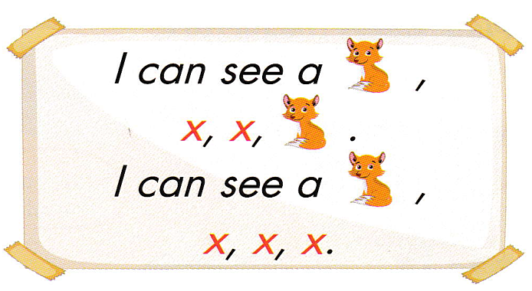

Slide 16
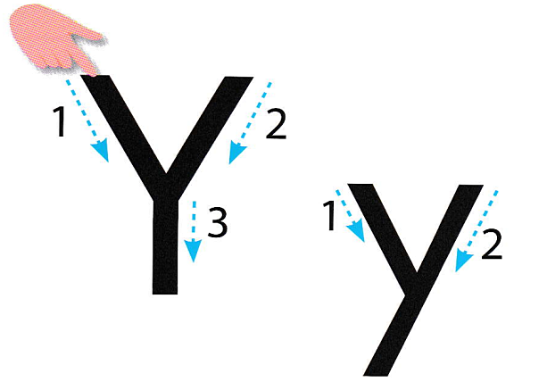

Slide 17
y
y
y

Slide 19
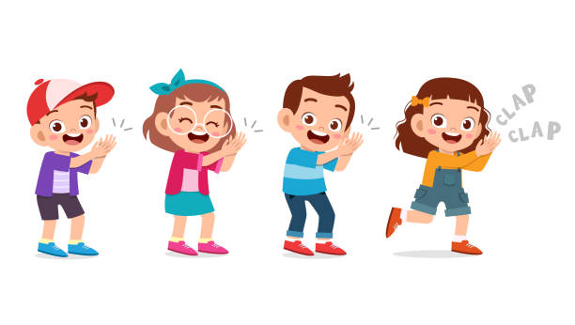

Slide 21
4
GAME TIME

Slide 22
Notes:
Thanh Yến Trần 0967 255 149 ZALO/ FB https://www.facebook.com/thanhyentrananhngutaymy/

Slide 23
Notes:
Thanh Yến Trần 0967 255 149 ZALO/ FB https://www.facebook.com/thanhyentrananhngutaymy/

Slide 24
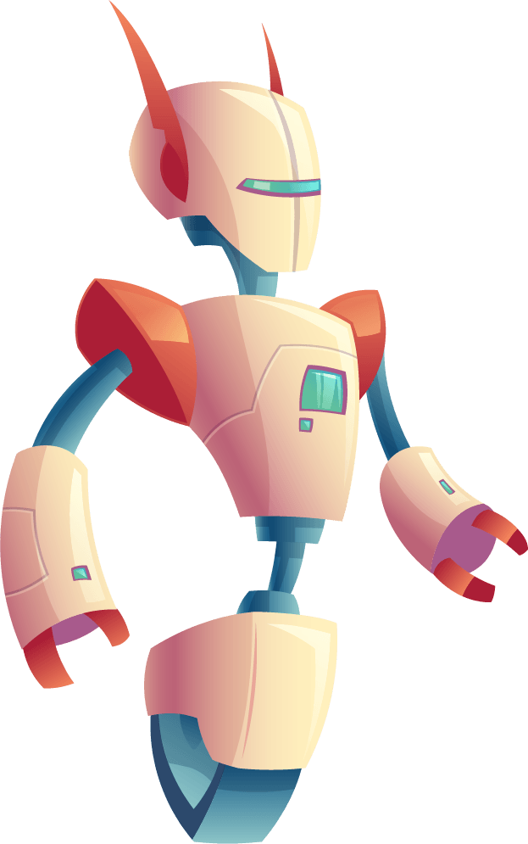
fox
box
yo-yo
Notes:
Thanh Yến Trần 0967 255 149 ZALO/ FB https://www.facebook.com/thanhyentrananhngutaymy/

Slide 25
box
fox
yo-gurt
Notes:
Thanh Yến Trần 0967 255 149 ZALO/ FB https://www.facebook.com/thanhyentrananhngutaymy/

Slide 26
x
What is the beginning
sound of the picture?
y
t

Slide 27
y
What is the ending
sound of the picture?
x
b

Slide 28
Listen

Slide 30
Listen

Slide 31
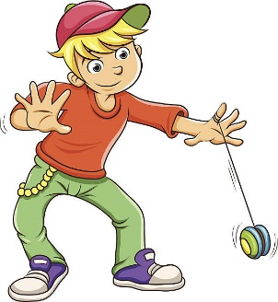
I have a
yo-yo.
True
False

Slide 32
I can see
a fox.
True
False

Slide 33
Listen and choose
I have a box.
I have a yo-yo.

Slide 34
5
GOOD
BYE

