Slide 1
Theme 9
Classroom Activities
LESSON 1

Slide 2
01 WARM UP
02 VOCABULARY
03 SENTENCE
04 GAME
Notes:
Thanh Yến Trần 0967 255 149/ zalo / Fb https://www.facebook.com/thanhyentrananhngutaymy/

Slide 3
01
WARM UP
Notes:
Thanh Yến Trần 0967 255 149/ zalo / Fb https://www.facebook.com/thanhyentrananhngutaymy/

Slide 5
02
VOCABULARY

Slide 6
eraser

Slide 7
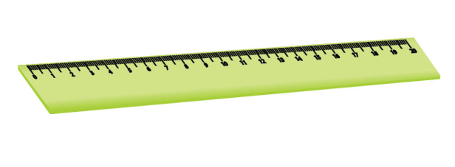
ruler

Slide 8
crayon

Slide 9
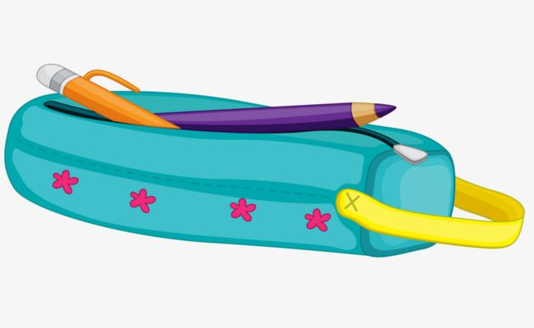
pencil case

Slide 10
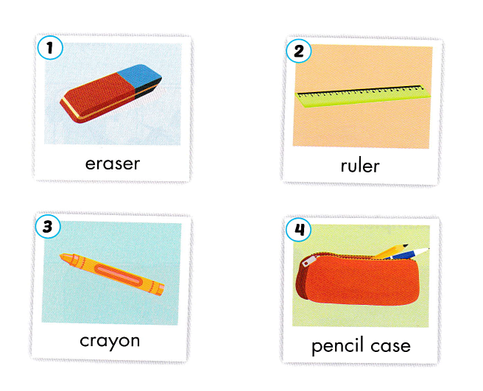

Slide 11
03
SENTENCE

Slide 12
eraser
Pick up your………..

Slide 13
Pick up your………..
pencil case
eraser
ruler
crayon

Slide 14
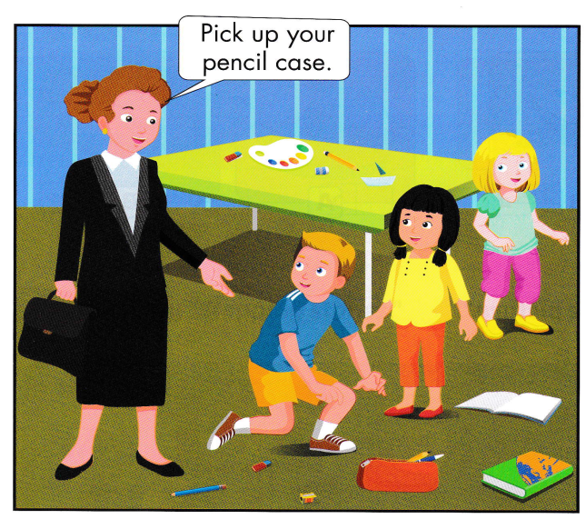

Slide 15
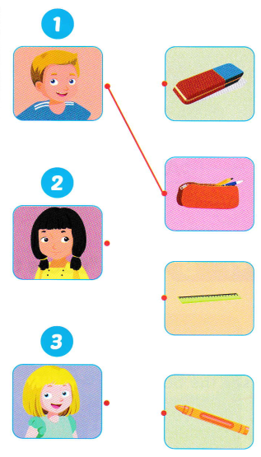

Slide 17
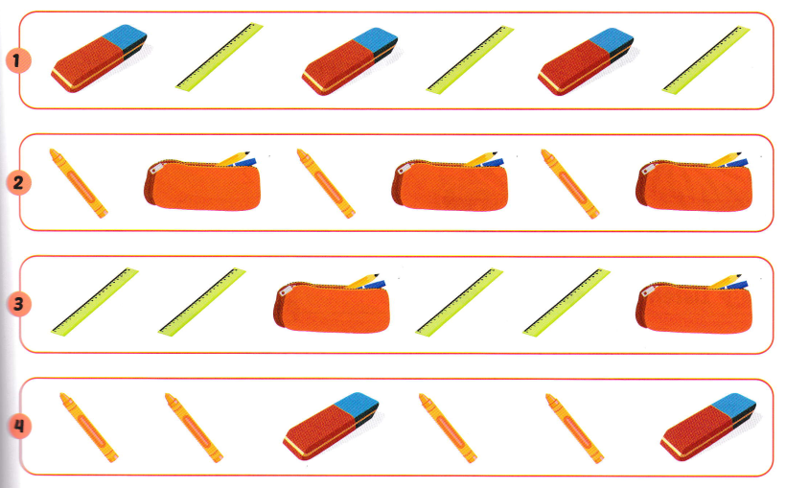

Slide 18
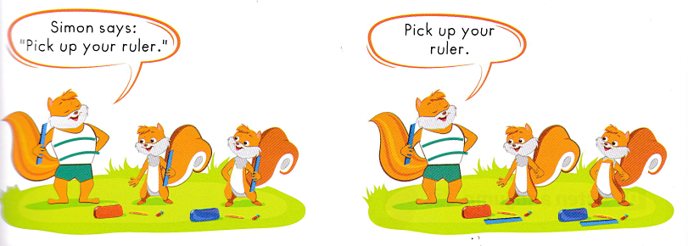

Slide 19
03
GAME TIME

Slide 20
Go
Notes:
Thanh Yến Trần 0967 255 149/ zalo / Fb https://www.facebook.com/thanhyentrananhngutaymy/

Slide 21
FINISH LINE
Congratulation
4
3
2
1
4
3
2
1
4
3
2
1
Notes:
Thanh Yến Trần 0967 255 149/ zalo / Fb https://www.facebook.com/thanhyentrananhngutaymy/

Slide 22
ruler
eraser
pencil
What is it?
Notes:
Thanh Yến Trần 0967 255 149/ zalo / Fb https://www.facebook.com/thanhyentrananhngutaymy/

Slide 23
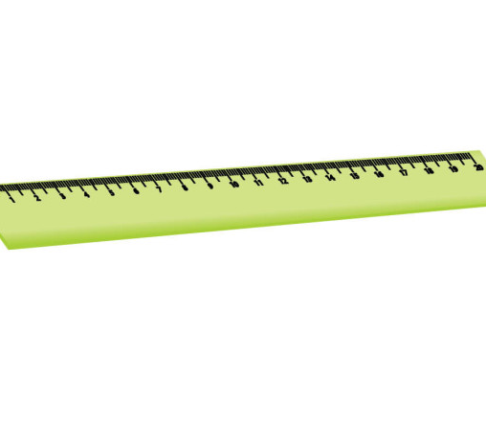
book
crayon
ruler
It is a …………
Notes:
Thanh Yến Trần 0967 255 149/ zalo / Fb https://www.facebook.com/thanhyentrananhngutaymy/

Slide 24
pencil case
ruler
crayon
Listen and choose
Notes:
Thanh Yến Trần 0967 255 149/ zalo / Fb https://www.facebook.com/thanhyentrananhngutaymy/

Slide 25
pencil case
ruler
pen
Pick up your……….
Notes:
Thanh Yến Trần 0967 255 149/ zalo / Fb https://www.facebook.com/thanhyentrananhngutaymy/

Slide 26
Pick up your ruler.
Pick up your pencil
Pick up your eraser
Listen and choose
Notes:
Thanh Yến Trần 0967 255 149/ zalo / Fb https://www.facebook.com/thanhyentrananhngutaymy/

Slide 27
crayon
ruler
pen
Pick up your …….
Notes:
Thanh Yến Trần 0967 255 149/ zalo / Fb https://www.facebook.com/thanhyentrananhngutaymy/

Slide 28
Reorder
Pick up ruler your.
up/ Pick/ ruler/ your
Pick your up ruler.
Pick up your ruler.
Notes:
Thanh Yến Trần 0967 255 149/ zalo / Fb https://www.facebook.com/thanhyentrananhngutaymy/

Slide 29
Find the missing letter in the word
p…nc…l c….se
e-i-a
e-a-i
e-o-i
Notes:
Thanh Yến Trần 0967 255 149/ zalo / Fb https://www.facebook.com/thanhyentrananhngutaymy/

Slide 30
o-e
Find the missing
letter in the word
cr….y….n
a-e
a-o
Notes:
Thanh Yến Trần 0967 255 149/ zalo / Fb https://www.facebook.com/thanhyentrananhngutaymy/

Slide 31
ruler
Reorder letter into
right word
rleur
relur
lurer
Notes:
Thanh Yến Trần 0967 255 149/ zalo / Fb https://www.facebook.com/thanhyentrananhngutaymy/

Slide 32
a
What is the beginning
sound of the picture
r
e
Notes:
Thanh Yến Trần 0967 255 149/ zalo / Fb https://www.facebook.com/thanhyentrananhngutaymy/

Slide 33
r
What is the ending
sound of the picture
l
p
Notes:
Thanh Yến Trần 0967 255 149/ zalo / Fb https://www.facebook.com/thanhyentrananhngutaymy/

Slide 34
04
GOOD BYE

