Slide 1
Unit 18 playing & doing
LESSON 1.1
Notes:
Thanh Yến Trần 0967 255 149 zalo/ FB https://www.facebook.com/thanhyentrananhngutaymy/

Slide 2
WARM UP

Slide 4
Vocabulary

Slide 5
dancing

Slide 6
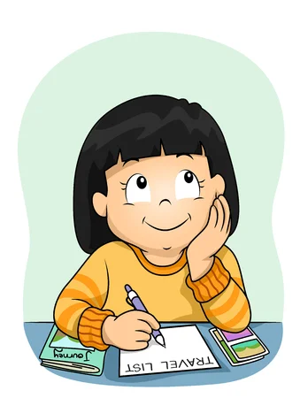
writing

Slide 7
reading

Slide 8
singing

Slide 9
REVIEW GAME

Slide 10
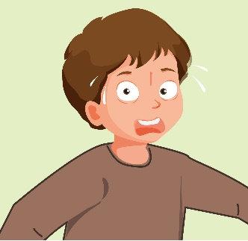
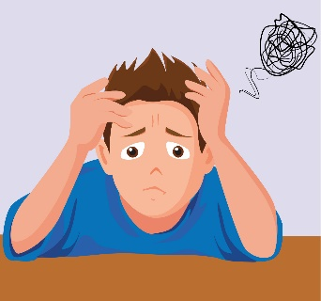
Suprised
NEXT
Click on the right picture

Slide 11
Listen
Click on the right picture
NEXT

Slide 12
singing
Click on the right picture
NEXT

Slide 13
dancing
reading
singing
writing
NEXTNext Slide
Click on the right picture

Slide 14
reading
Click on the right picture
NEXT

Slide 15
writing
reading
singing
dancing
NEXT
Click on the right picture

Slide 16
dancing
walking
singing
reading
Listen
Click on the right picture
NEXT

Slide 18
sENTENCE

Slide 19
I'm + V-ing
Ex: I'm reading.
I'm dancing.

Slide 20
I'm + V-ing
Ex: I'm reading.
I'm dancing.

Slide 21
REVIEW GAME

Slide 23
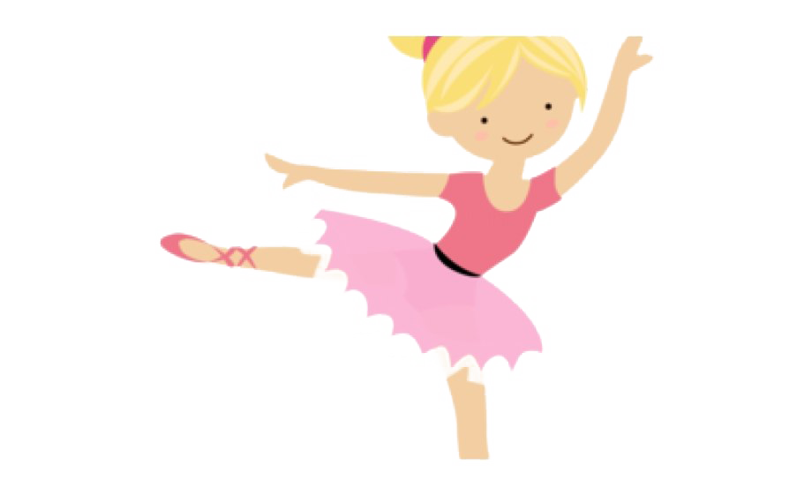
dancing
Answer the question
I'm .......
CHECK
This Photo by Unknown Author is licensed under CC BY

Slide 24
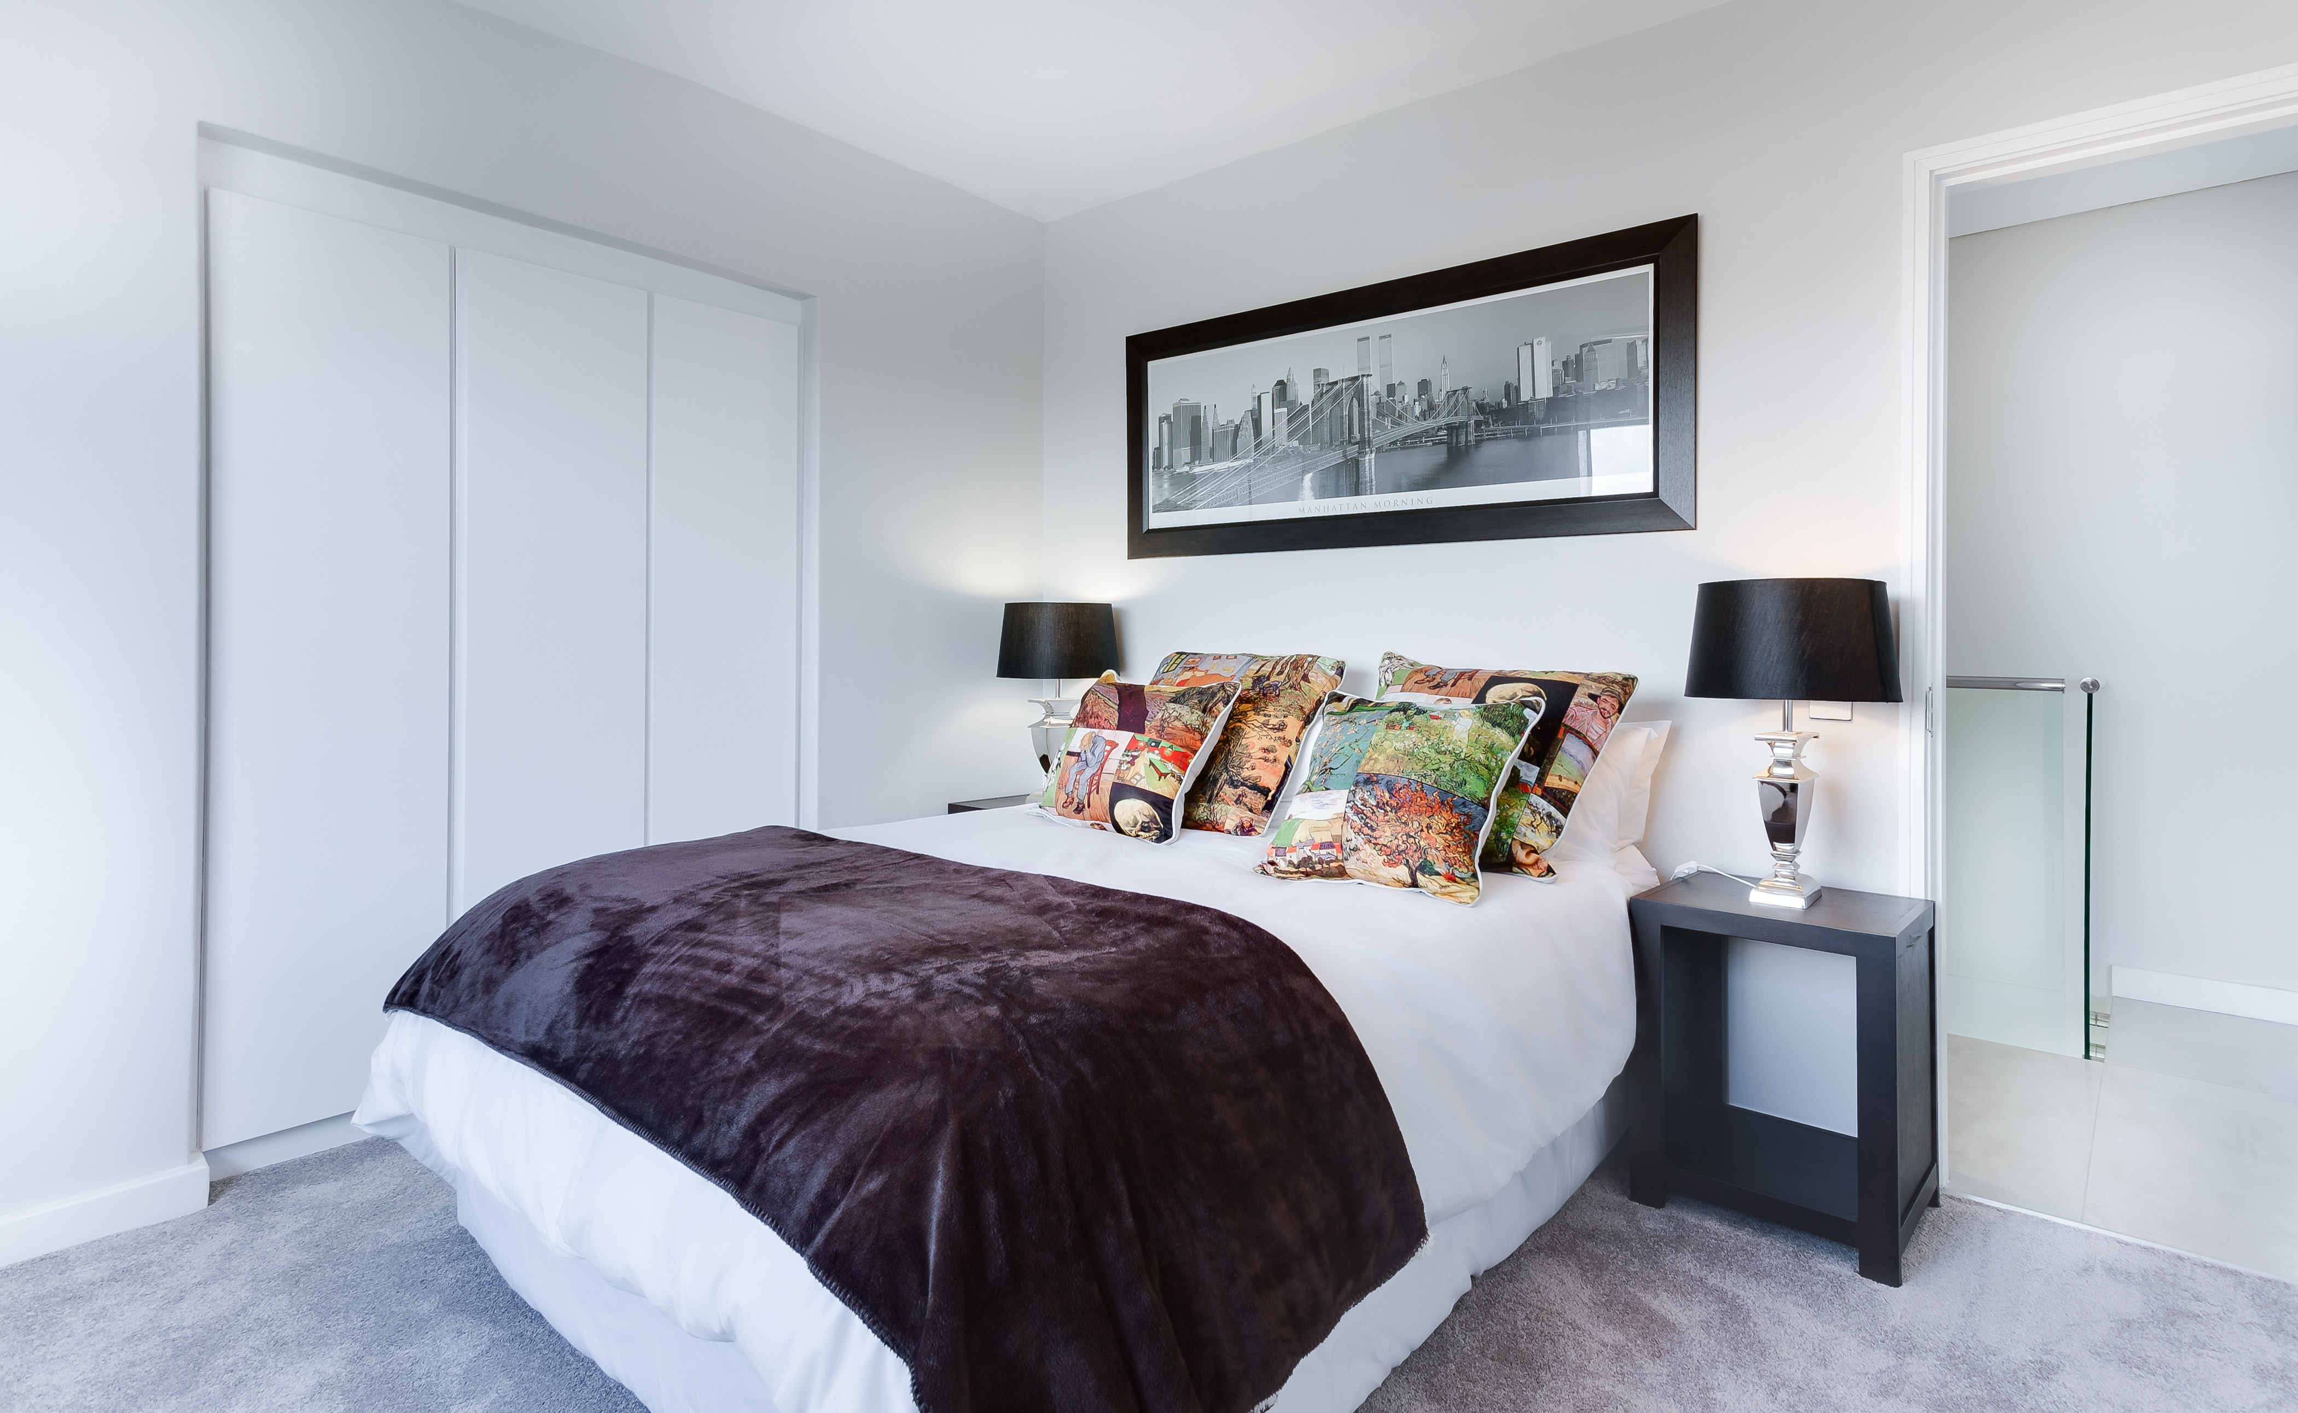
Click on the right adjective to complete the sentence:
reading
I'm .
reading
writing

Slide 25
am
I ...... singing.
CHECK

Slide 26
writing
I'm .
dancing
writing

Slide 27
I am dancing.
I/dancing/./am
CHECK

Slide 28
singing
I'm..................
singing
reading

Slide 29
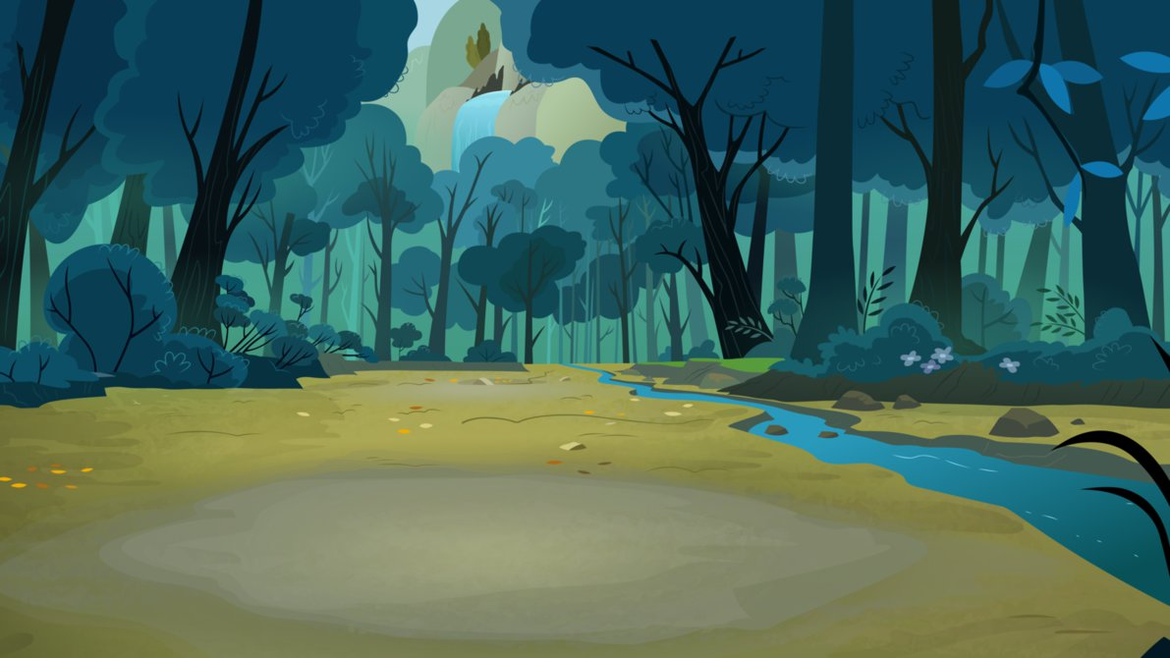
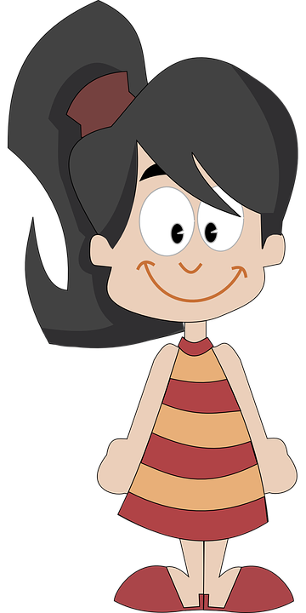
I'm singing.
............
CHECK

Slide 31
ACTIVITIES

Slide 32
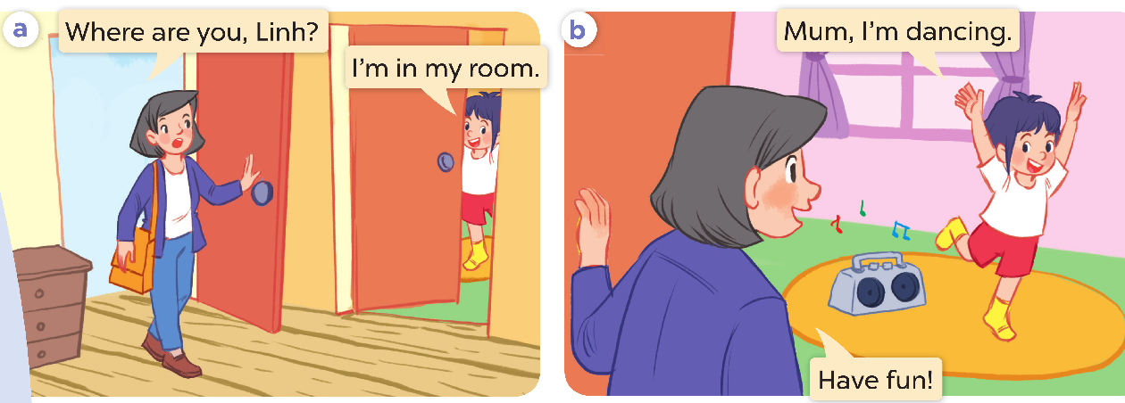

Slide 33
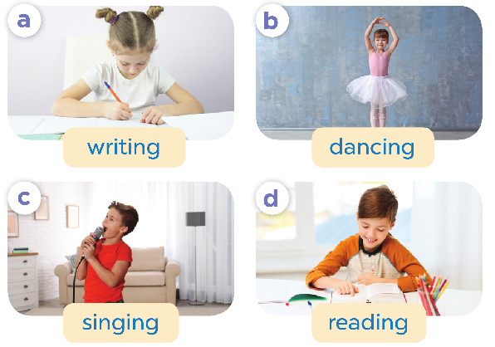

Slide 34
SPEAKING

Slide 35
