Slide 1
Unit 18 PLAYING AND DOING
LESSON 3.2
Notes:
Thanh Yến Trần 0967 255 149 zalo/ FB https://www.facebook.com/thanhyentrananhngutaymy/

Slide 2
WARM UP!

Slide 4
01
REVIEW

Slide 5
Click on the right word
listening
dancing
singing

Slide 6
Click on the right word
drawing pictures
watching TV
reading books

Slide 7
Click on the right word
I'm dancing.
I'm reading.
I'm singing.

Slide 8
Click on the right word
writing
drawing
reading

Slide 9
I'm playing basketball.

Slide 10
REODER: am/ listening/ I/ music/ to
I'm music to listening.
I'm to listeing music.
I'm listening to music.

Slide 11
Click on the right word: DRAWING.........
a book
a picture
a song

Slide 12
Click on the right word

Slide 13
Click on the right word
I'm drawing a picture.
I'm reading a book.
I'm writing.

Slide 14
UNSCRAMBLE: I-W-R-I-T-G-N
WIRTING
RIWTING
WRITING

Slide 16
02
Read & Write

Slide 17
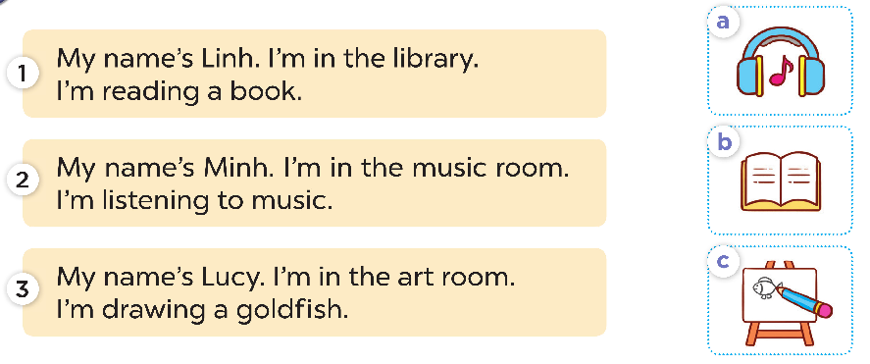

Slide 19
02
ACTIVITIES
03

Slide 21
Thanks for watching

