Slide 2
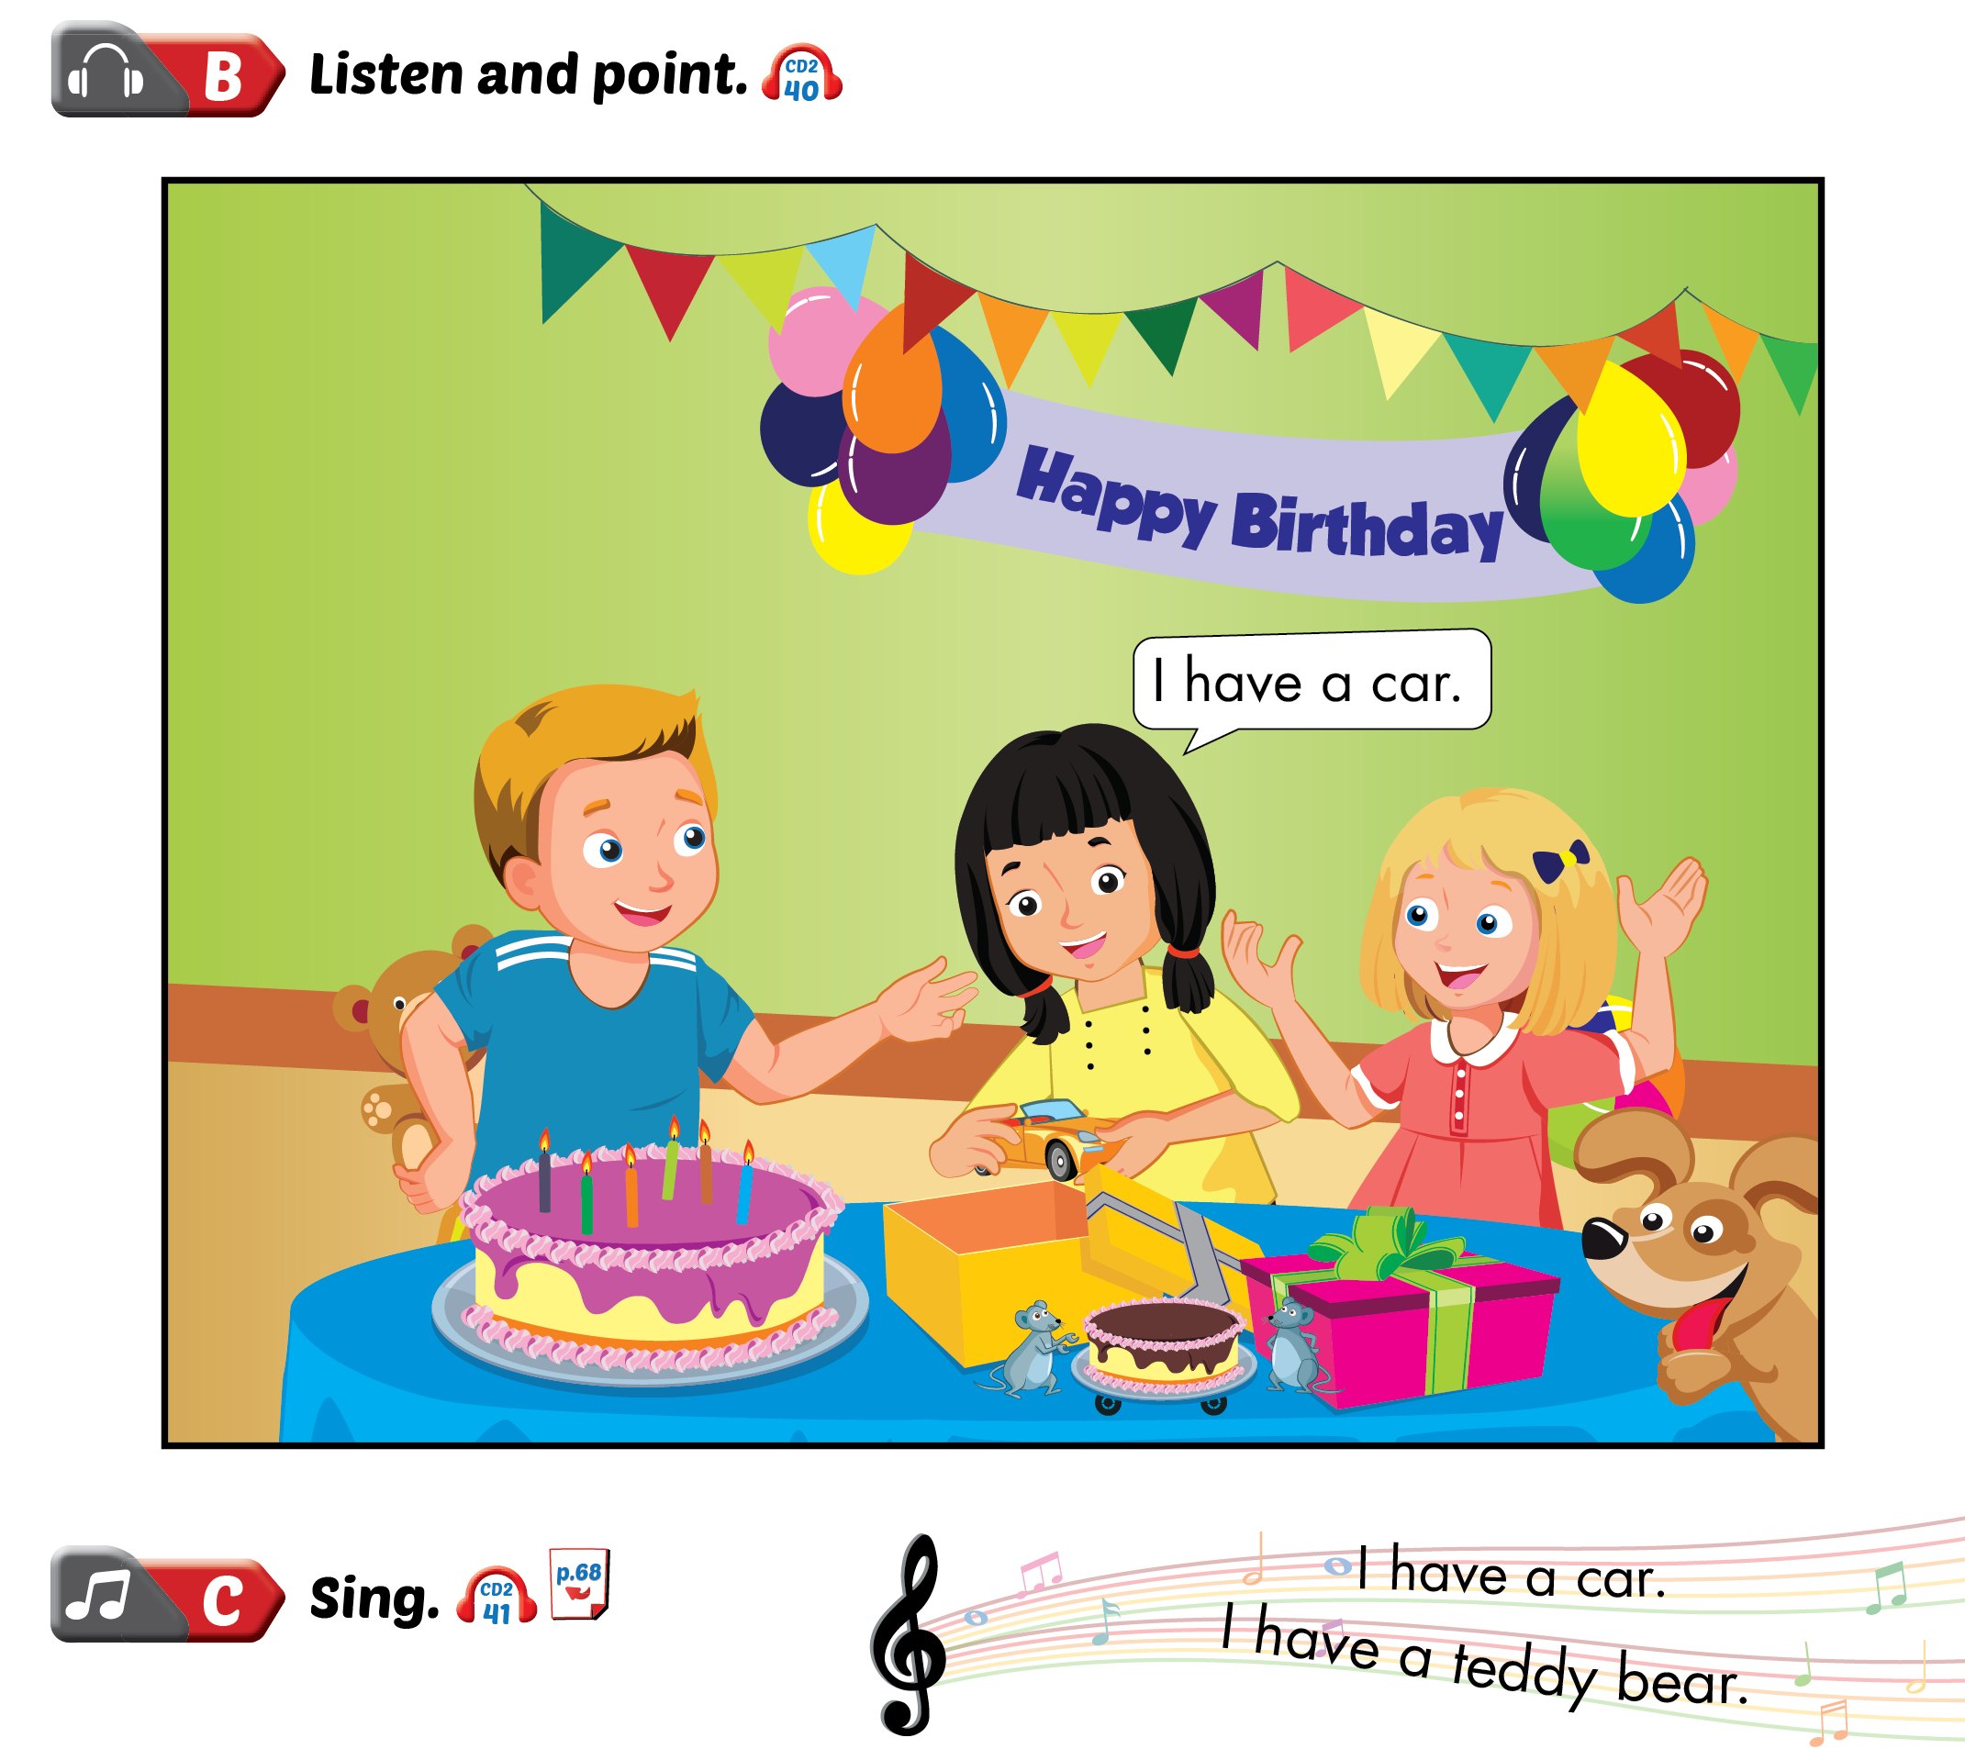
Lesson 1

Slide 3
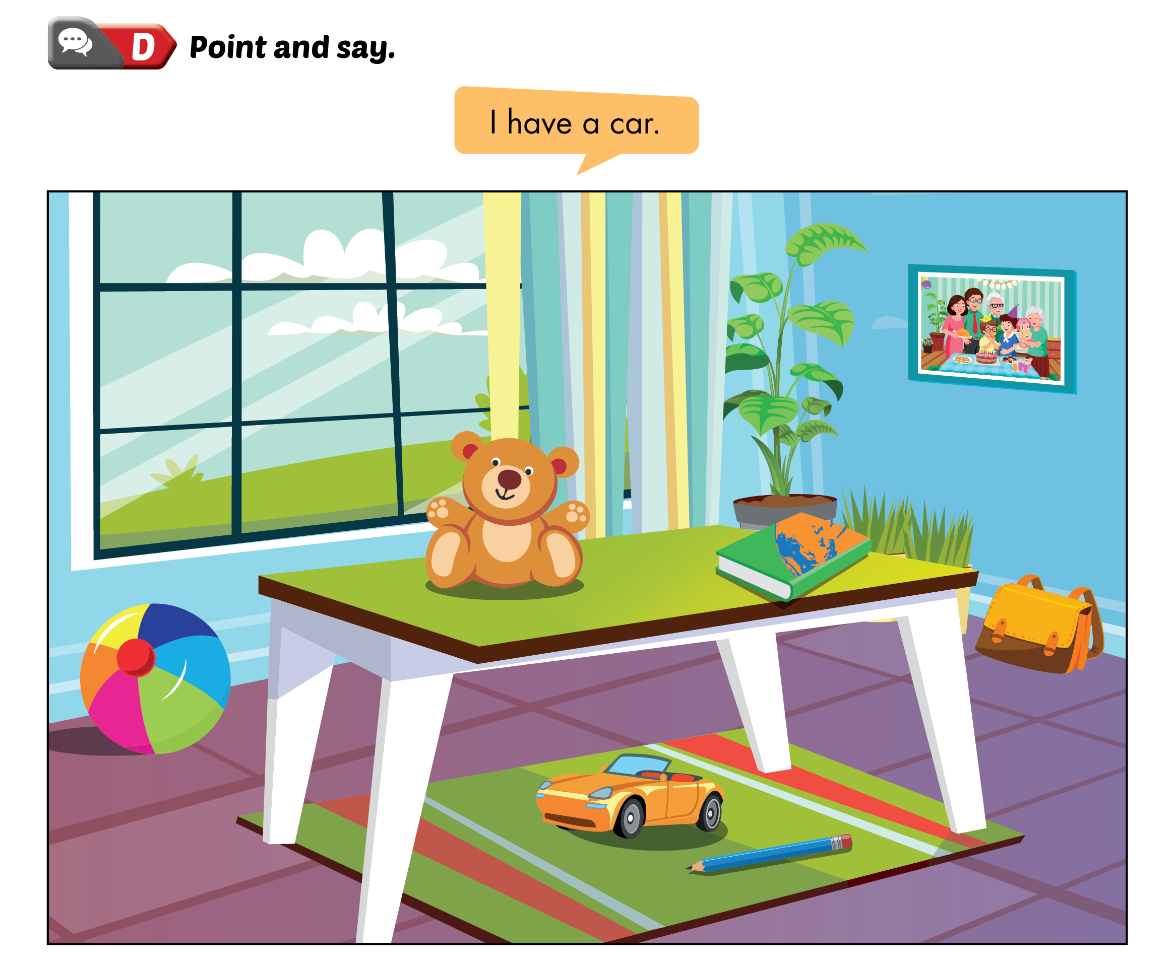
Lesson 1

Slide 4
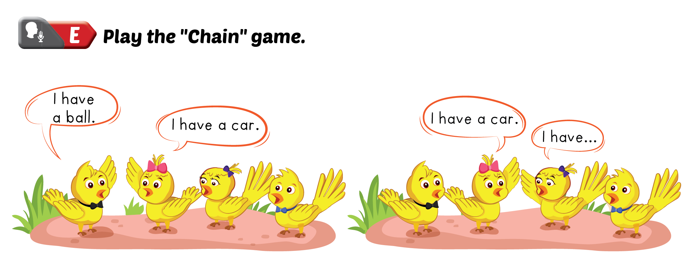
Lesson 1

Slide 6
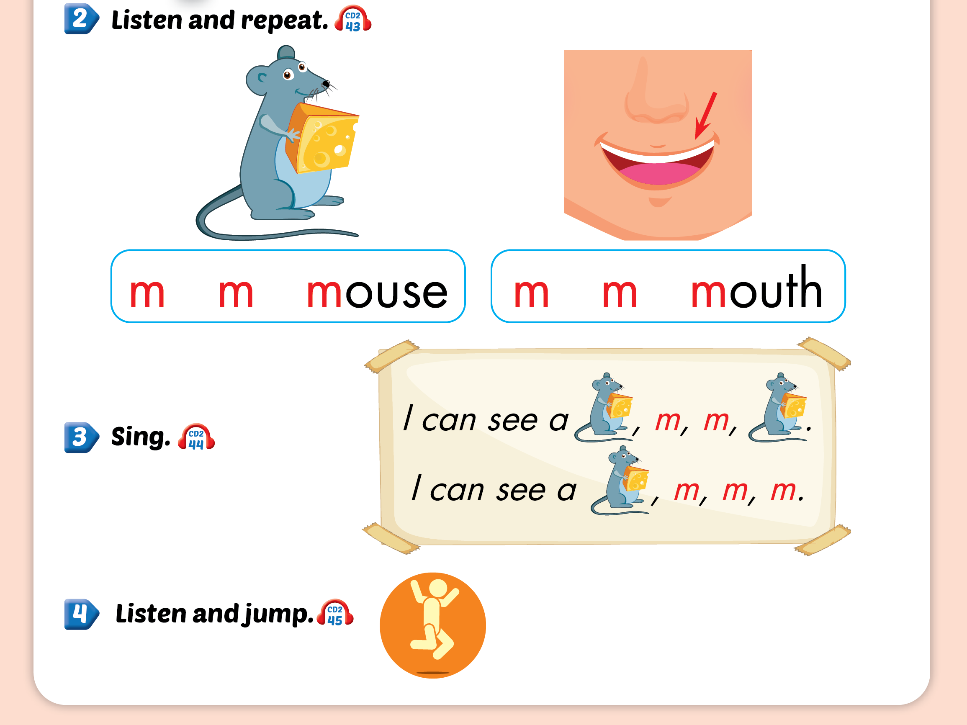
Lesson 2

Slide 7
Lesson 2

Slide 8
Lesson 2

Slide 10
Lesson 3

Slide 11
Lesson 3

Slide 12
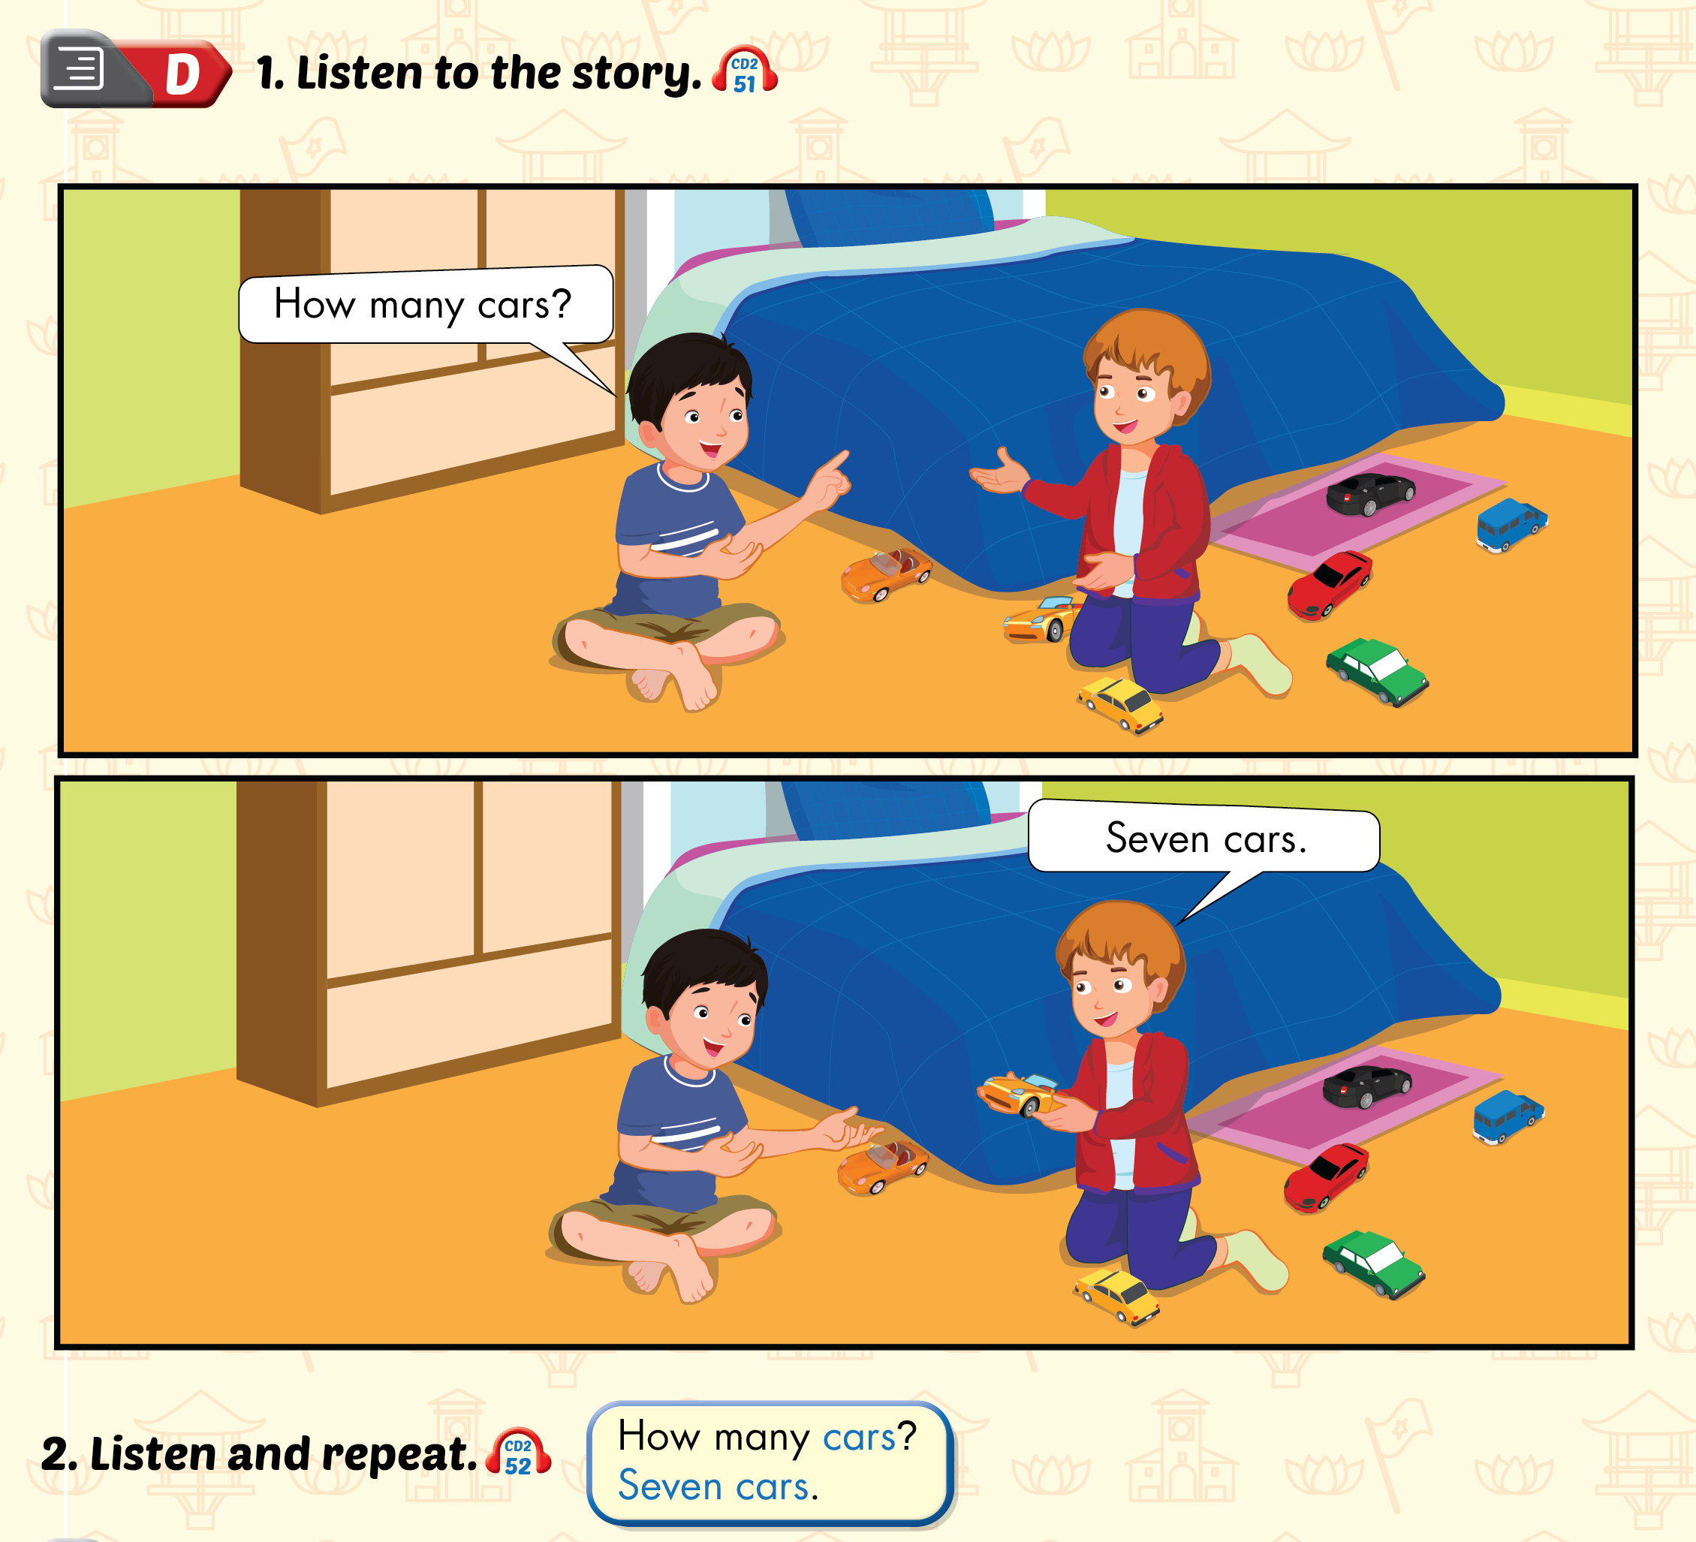
Lesson 3

Slide 13
Lesson 3

