Slide 1
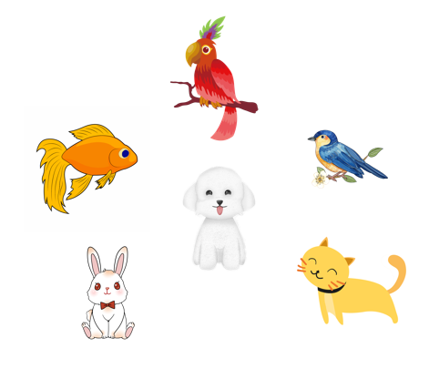
..................................
My pets
Unit
16
Lesson 1 (1+2+3)
Facebook : Bùi Liễu
0968142780

Slide 2
Warm-up

Slide 3
Let’s sing.

Slide 4
Contents
Facebook : Bùi Liễu
0968142780
Look, listen and repeat.
Listen, point and say.
Let’s talk.

Slide 5
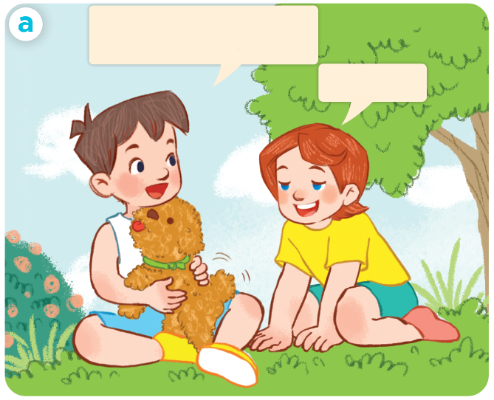
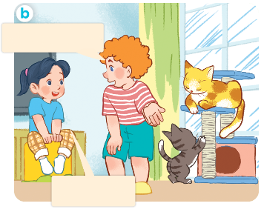
1. Look, listen and repeat.
Click on the sentences to hear.
I have a dog.
Do you have any dogs.
I have two cats. Do
you have any cats?
Yes,I do.
No, I don’t.
I have one dog
Who are they?
Where are they?
What are they doing?

Slide 6
Vocabulary

Slide 7
pets
/pets/
các con thú cưng

Slide 8
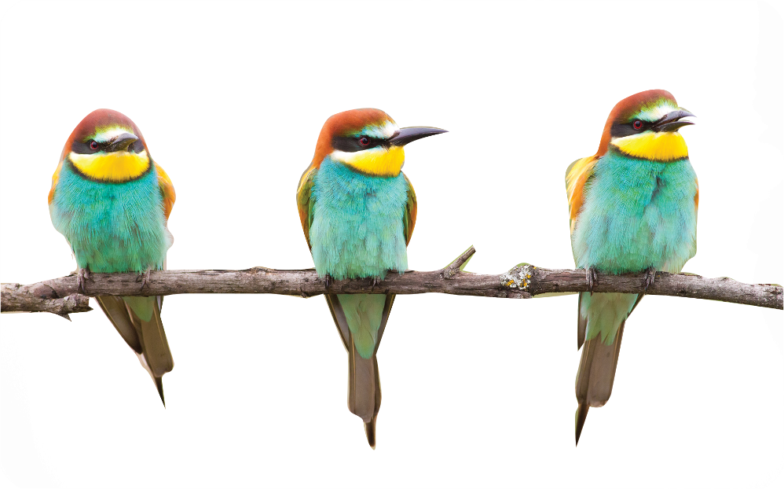
bird
birds
/bɜːd/
/bɜːdz/
con chim
các con chim

Slide 9
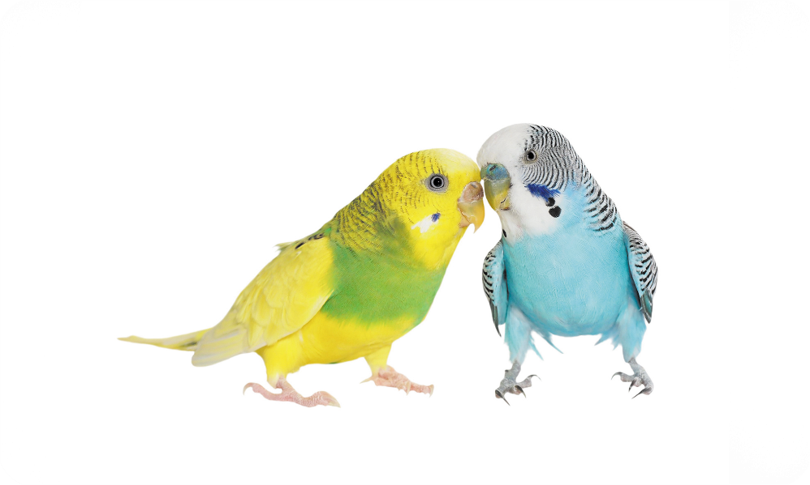
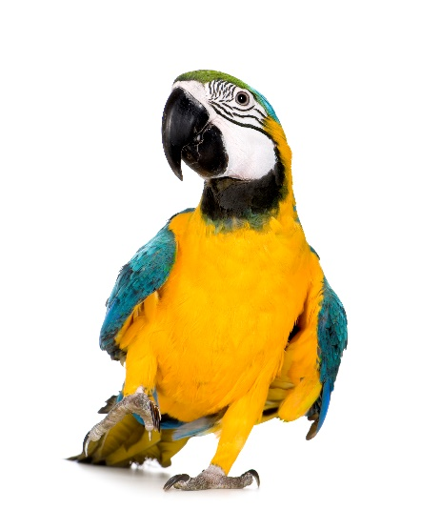
parrot
parrots
/ˈpær.ət/
/ˈpær.əts/
con vẹt
các con vẹt

Slide 10
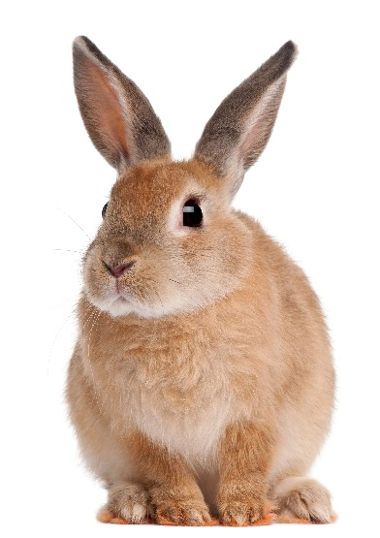
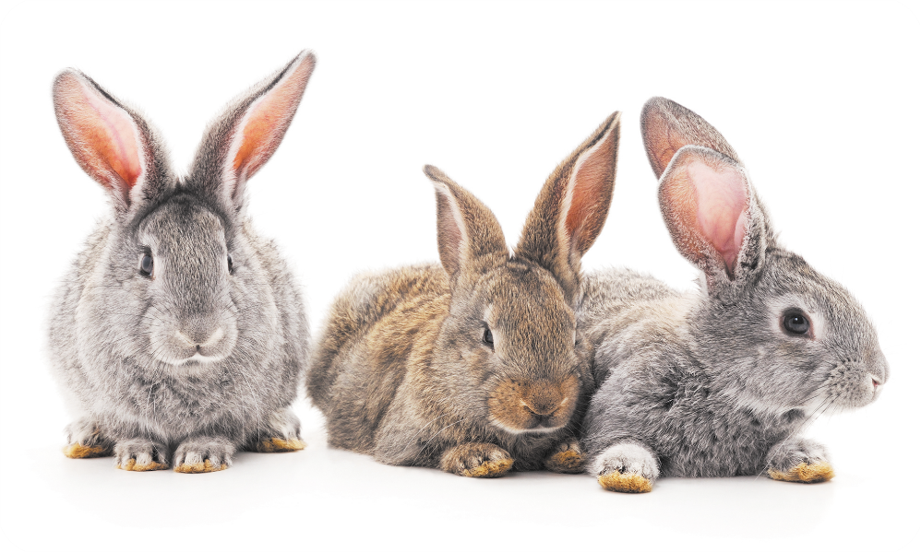
rabbit
rabbits
/ˈræb.ɪt/
/ˈræb.ɪts/
con thỏ
các con thỏ

Slide 11
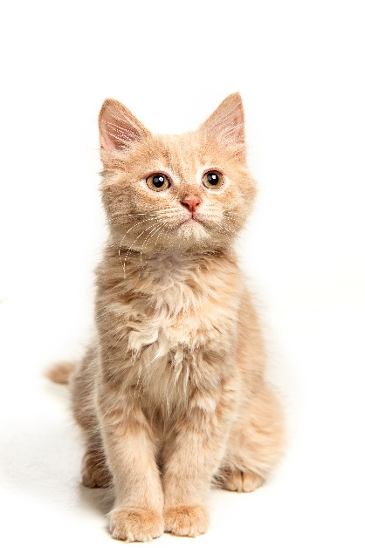
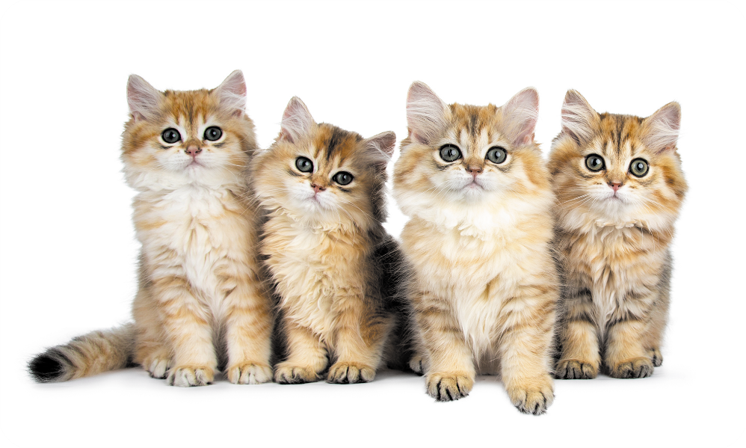
cat
cats
/kæt/
/kæts/
con mèo
các con mèo

Slide 12
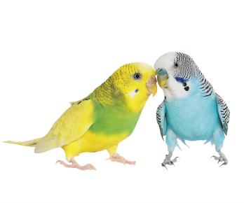
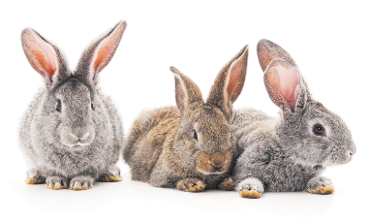
Review
pets
birds
parrots
rabbits
cats

Slide 13
Checking vocabulary
pets
các con thú cưng
birds
các con chim
parrots
các con vẹt
rabbits
các con thỏ
cats
các con mèo

Slide 14
Structures

Slide 15
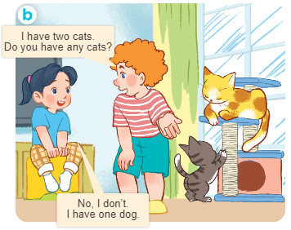
Structures
Cách hỏi bạn có loại thú cưng nào không.
- Do you have any ________?
+ Yes, I do.
+ No, I don’t.

Slide 16
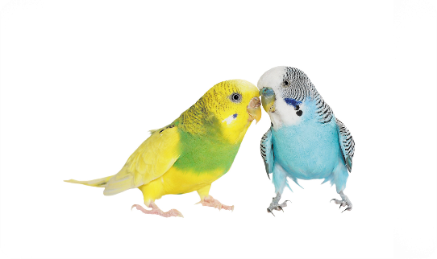
2. Listen, point and say.
a
b
Do you have any _____?
birds / yes
parrots / no
Yes, I do.
c
d
No, I don’t.
rabbits / yes
cats / no

Slide 17
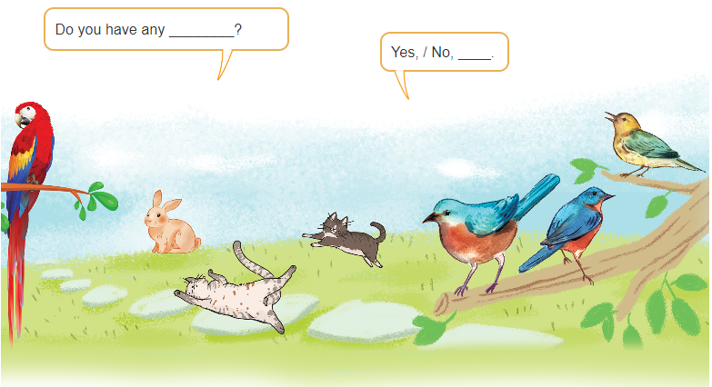
3. Let’s talk

Slide 18
Let’s play!
Facebook : Bùi Liễu
0968142780
START

Slide 19
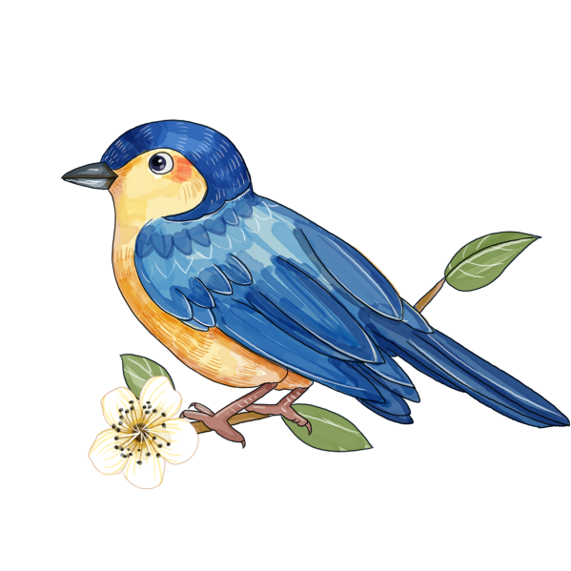
A. cat
Facebook : Bùi Liễu
0968142780
B. bird
C. rabbit
NEXT

Slide 20
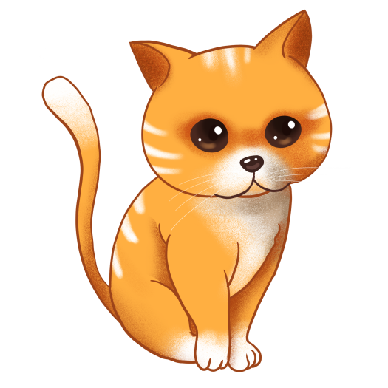
A. cat
Facebook : Bùi Liễu
0968142780
B. rabbit
C. bird
NEXT

Slide 21
Choose the correct answer.
A. cat
Facebook : Bùi Liễu
0968142780
B. bird
C. parrot
NEXT

Slide 22
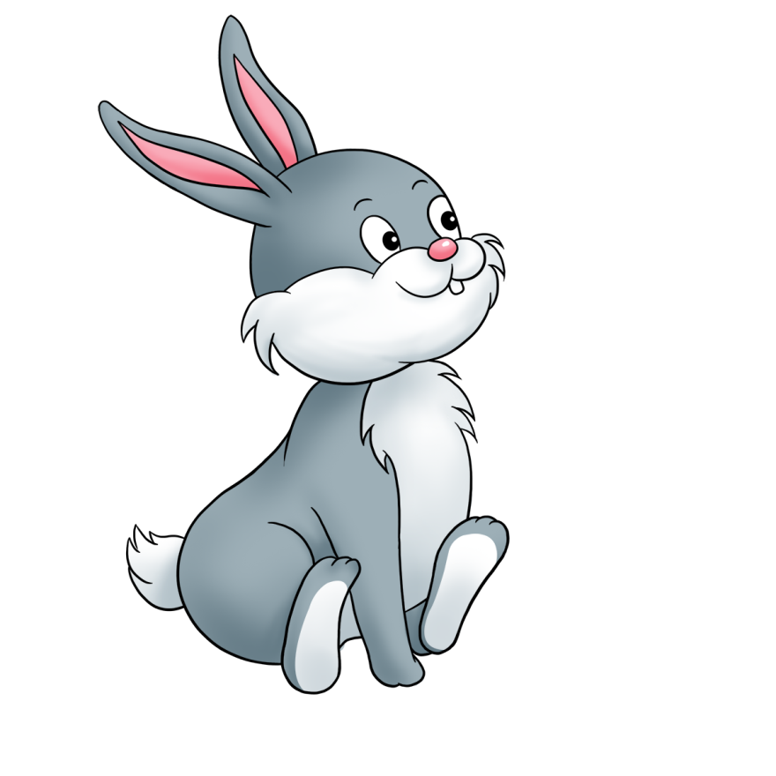
Choose the correct answer.
A. cat
Facebook : Bùi Liễu
0968142780
B. rabbit
C. bird
NEXT

Slide 23
Choose the correct answer.
A. cat
Facebook : Bùi Liễu
0968142780
B. bird
C. rabbit
NEXT

Slide 24
Choose the correct answer.
A. cat
Facebook : Bùi Liễu
0968142780
B. rabbit
C. bird
NEXT

Slide 25
Do you have any____?
Yes, I do.
A. birds
Facebook : Bùi Liễu
0968142780
B. cats
C. rabbits
NEXT

Slide 26
Do you have any parrots?
_____, I do.
Facebook : Bùi Liễu
0968142780
A. No
B. Yes
NEXT

Slide 27
Do you have any parrots?
No, I ______.
Facebook : Bùi Liễu
0968142780
A. do
B. don’t
NEXT

Slide 28
Do you have any___?
No, I don’t.
A. birds
Facebook : Bùi Liễu
0968142780
B. rabbits
C. cats
NEXT

Slide 29
Do you have any parrots?
_______________.
A. Yes. I do.
Facebook : Bùi Liễu
0968142780
B. No, I don’t.
NEXT

Slide 30
____you have any rabbits?
Yes, I do.
Facebook : Bùi Liễu
0968142780
A. Does
B. Do
END

Slide 31
Well done!
Facebook : Bùi Liễu
0968142780

Slide 32
Wrap up

Slide 33
Review
pets
birds
parrots
rabbits
cats

Slide 34
Structures
Cách hỏi bạn có loại thú cưng nào không.
- Do you have any ________?
+ Yes, I do.
+ No, I don’t.

Slide 35
Facebook : Bùi Liễu
0968142780
Thank you!

